Slide 1

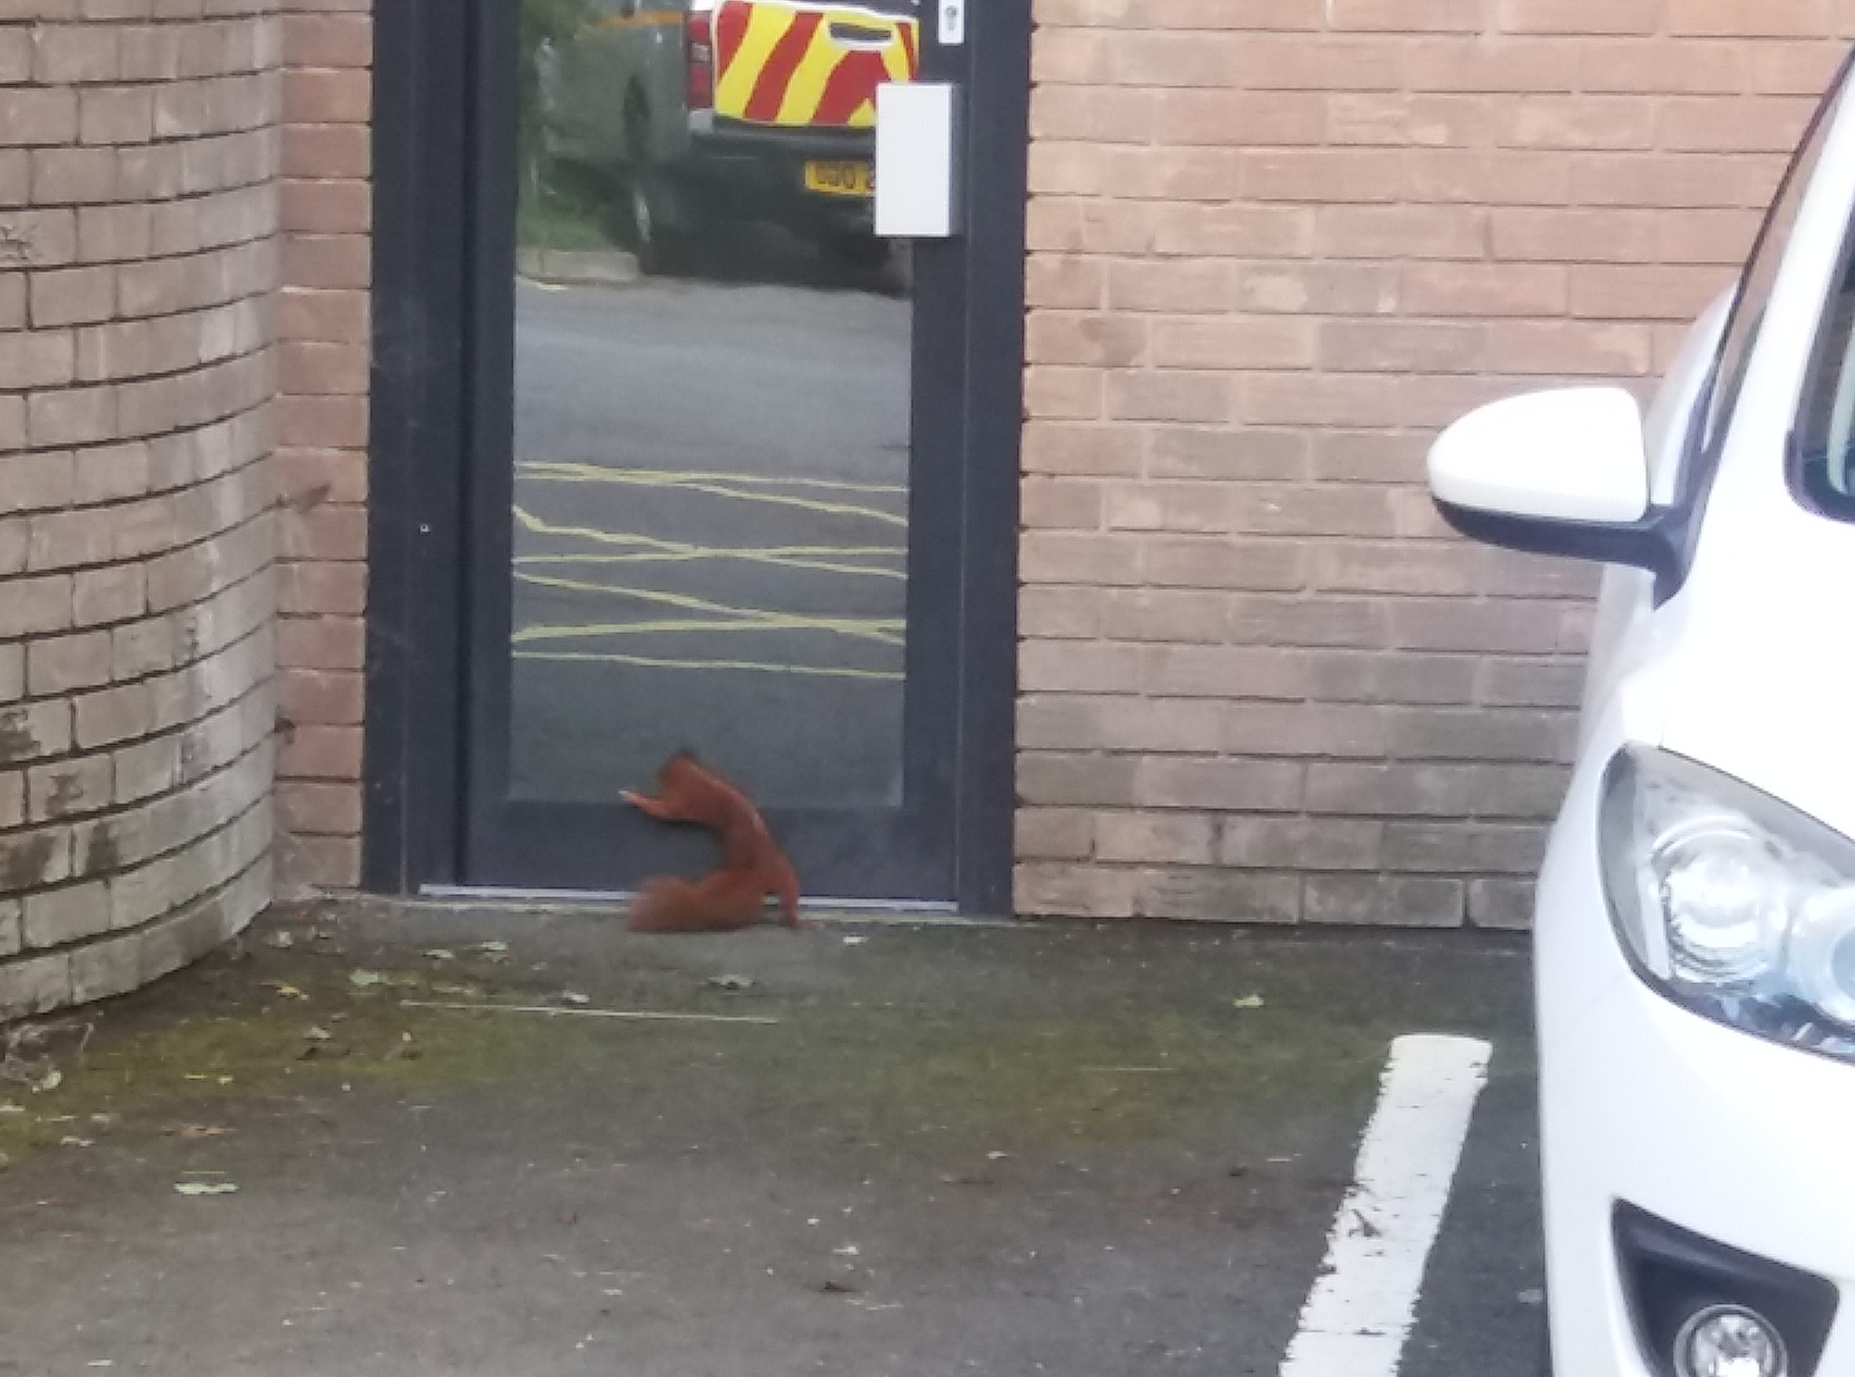

Red squirrel conservation in Wales
Cadwraeth y wiwer goch yng Nghymru
LIFE14 NAT/UK/000467

Slide 2
Talk outline
Background to red squirrel conservation in Wales
  Liz Halliwell – Natural Resources Wales
Anglesey/Gwynedd, protecting Anglesey from reinvasion
  Holly Peek – Red Squirrels Trust Wales
Clocaenog, establishing a new conservation approach
  Becky Clews-Roberts – Red Squirrels Trust Wales
Mid-Wales, developing habitat management plans
  Becky Hulme – Wildlife Trust South and West Wales
Notes:
‘quadruple act’! Give you a flavour of what’s going on in Wales and our approach.

Slide 3
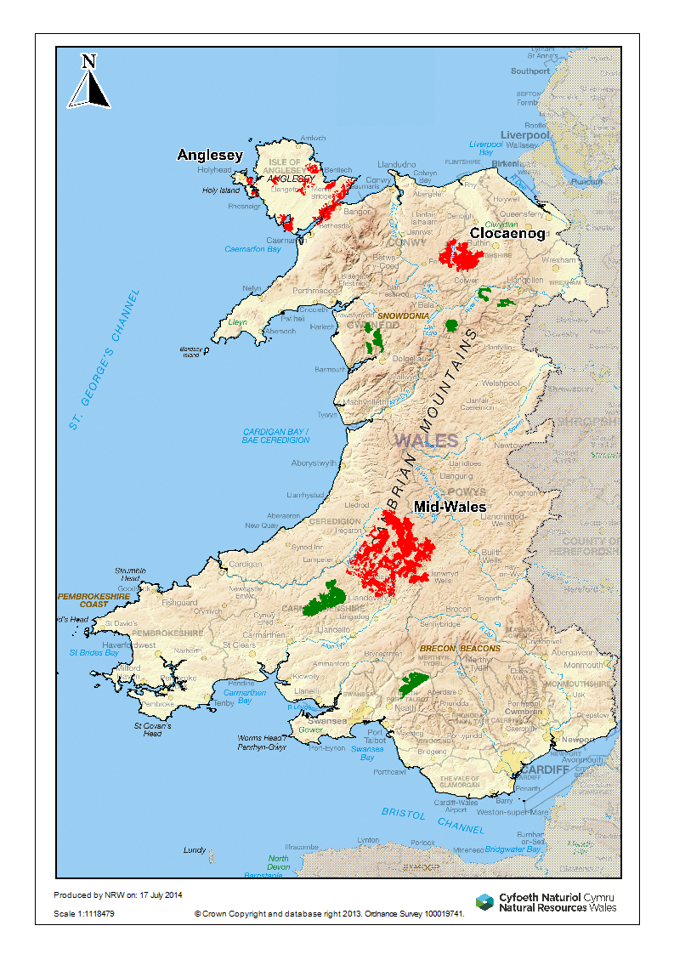
Red squirrel strategy
Wales Squirrel Forum
1999: Red Squirrel Strategy for Wales
  Priority sites for action, ranked
2009: Conservation plan for red squirrels in Wales
  Focal sites for action
  Targets
  1. Maintain breeding populations of red squirrels at all Focal Sites within Wales
  2. Maintain the current distribution of red squirrels within Wales if resources permit
  Actions
2017 review and refresh
WG consultation Grey Squirrel Management Action Plan
Notes:
Focus of work

Slide 4
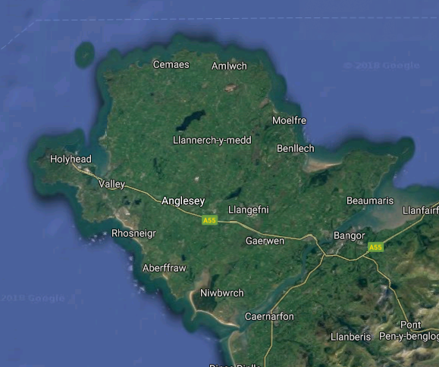
Anglesey
1997: 40 red squirrels
Community led project
Annual grey squirrel control from 1998
Eradicated GS 2015
Series of red squirrel reinforcements
Estimated >700 red squirrels
Red squirrels spread to Gwynedd
Total area: 71,000 ha
Wooded area: 2,500 ha
Private/some government
Notes:
Brief introduction to the three project areas:
Also add that larger populated area, relatively small wooded area. Although lots of gardens.

Slide 5
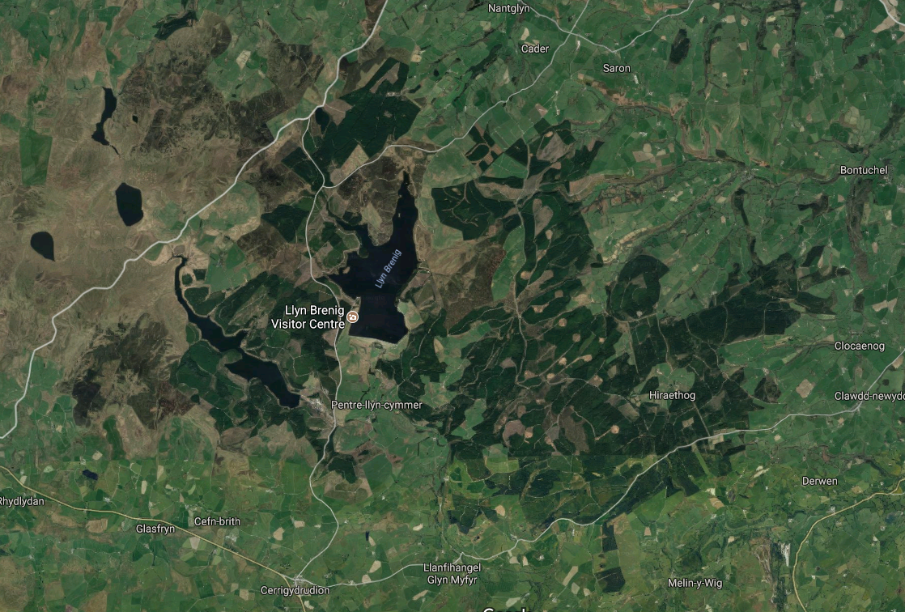
Clocaenog
1998: 300-400 red squirrels
Government funded
Grey squirrel control from 1994
Habitat management
Small scale control initially, increased targeting from 2009
No community group
Currently est. <50 red squirrels
RSU – new community group
Upland conifer forest
Total: 5,5000 ha
Wooded: 4,700 ha
Government

Slide 6
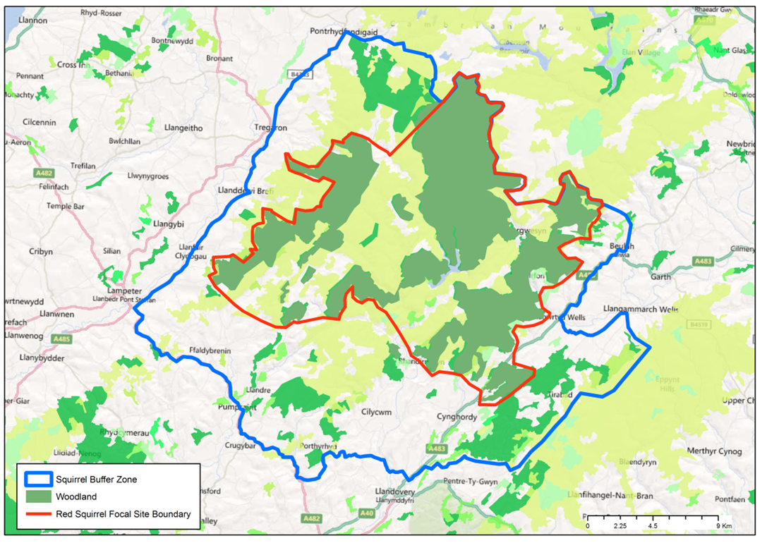
Mid-Wales
150-300 red squirrels
Wildlife Trust project 2002
Small scale initially, extensive trapping projects
Range of funding applications
Volunteer groups: trap loan scheme, forest surveys
Large forest area in rural landscape
Habitat management planning
Upland conifer forest
Total area: 29,5000 ha
Wooded area: 15,000 ha
Private/government
Notes:
Widespread, low density RS population.

Slide 7
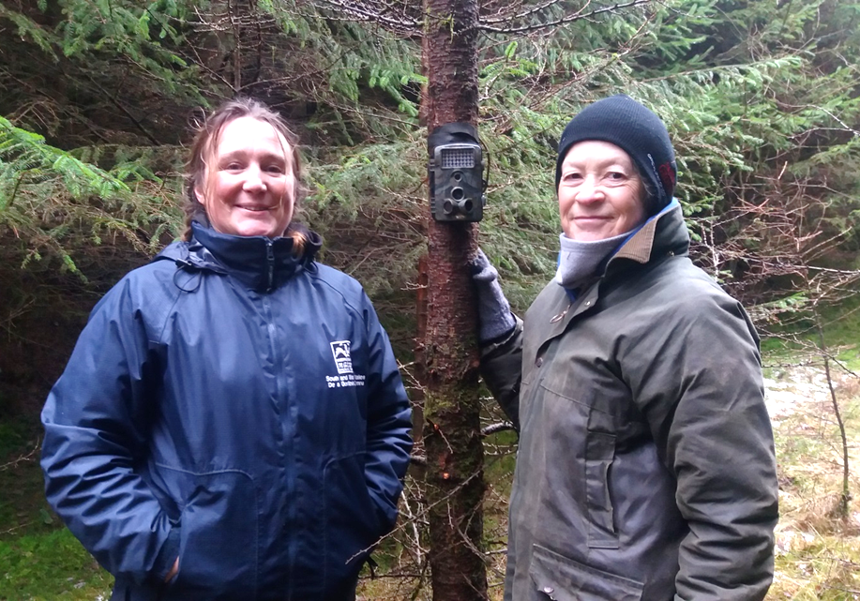
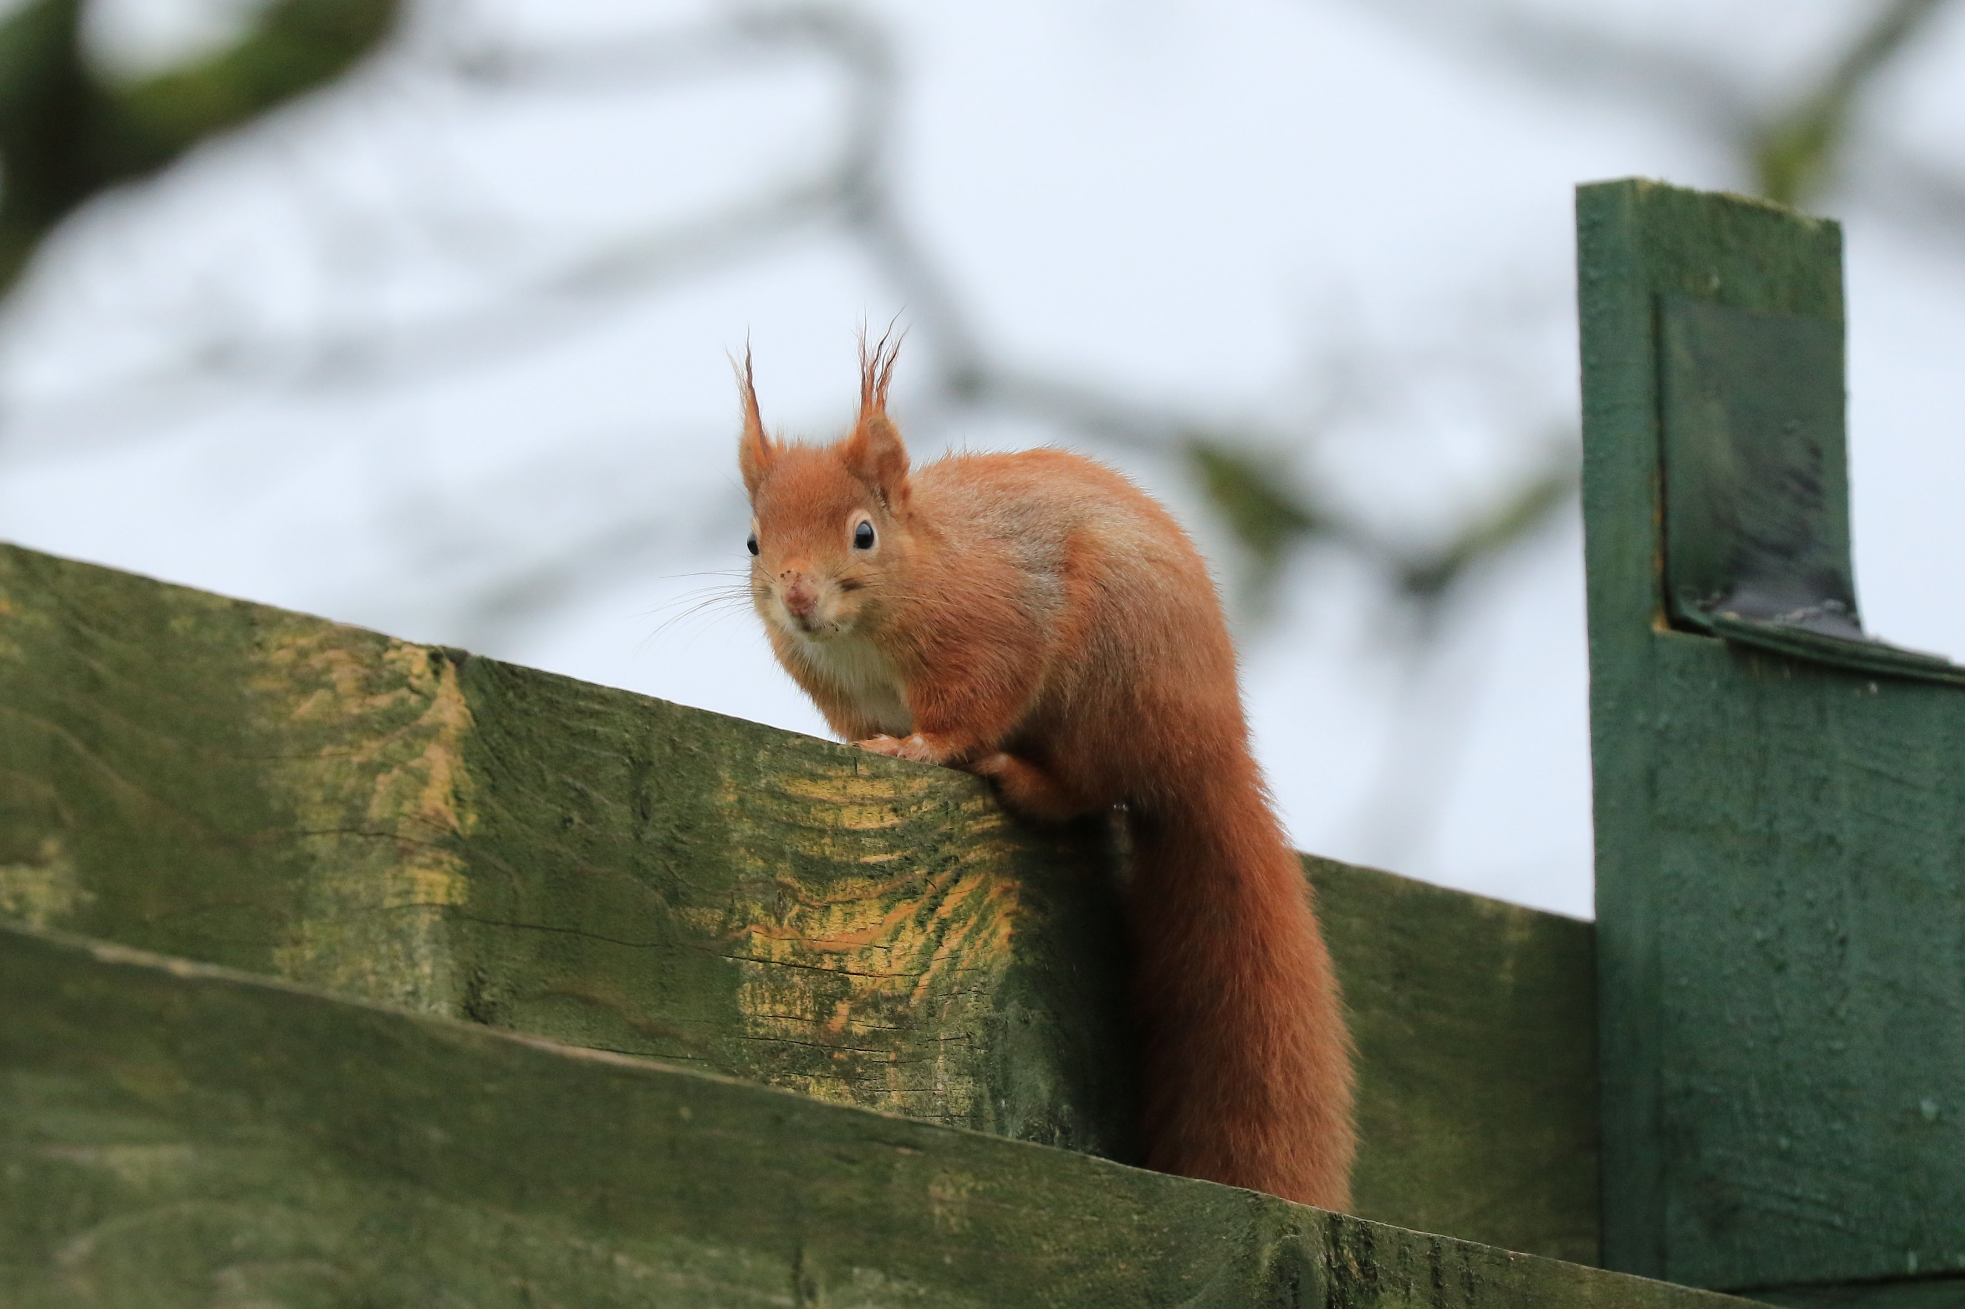
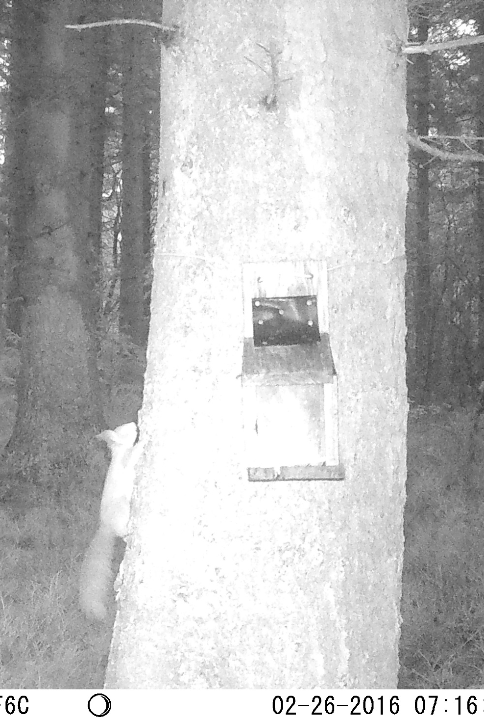
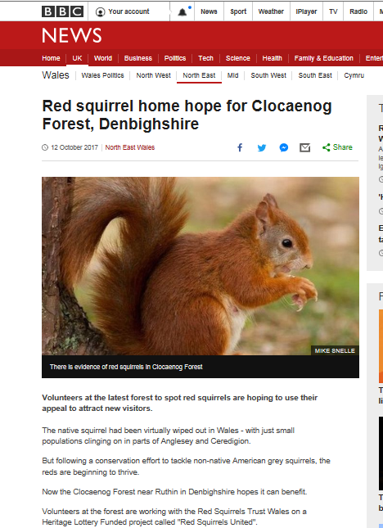
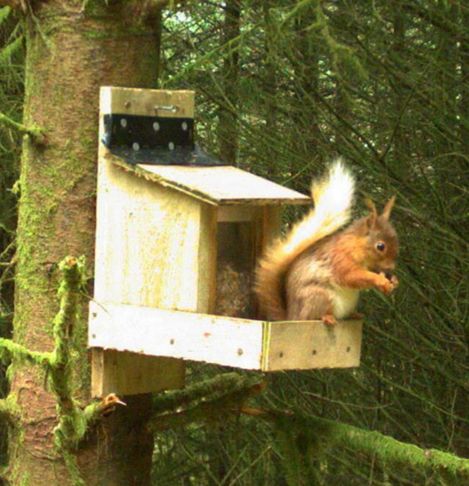
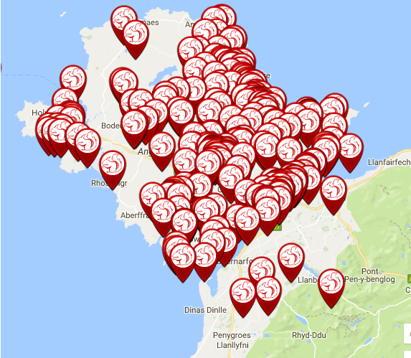
Summary
Mid-Wales Anglesey/Gwynedd Clocaenog
Three focal sites in Wales – taken different approaches, but each proving successful.
Notes:
Three projects – contrasting approaches.
Anglesey – community led, GS eradicated. RS very visible Work now focussed on Gwynedd and safeguard Anglesey.
Mid-Wales – WTs led project to put red squirrels on the map, get funding and develop project. Upland rural landscape. Low density population. Stable?
Clocaenog – Government forest. Upland conifer. Rural. No community involvement. RS numbers declined. Project on new footing.
Overarching conservation plan/strategy, work independently, sharing guidance/advice at WSF. Conservation Plan important to provide context and backing for funding bids.
Over to Holly, then Becky C-R and then Becky H.

Slide 8
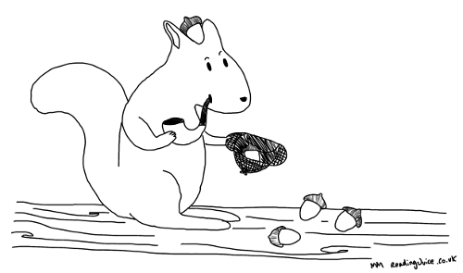
Anglesey – Grey squirrels
LIFE14 NAT/UK/000467

Slide 9
The Facts
Grey squirrel cull started on Anglesey in 1998, Anglesey classified as grey squirrel free in 2013.
In October 2015 three grey squirrels were reported and caught (all female)
In October 2017 two grey squirrel were reported and caught – Mature female (never bred) at Llangoed, male caught at Penrhos nature reserve.
In February 2018 grey squirrel reported Penrhos nature reserve – yards away from Octobers sighting.

Slide 10
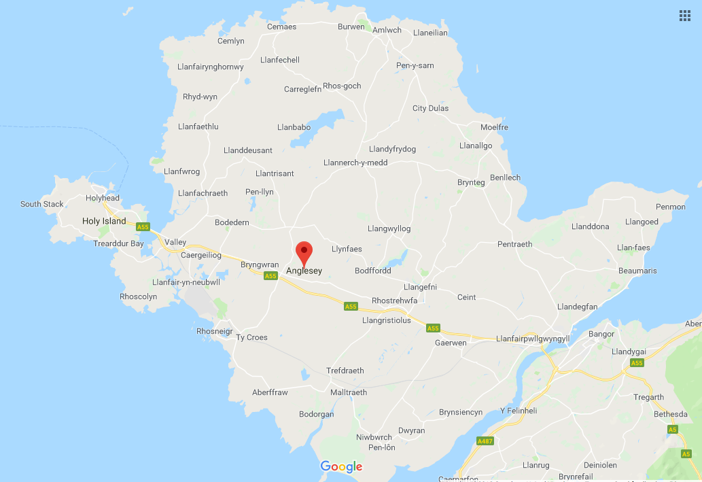

Slide 11
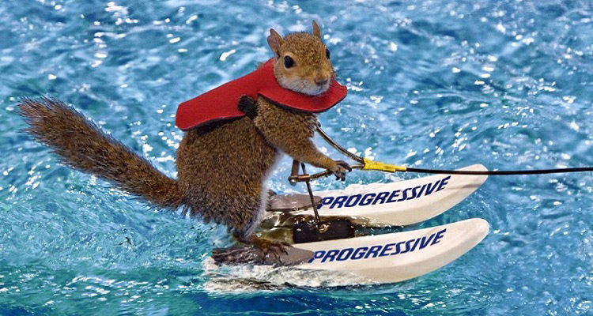
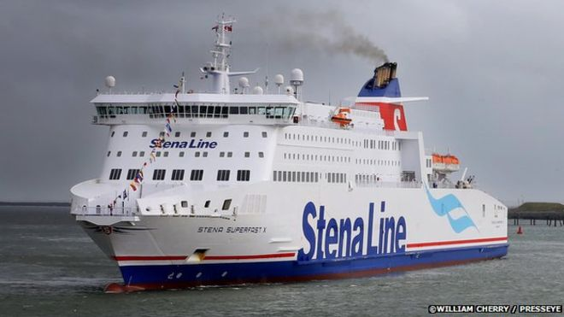
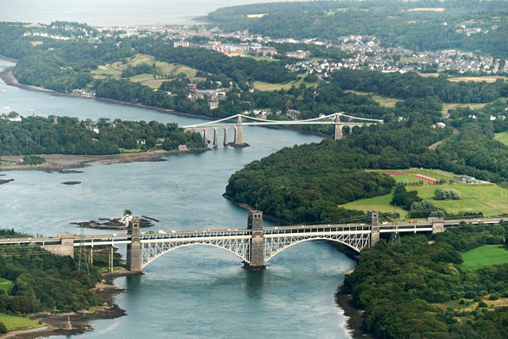
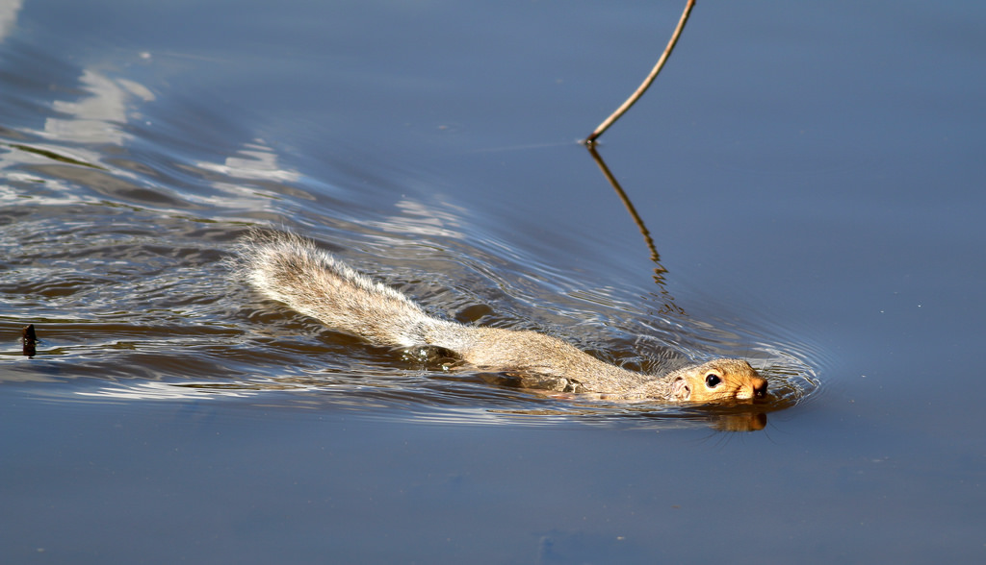
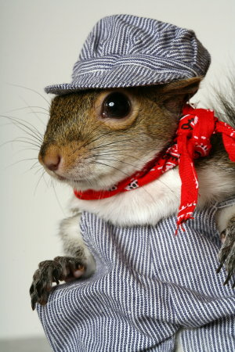
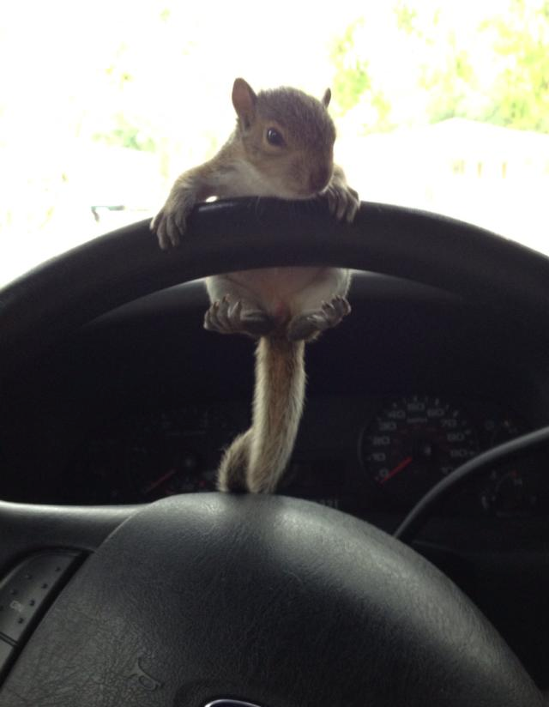
How?
© Steve Ransom

Slide 12
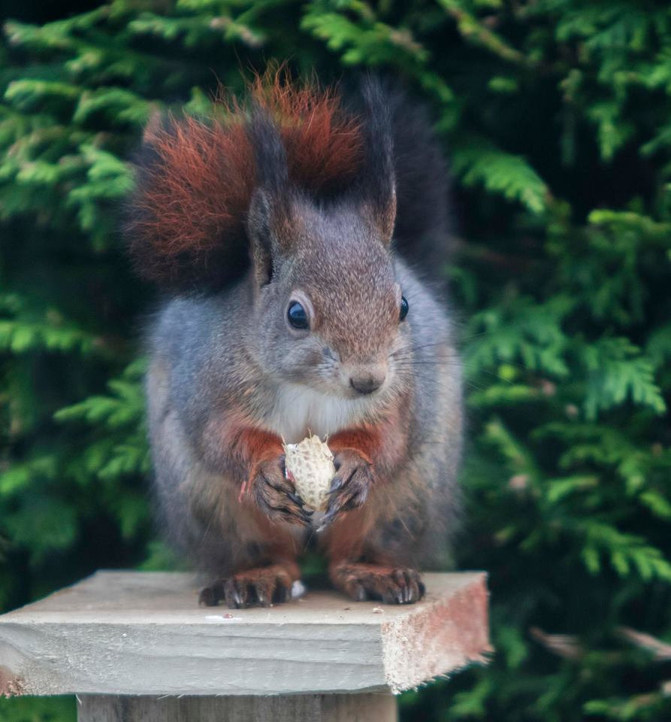
Local support
People on Anglesey reported the grey squirrels to us
Sometimes there is confusion…
Camera phones and social media are really
helpful

Slide 13
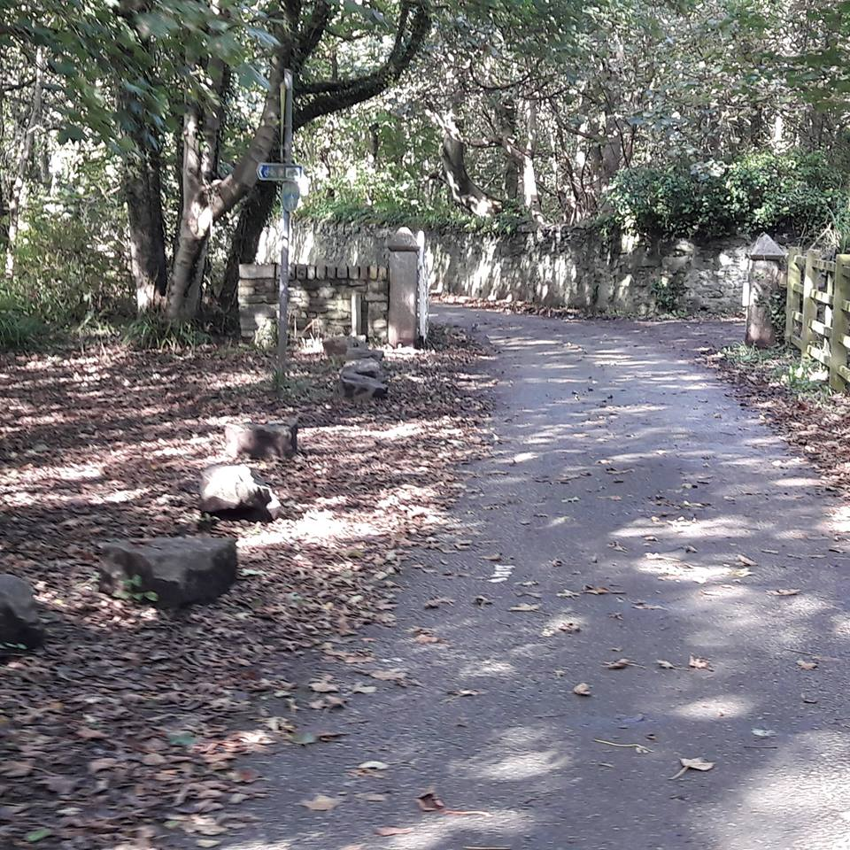

Slide 14

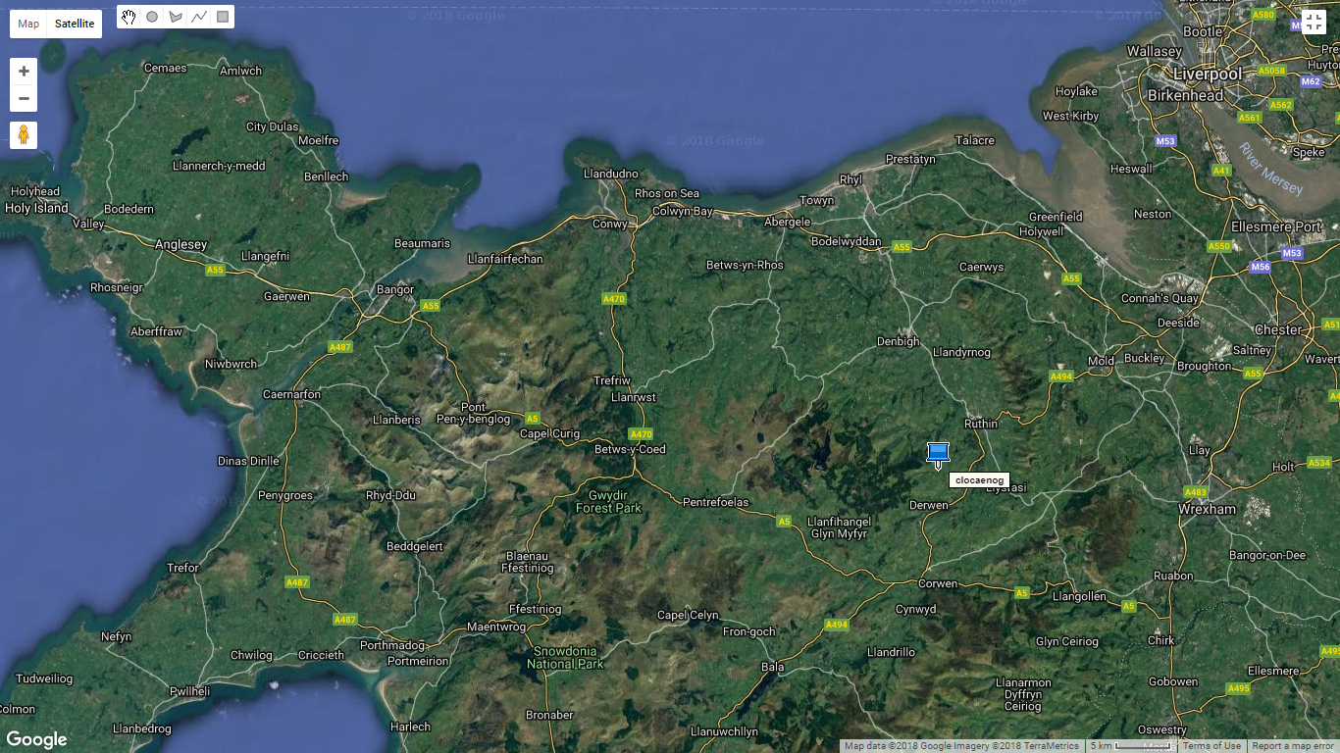
Clocaenog (Clock i nog!) Forest
Notes:
A 5500ha upland commercial conifer plantation in north Wales
Situated on the southern end of Hiraethog Moor and sliced in half with the county of Denbighshire to the East and Conwy to the West.
Natural Resources Wales manage the forest and do as a commercial concern but with wildlife in mind.
Sitka spruce dominates - 69% - not so suitable for reds but
Tree species more suitable to red squirrels exist but are widely dispersed - Norway spruce, 13%; larch, 6%; pine 4%.
It is very much situated in a rural area with Ruthin being the nearest market town with a population of just 5000.
People use the forest for walking, and apart from an annual rally that takes place, it is not used extensively for recreational purposes.
There is evidence that upland Sitka-dominated plantations that are greater than 2000ha may offer an important refuge for red squirrels.
Clocaenog Forest fits the bill nicely.

Slide 15
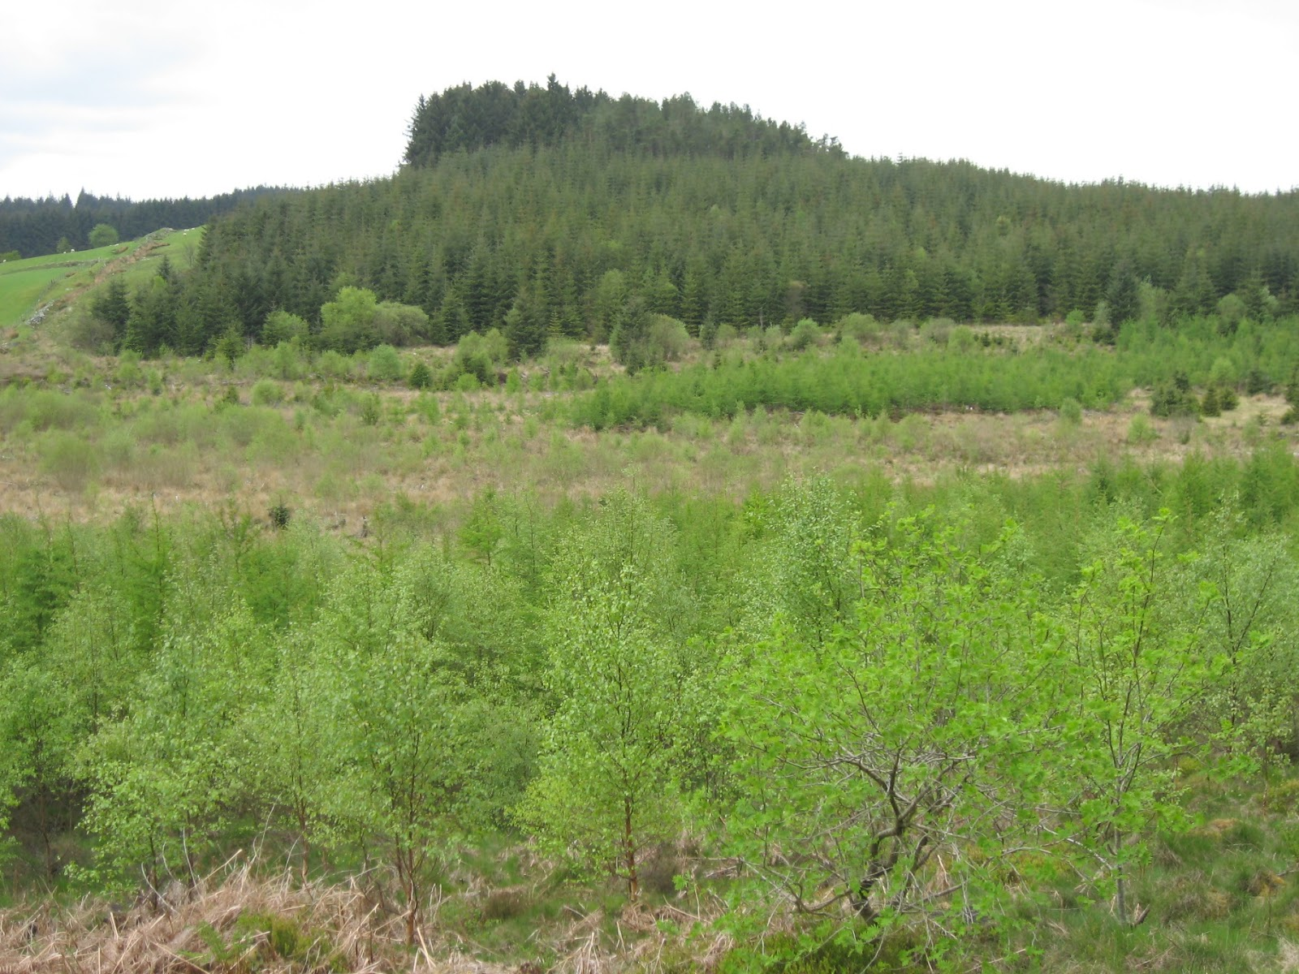
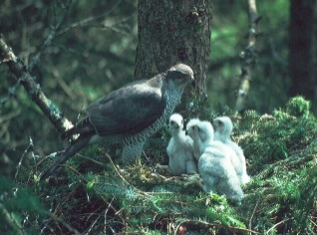
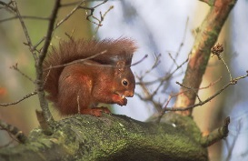
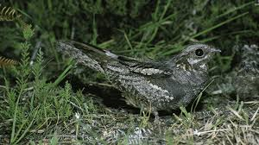
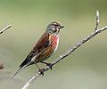
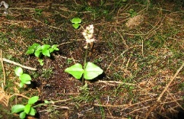
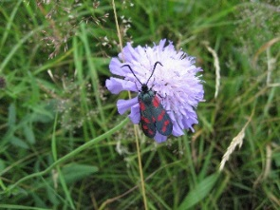

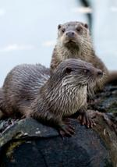

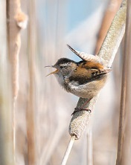


Biodiversity
Notes:
Red squirrel are a priority feature of the forest and management is undertaken accordingly.
There are many other species within the forest including Marsh frit butterfly & EPS dormouse – it’s a balancing act to ensure all are protected and not disturbed whilst also running it commercially.

Slide 16
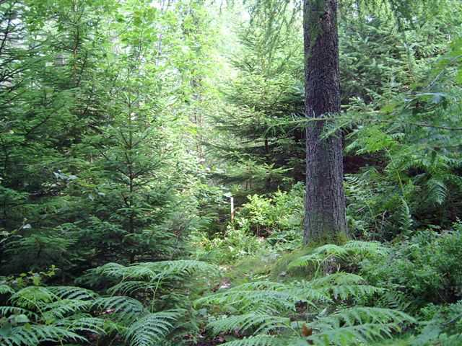
Continuous Cover Forestry
Notes:
Red Squirrel Management
maintains productive high forest and canopy connectivity
Retain the existing Norway Spruce and Scots Pine.
Aim to increase Norway Spruce & Scots Pine – preferred by reds
Reduce competition from Grey Squirrels by not planting large seeding broadleaves, and existing ones to be progressively removed by thinning.

Slide 17
Red Squirrel Status
Notes:
The current status of red squirrels in Clocaenog forest is poorly understood, however evidence suggests that the population is small.
A three month red squirrel trapping programme in 2011/12 failed to capture any red squirrels. One animal was seen in the forest during the study and an adult male in breeding condition was killed by road traffic in June 2014.
Recent grey squirrel control operations in several forest locations indicate an increase in populations since the late 1990s.
low density red squirrel population makes it impossible to determine whether the red squirrel decline has been the result of gradual competition from grey squirrels, or whether there has been a sudden decline resulting from a squirrelpox virus outbreak.

Slide 18
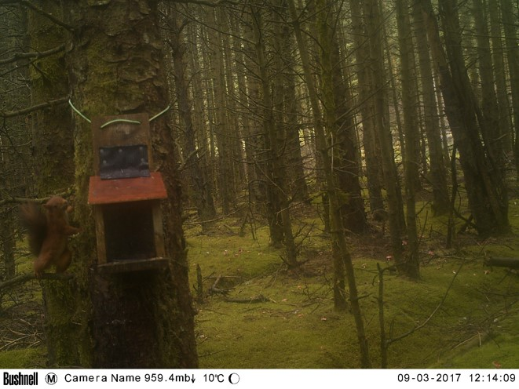
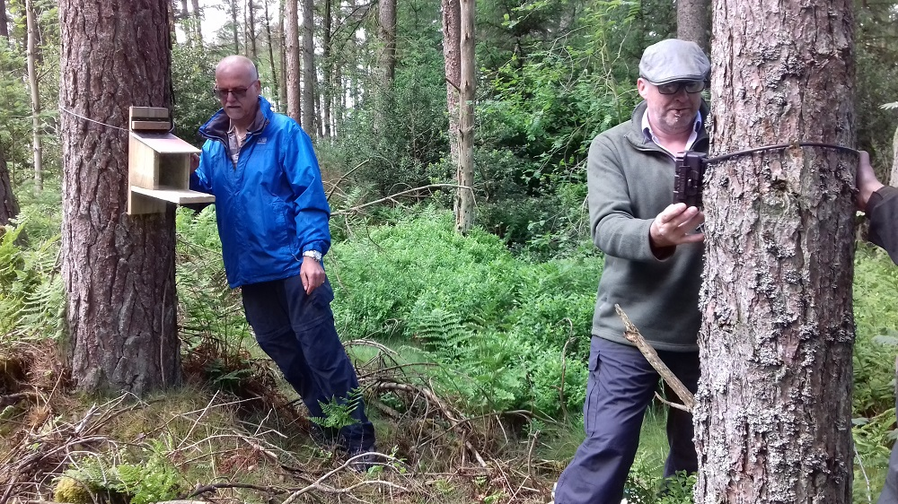
Red Squirrels United
Notes:
Up to 2016, the site has been government and research-led and hence no attempt to develop a volunteer network.
Today the importance of community involvement is recognised as a key element of successful conservation projects and this led to the RSU project at Clocaenog Forest.
RSU has enabled a local following from a zero base.
Within just 1 year a group of dedicated volunteers have spent 2000 Hours in:
Setting up 40+ cameras;
Monitoring them for activity
Carrying out grey control – we’ve run 5 Training days now.
In the first year of monitoring the cameras, only 11 records – further evidence of a very low population.
This coupled with the trapping exercise results led to NRW carrying out a pilot reinforcement.

Slide 19
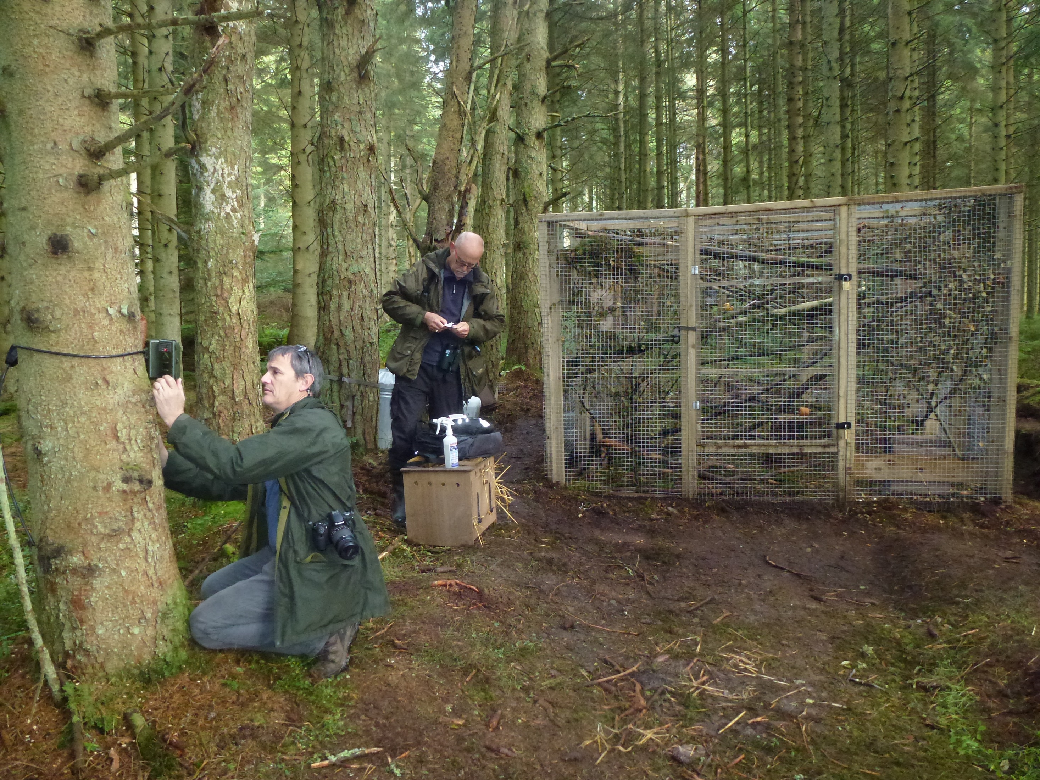
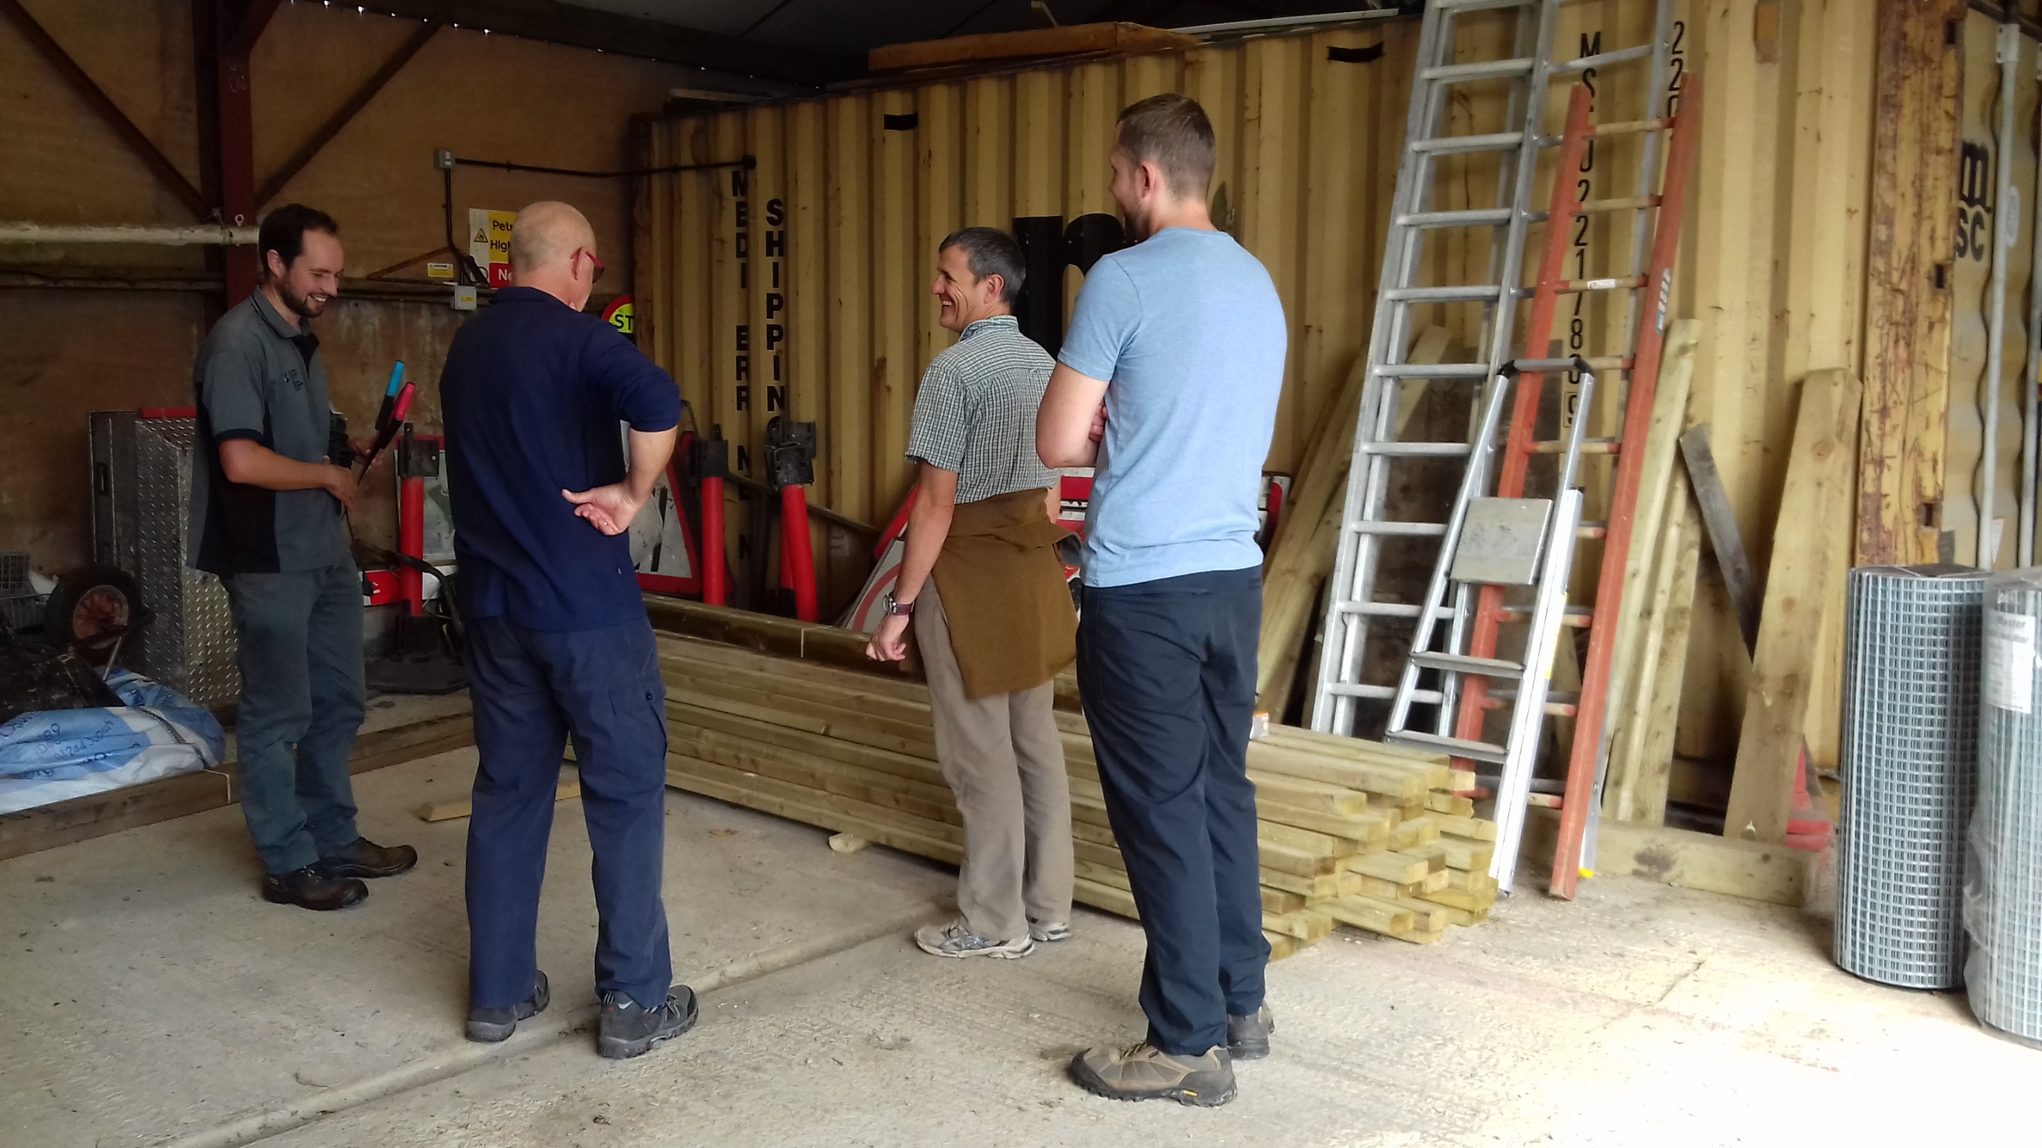
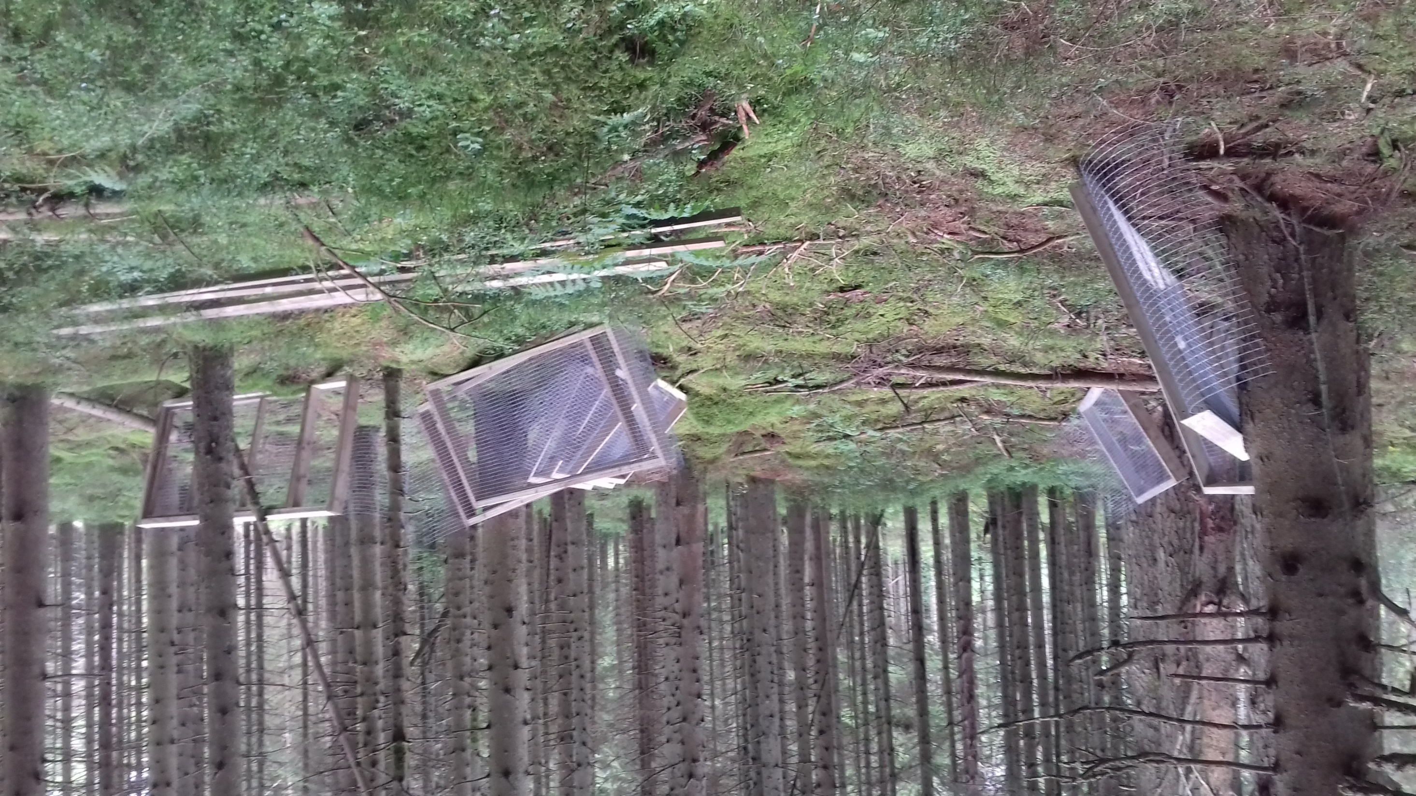
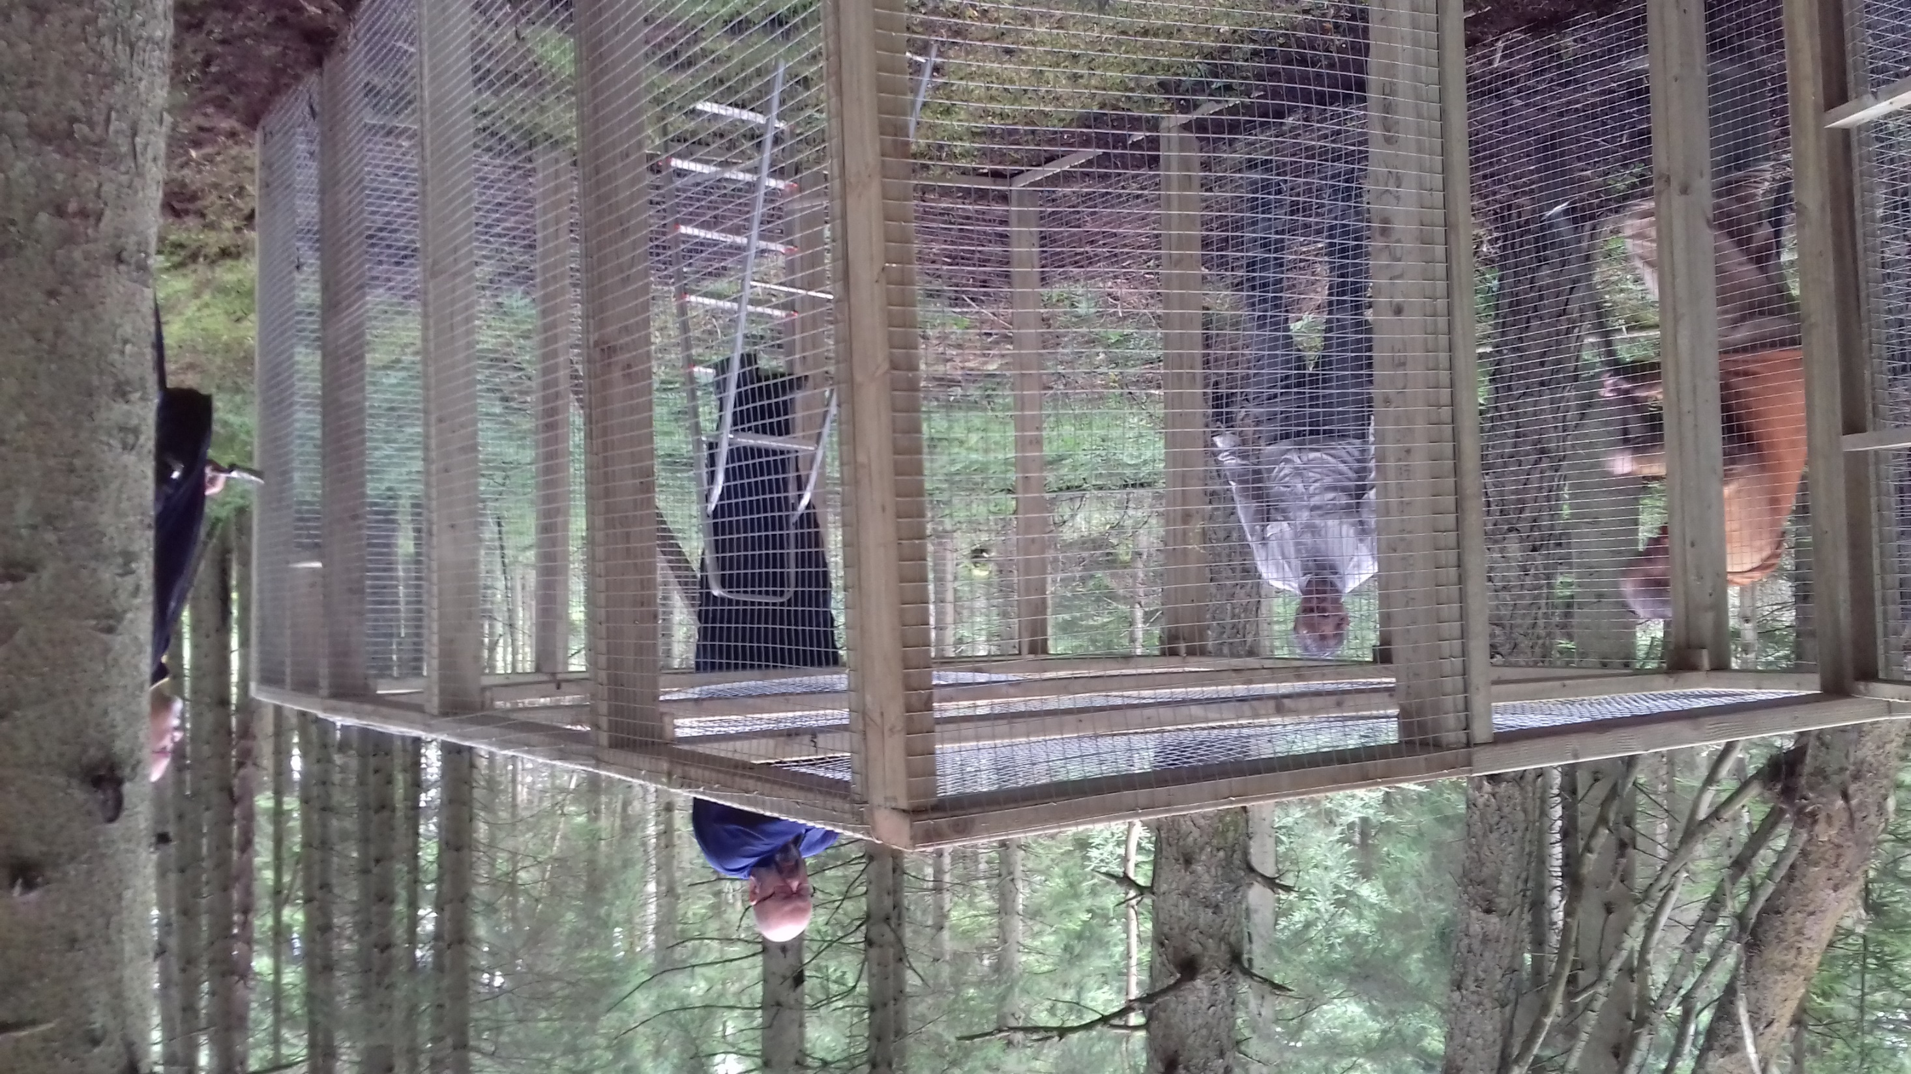
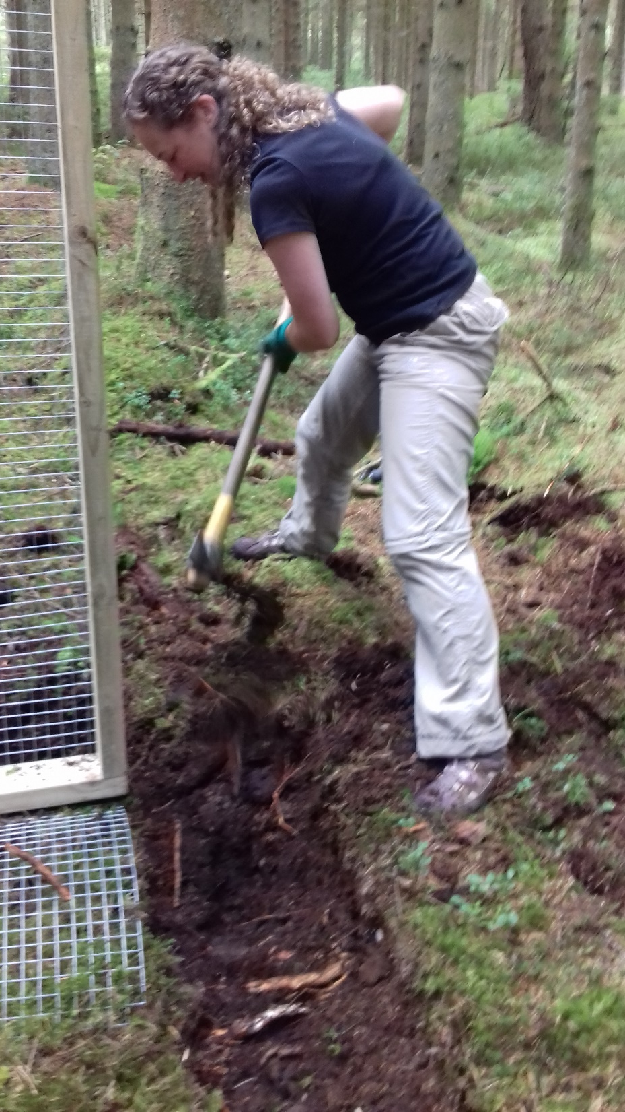
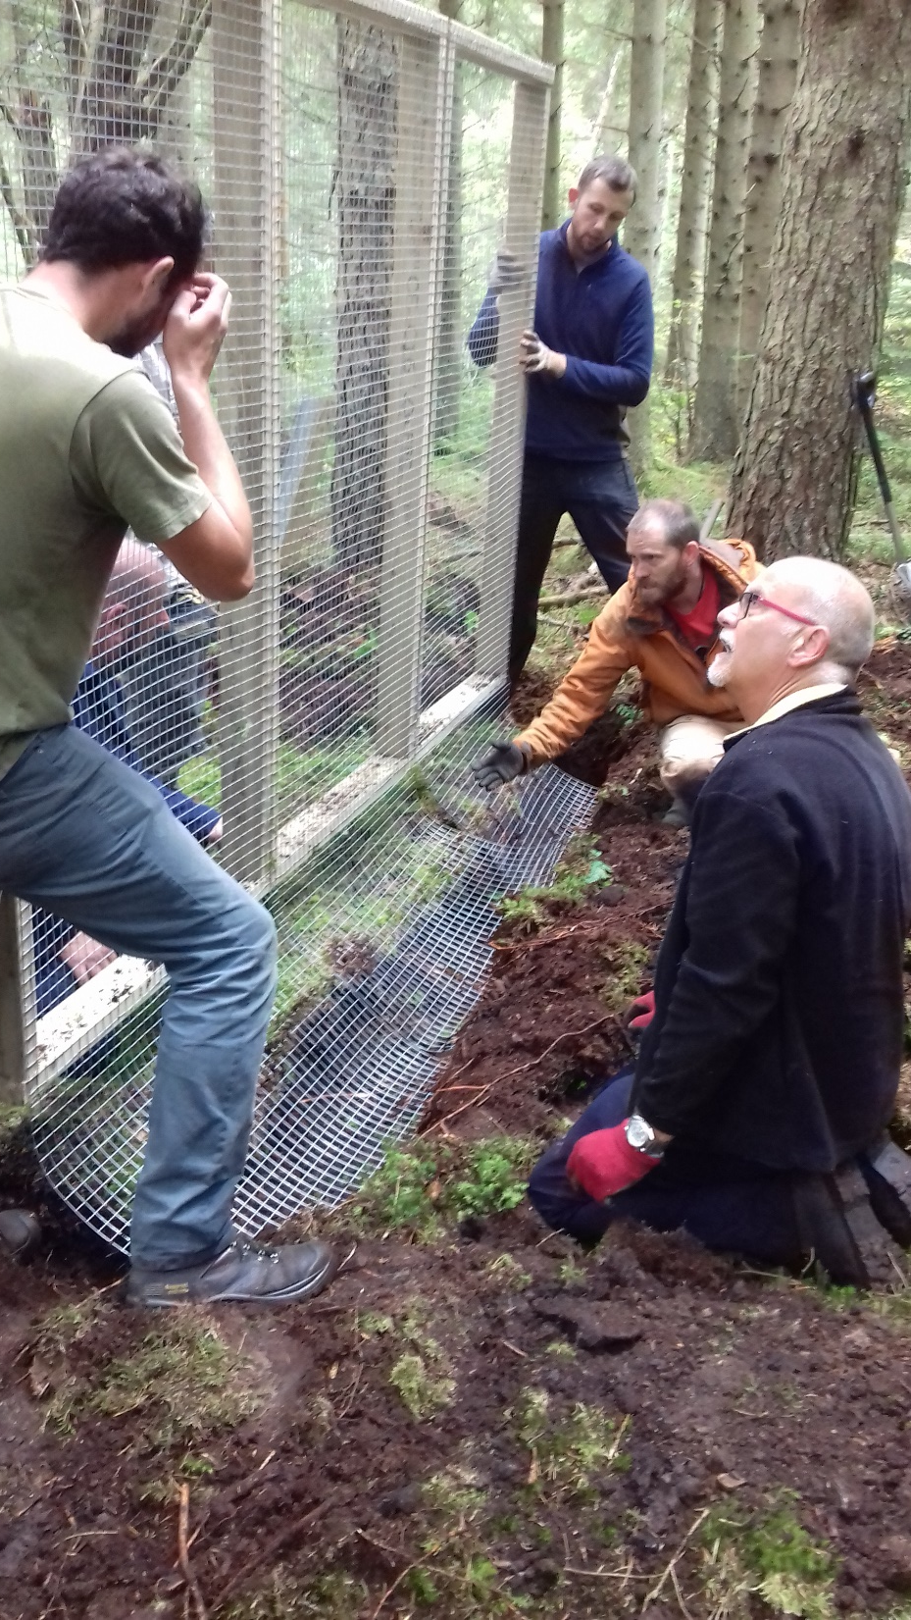
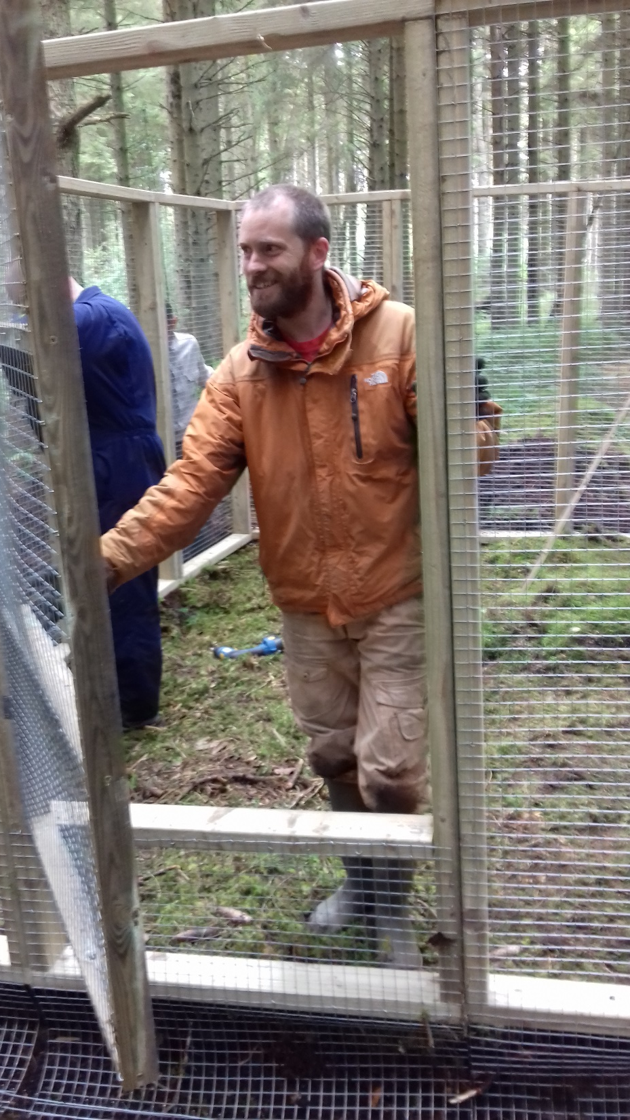
Red Squirrel Reinforcement Sept2017
Notes:
The RSU volunteers have been key to the success of this reinforcement from building the enclosures to carrying out daily checks to acting upon any grey squirrel records.
The enclosures were checked every day including Xmas day!

Slide 20

Red Squirrel Reinforcement Sept2017
Notes:
The RSU volunteers have been key to the success of this reinforcement from building the enclosures to carrying out daily checks to acting upon any grey squirrel records.
The enclosures were checked every day including Xmas day!

Slide 21
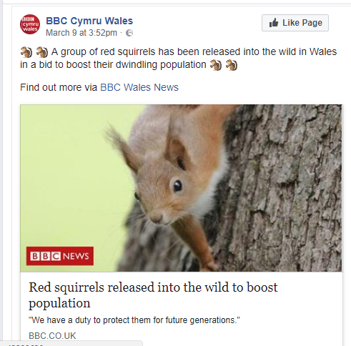
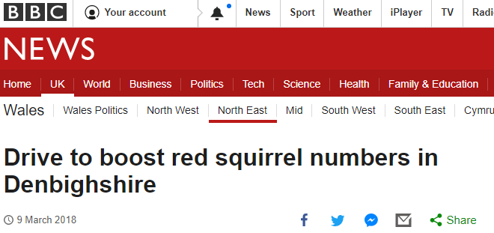
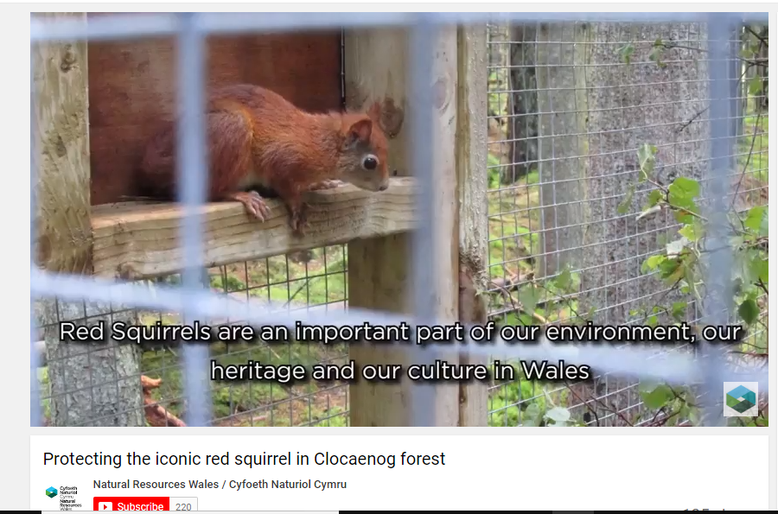
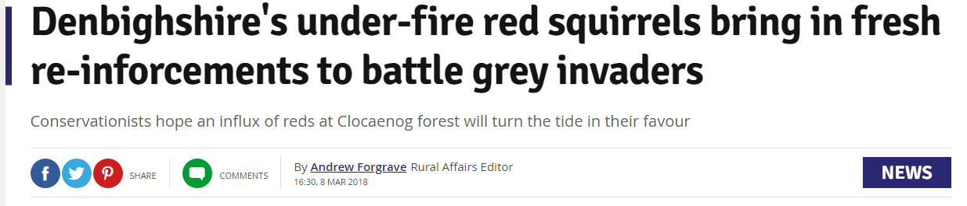
Clocaenog Forest is now on people’s radar!
We've released 7 red squirrels in #Clocaenog forest to help give the iconic population a boost - http://naturalresourceswales.gov.uk/about-us/news-and-events/news/protecting-the-iconic-red-squirrel/?lang=en … @RedSquirrelsinW @WelshMountainZo @RedSquirrelsUtd
Notes:
The reinforcement has certainly gone a long way to ensuring Clocaenog Forest’s red squirrels are on everyone’s radar

Slide 22
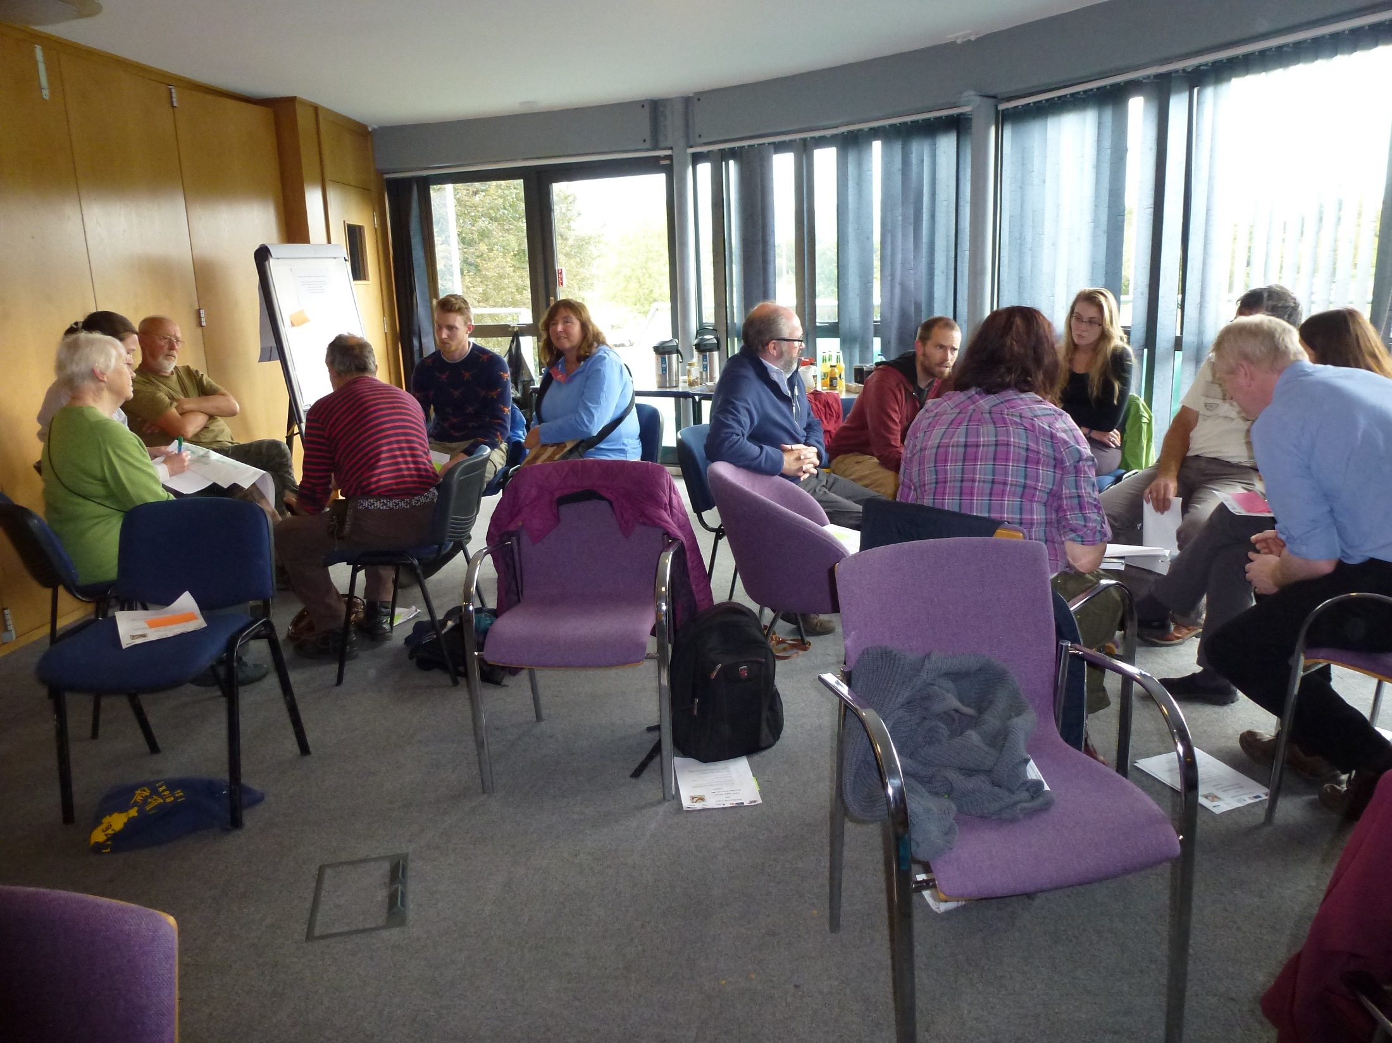
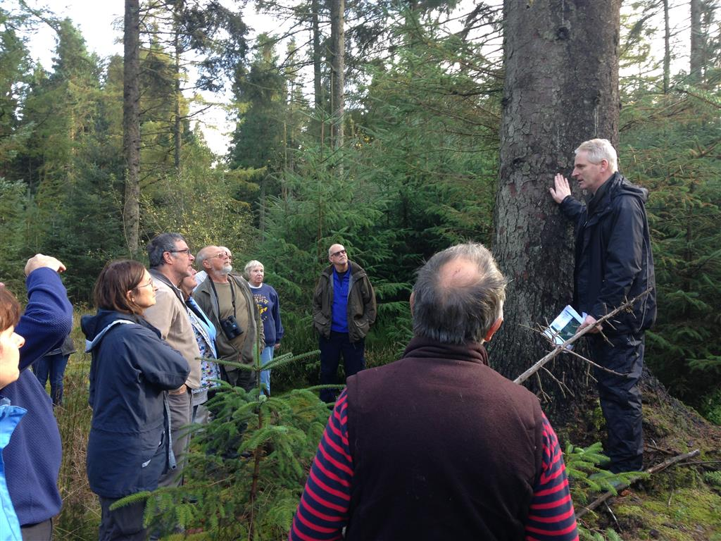
Future
Notes:
Hope that a Friends of Group will form
Hope that visitors to the area can visit Clocaenog forest to see red squirrels.

Slide 23
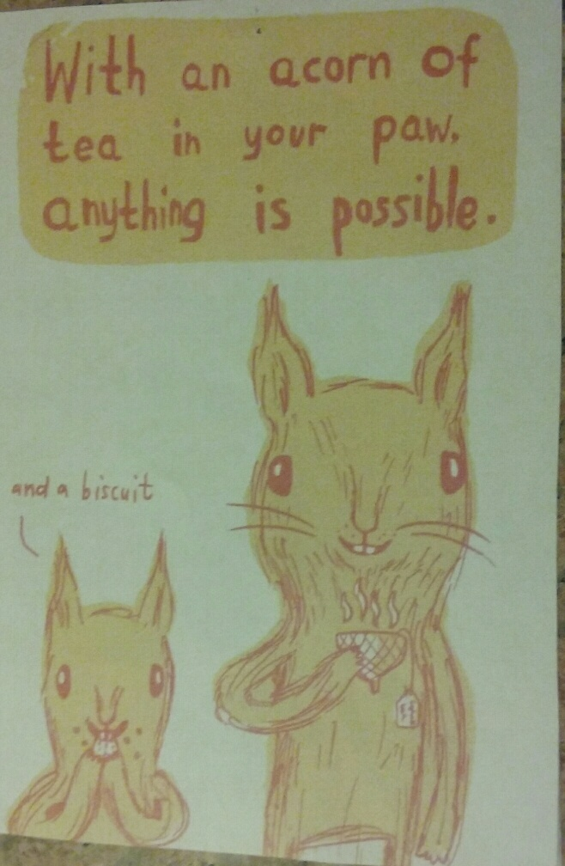
Notes:
Yes it’s a challenge but we believe its achievable.

Slide 24
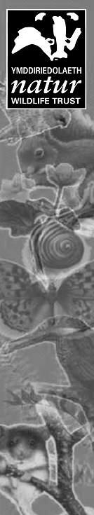


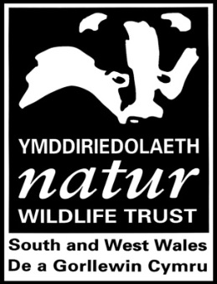


Gwarchod Bywyd Gwyllt ar gyfer y Dyfodol Protecting Wildlife for the Future
Notes:
Me- RS officer for WTSWW, part time. Work on behalf of MWRS Partnership. Running MWRS project since 2014. MWRS Partnership set up in 2002, partnership of 2 x WTs, 3 x CC, NRW, private forestry companies & members of the public. Since 2016 Ben Allen GS control officer @ 2 days a week (RSU / HLF funded).

Slide 25
Gwarchod Bywyd Gwyllt ar gyfer y Dyfodol Protecting Wildlife for the Future
Notes:
MWRSP Focal Site (Reserve and buffer zone) approved Welsh ministers in 2009 – map showing the core area (primarily conifer) in pink and the buffer area (including broadleaf and grey squirrel habitat) in blue. Why have we retained red squirrels when advance of greys heralded red demise in most of the rest of Britain?

Slide 26



Gwarchod Bywyd Gwyllt ar gyfer y Dyfodol Protecting Wildlife for the Future
Notes:
Planted Mid Wales uplands at vast rate in 1960s. At same time grey squirrels were advancing in to mid Wales (1958 first known sighting.)

Slide 27



Gwarchod Bywyd Gwyllt ar gyfer y Dyfodol Protecting Wildlife for the Future
Notes:
Reds have a slight competitive advantage over greys in some types of coniferous woodland. Although have simil.ar diets, they are smaller, so don’t need so much food and can therefore survive in low numbers on a diet of conifer seeds. Of particular importance are lodgepole pine and Norway spruce

Slide 28


Gwarchod Bywyd Gwyllt ar gyfer y Dyfodol Protecting Wildlife for the Future
Notes:
Habitat studies: 2012 – habitat survey (Denman and Cartmel). Assessed and mapped location, extent and quality habitat suitable for red squirrels. Graded habitat from 1 – 3 and assessed arboreal connectivity between key areas. Provides recommendations for maintaining and enhancing key areas and arboreal connectivity.

Slide 29

Gwarchod Bywyd Gwyllt ar gyfer y Dyfodol Protecting Wildlife for the Future
Notes:
Management planning process = lengthy. Began in Spring 2015 with a meeting of Forest Managers. Brought all 5 major Forest Managers on board – Tilhill, PRS, SW, Huw Denman and NRW.

Slide 30

Gwarchod Bywyd Gwyllt ar gyfer y Dyfodol Protecting Wildlife for the Future
Notes:
NRW is the major land manager. Undergoing a review of their FDPs very soon, help in planning future FS management. Private forestry companies are significant

Slide 31

A Management Plan
for the Mid Wales Red Squirrel Focal site
Optimising Habitat Management for Reds Squirrels
Gwarchod Bywyd Gwyllt ar gyfer y Dyfodol Protecting Wildlife for the Future
Notes:
5 year Management plan is a result of collaborative work between the Wildlife Trust of South and West Wales, private forestry companies and NRW, on behalf of the MWRSP. Covers over 15,000 ha of forests. The purpose is to maintain and enhance the red squirrel population and its habitat in mid Wales. Appreciate that the forest industry’s first objective is to produce a financial return for their investors (Welsh tax payers, NRW) but, with a bit of thought, these 2 objectives can work together.

Slide 32

Gwarchod Bywyd Gwyllt ar gyfer y Dyfodol Protecting Wildlife for the Future
Notes:
34 sites in all (some are part of wider complexes) . Showing different forest managers. Over 15,200 ha, sites range from 41 ha to 1,625 ha.

Slide 33

Gwarchod Bywyd Gwyllt ar gyfer y Dyfodol Protecting Wildlife for the Future
Notes:
Key Areas are stands of either lodgepole pine, Scots pine, Douglas fir or Norway spruce; it is accepted that, due to Phytophthora ramorum disease, larch cannot be retained on the long term. Stands adjacent to Key Areas should not be felled until adjacent crops are a minimum of 4 metres in height and should be felled in small coupes. Narrow and linear clear-fells that minimise the distances that red squirrels have to travel over open ground are preferable.
Pine = Lodgepole would be preferable due to early coning and prolific seed production, although alternatively Scots pine. Large-seeded broadleaves = attraction to grey squirrels.

Slide 34

Gwarchod Bywyd Gwyllt ar gyfer y Dyfodol Protecting Wildlife for the Future
Notes:
Nant Cerdin – PRS. The retention of the majority of Key Areas on this site, as well as the inclusion of lodgepole pine. Norway spruce and Douglas fir in long term restocking plans will retain species diversity and provide even more habitat suitable for red squirrel in the future. The position and limited size of proposed felling compartments will not impact overly on connectivity on this site. The implementation of grey squirrel control at Nant Cerdin would further improve this site for red squirrels.

Slide 35

Gwarchod Bywyd Gwyllt ar gyfer y Dyfodol Protecting Wildlife for the Future
Notes:
Fannog – NRW (positive), arboreal connectivity is recovering, with connectivity now relatively good. The section of this site under LISS management will ensure that arboreal connectivity is retained across this area, connecting several Key Areas. Although felling plans will impact on arboreal connectivity, this will not be overly detrimental, leaving some form of connectivity across the site. Despite the proposed felling of areas of larch due to Phytophthora ramorum control measures, much of the Grade 1 Key Areas on this site will be retained and will continue to benefit the red squirrel population. The NRW restocking policy, along with recent restocking already undertaken will benefit tree species diversity and provide more Key Areas for red squirrels in the long term.

Slide 36

Gwarchod Bywyd Gwyllt ar gyfer y Dyfodol Protecting Wildlife for the Future
Notes:
Pieced together the site plans to create maps of 3 x habitat networks showing arboreal connectivity, or lack of (trees under 4m high), proposed felling coupes and grade 1 Key Areas. Eastern habitat network – the largest of the 3 forest networks in the MWRSFS.

Slide 37


Community Action
Co-ordinate volunteer activity
Trap Loan Scheme
Local Coordinators
Raise awareness
Educational activities
Squirrel surveys
Gwarchod Bywyd Gwyllt ar gyfer y Dyfodol Protecting Wildlife for the Future
Notes:
Very little staff time on project, volunteers have contributed over 8K hours in the past 2.5 years. GS control, RS monitoring / survey, GIS mapping work, TLS administration, feeder box creation, translation, promotion etc.

Slide 38


Gwarchod Bywyd Gwyllt ar gyfer y Dyfodol Protecting Wildlife for the Future
Notes:
Survey volunteers. Multiple camera traps in one or more sites.

Slide 39

Gwarchod Bywyd Gwyllt ar gyfer y Dyfodol Protecting Wildlife for the Future
Notes:
Camera trap monitoring – interesting ‘tail waving’ behaviour.

Slide 40

Gwarchod Bywyd Gwyllt ar gyfer y Dyfodol Protecting Wildlife for the Future
Notes:
Camera trap monitoring – all weathers – using box as shelter

Slide 41


Gwarchod Bywyd Gwyllt ar gyfer y Dyfodol Protecting Wildlife for the Future
Notes:
Pupils from Dyfryn Aman. Remote camera – uses phone network (limited use in Tywi).

