Slide 1
Red Squirrels United: Overview and progress
LIFE14 NAT/UK/000467

Slide 2
Red Squirrels United: Overview
The first UK-wide network working together to secure the future of our red squirrels, uniting 40 organisations across the UK and 5,000 volunteers.
The largest invasive species management programme in Europe, representing a significant investment by EU LIFE and Heritage Lottery Fund of ~£3 million.
A scientifically robust programme of conservation, protecting nine main stronghold red squirrel populations.

Slide 3
Red Squirrels United: Progress
Over 50 community engagement events held
(target 56)
18 trainings events held (target 51)
Four entirely new volunteer groups set up (target nine)
All regions have implemented an early warning/rapid response system – largely using volunteers

Slide 4
Red Squirrels Trust Wales
ACTION C2 Island Reinvasion Prevention
LIFE14 NAT/UK/000467

Slide 5
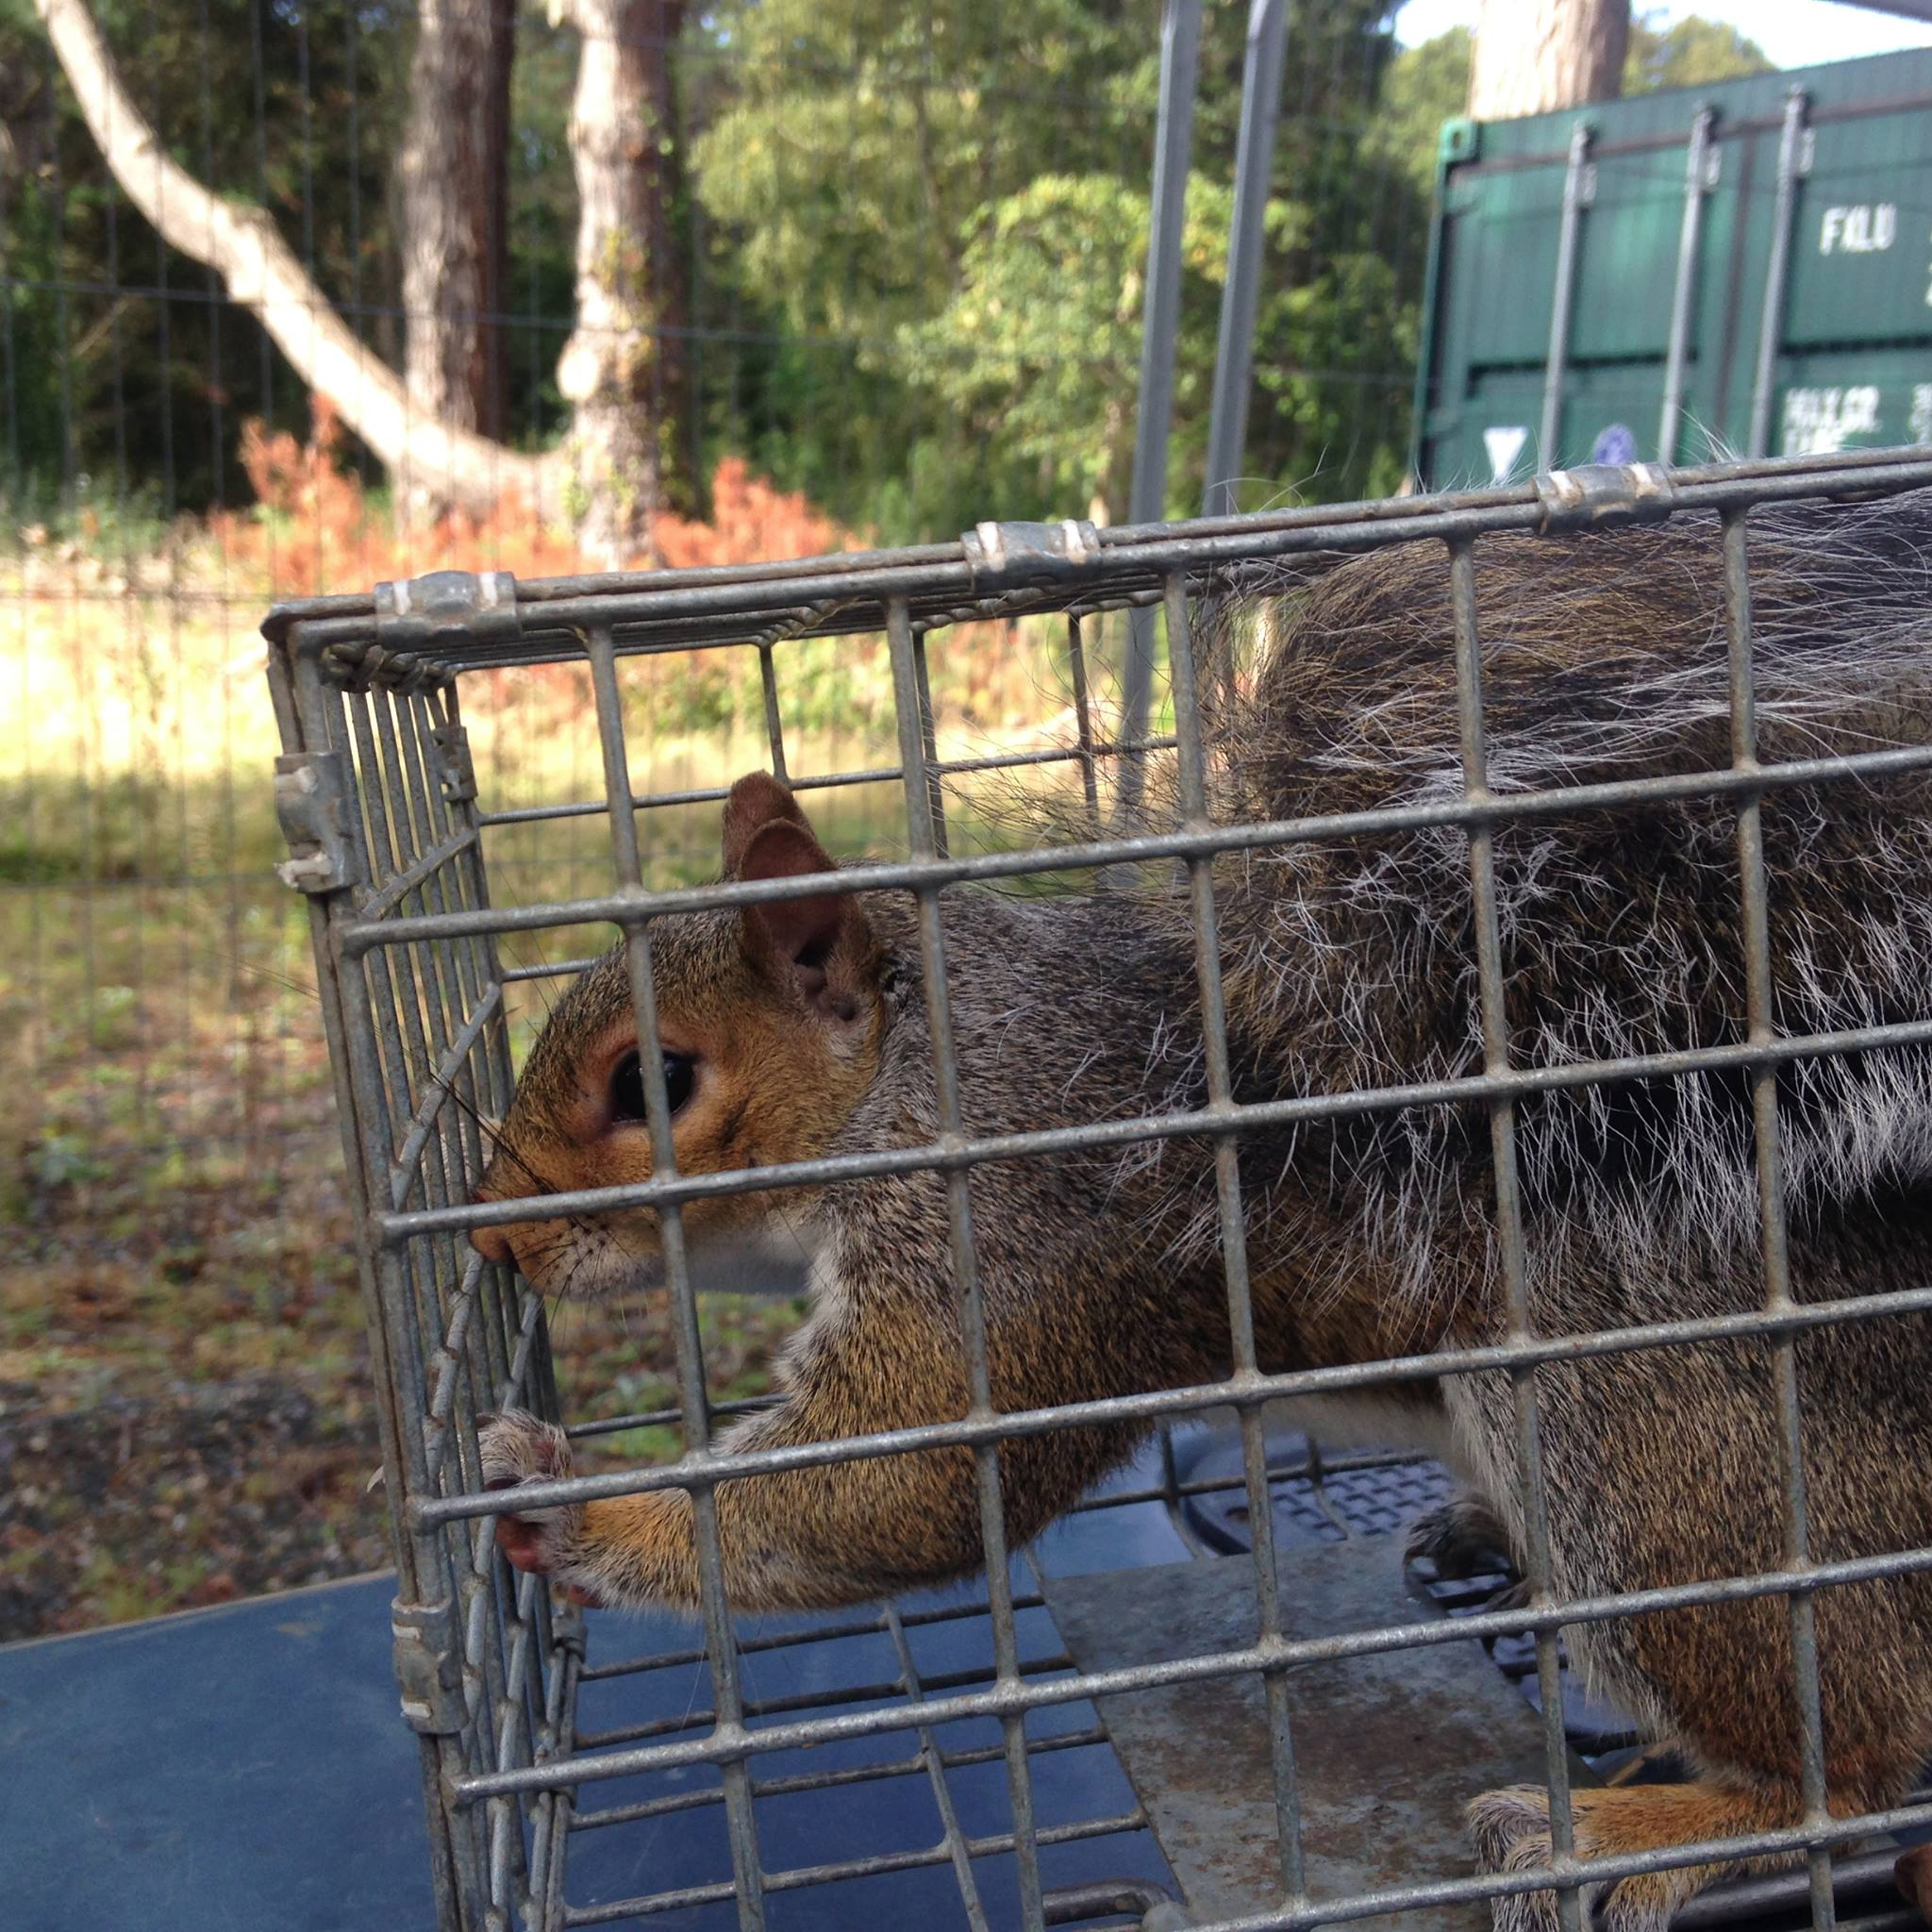
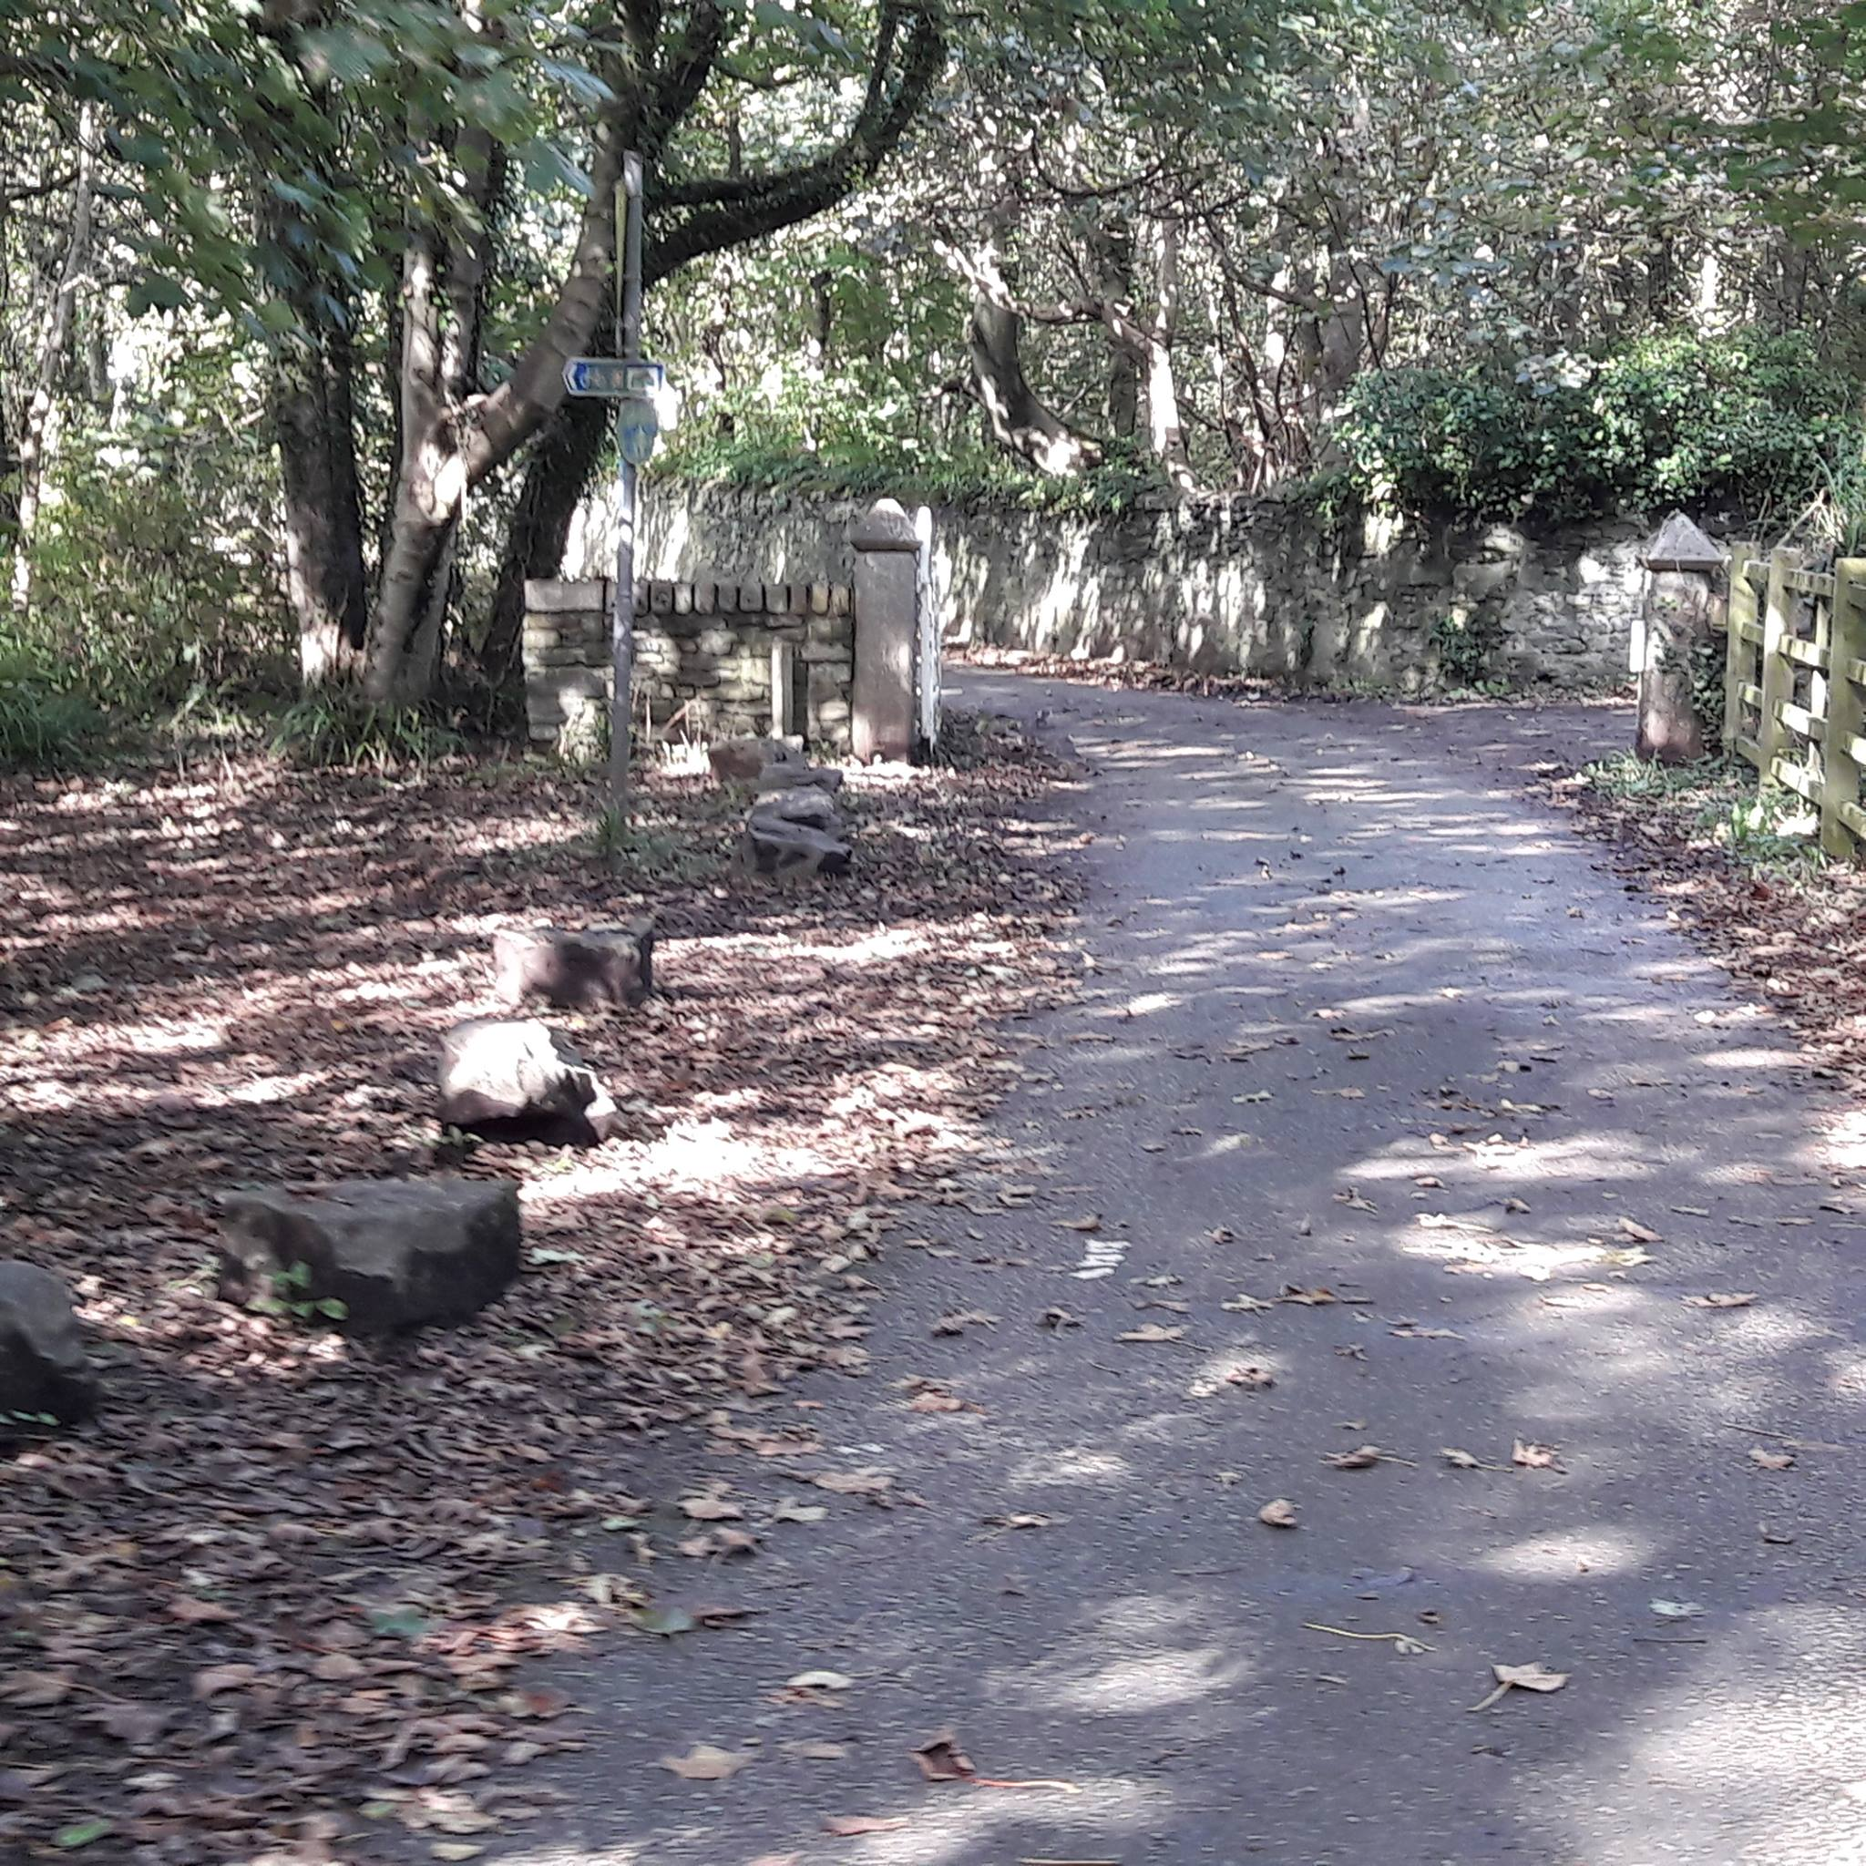
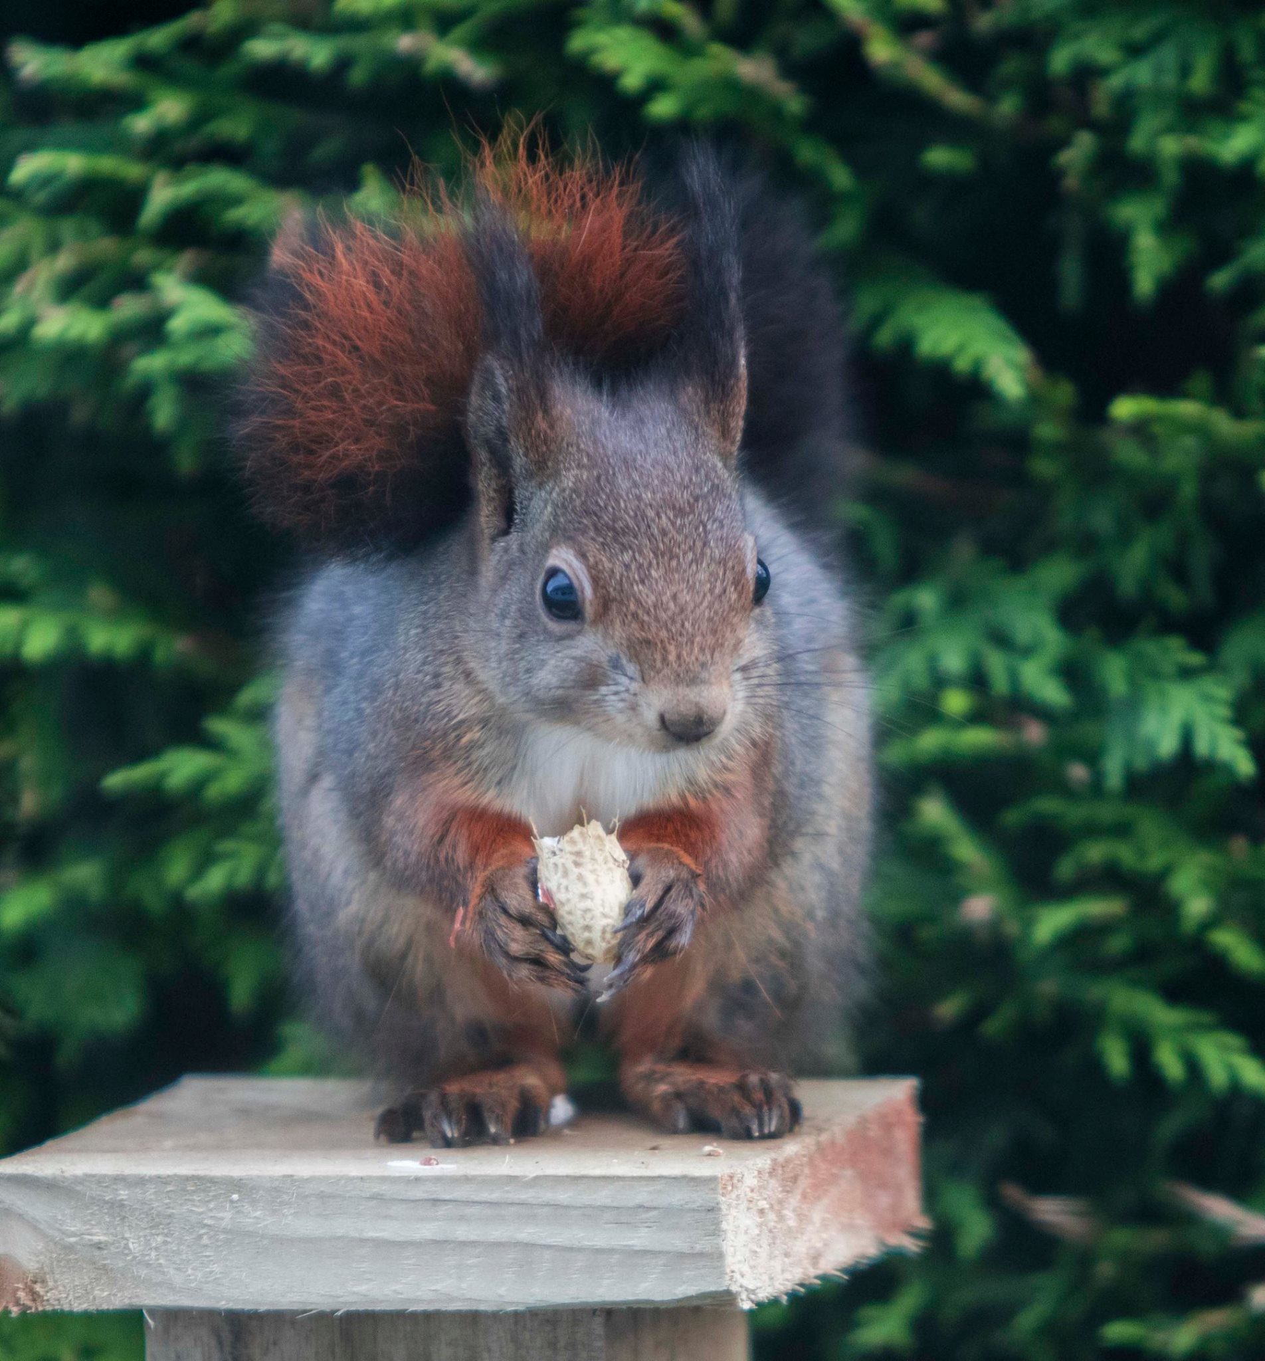
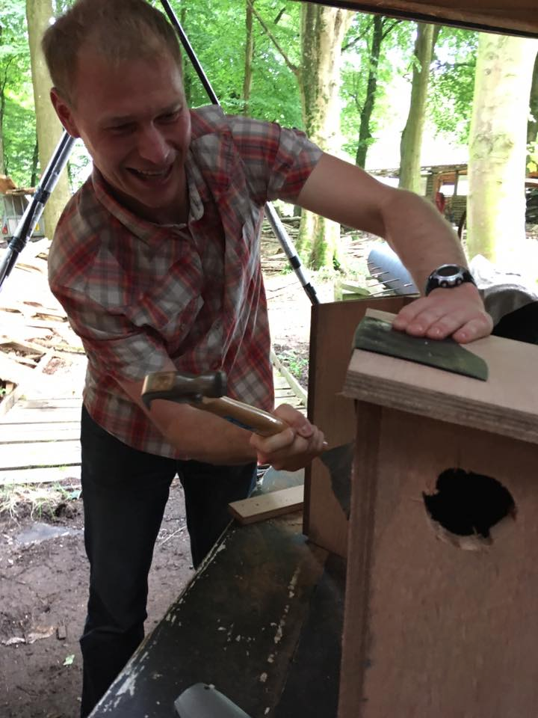
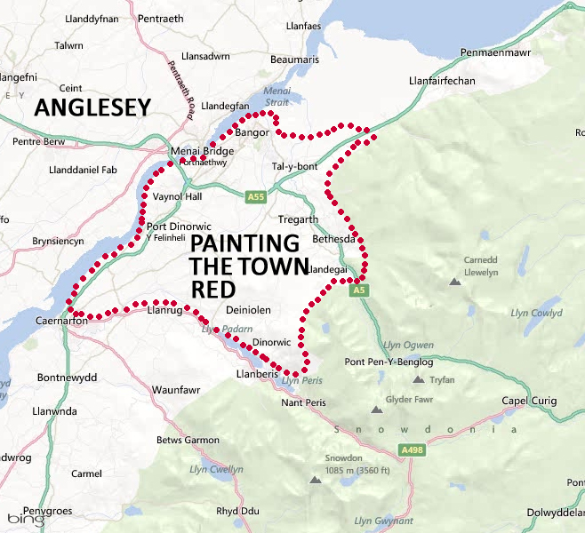
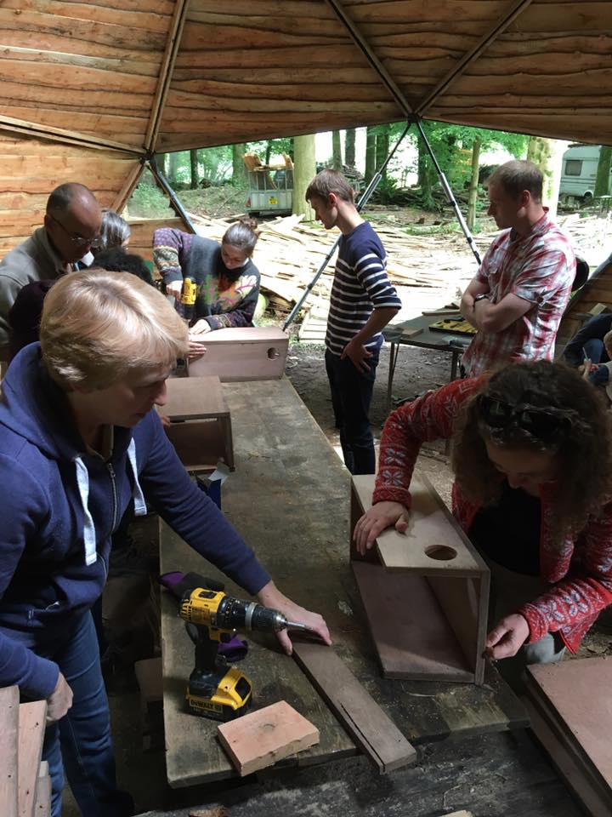
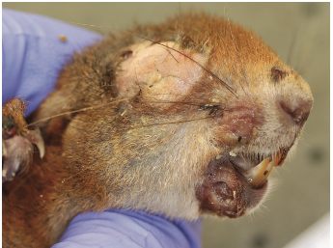
RSTW Anglesey and Gwynedd
© John Wright
ACTION C2 Island Reinvasion Prevention
Notes:
My name is Holly Peek I am the Red Squirrel Ranger for Anglesey and Gwynedd working for RSTW.
Talk about reds came over in 2009 (meaning greys can get over if they want) decided to work on the mainland to prevent this from happening and to help the spread of red squirrels.
Anglesey is full of them (new areas more sightings red squirrel rope bridge)
Recruited a whole new load of volunteers both on anglesey and the mainland helping with red squirrel monitoring, grey squirrel control and everything in between
Squirrel pox in bangor!
Baby reds in snowdonia national park – first time in 50 years.
Anglesey invasion! Grey squirrel escapees!

Slide 6
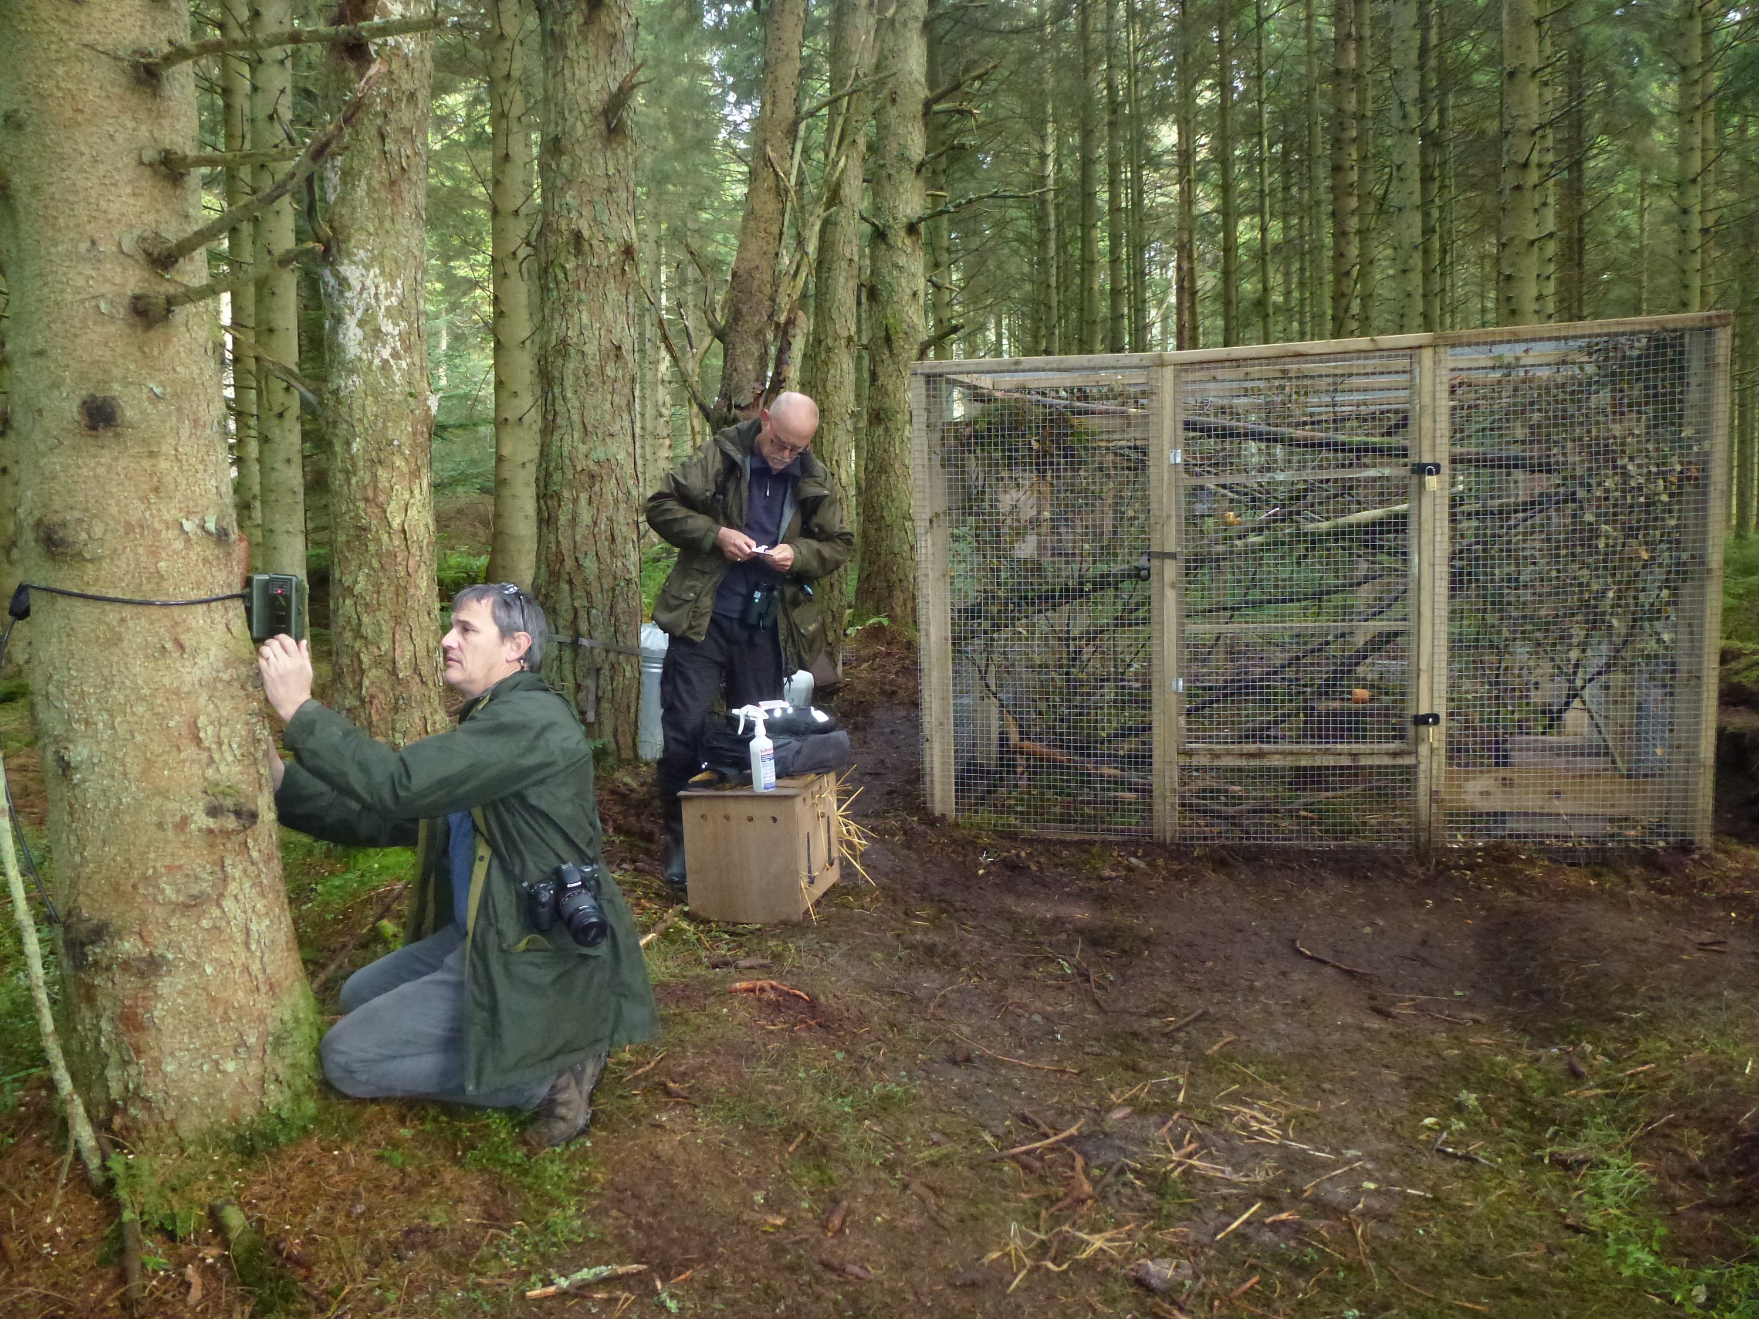
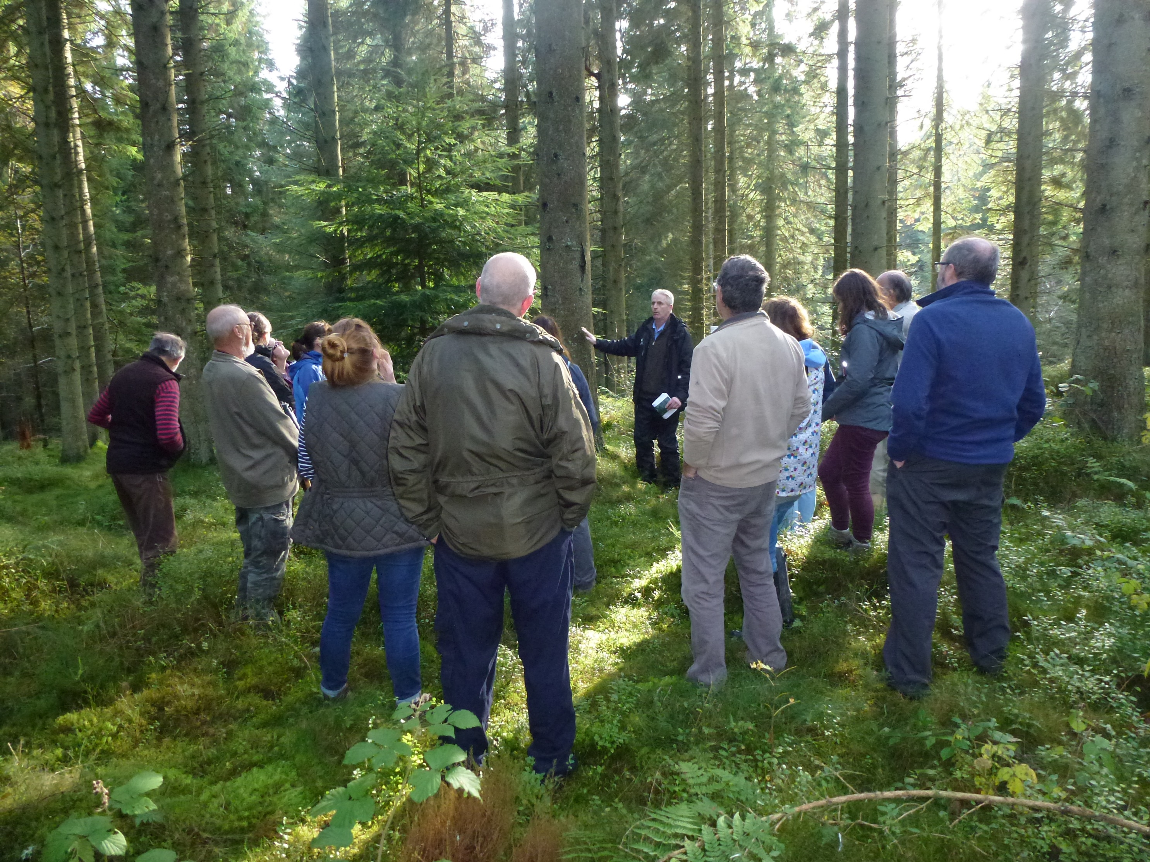
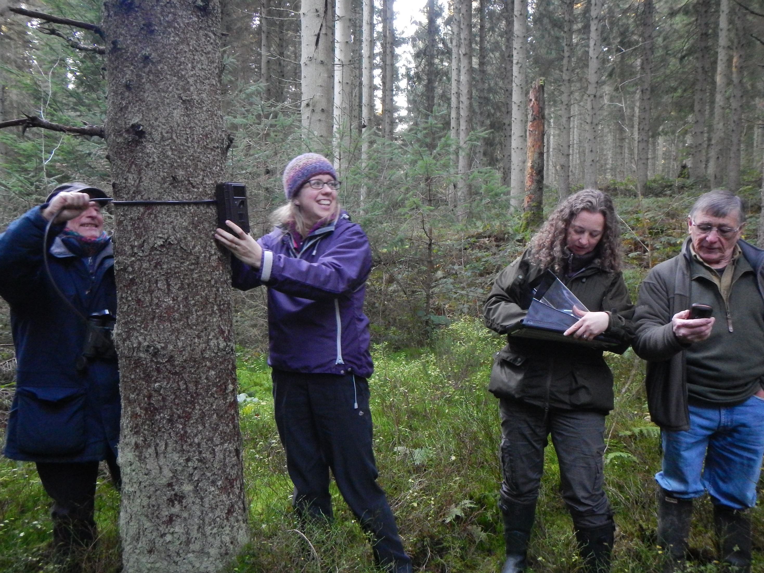
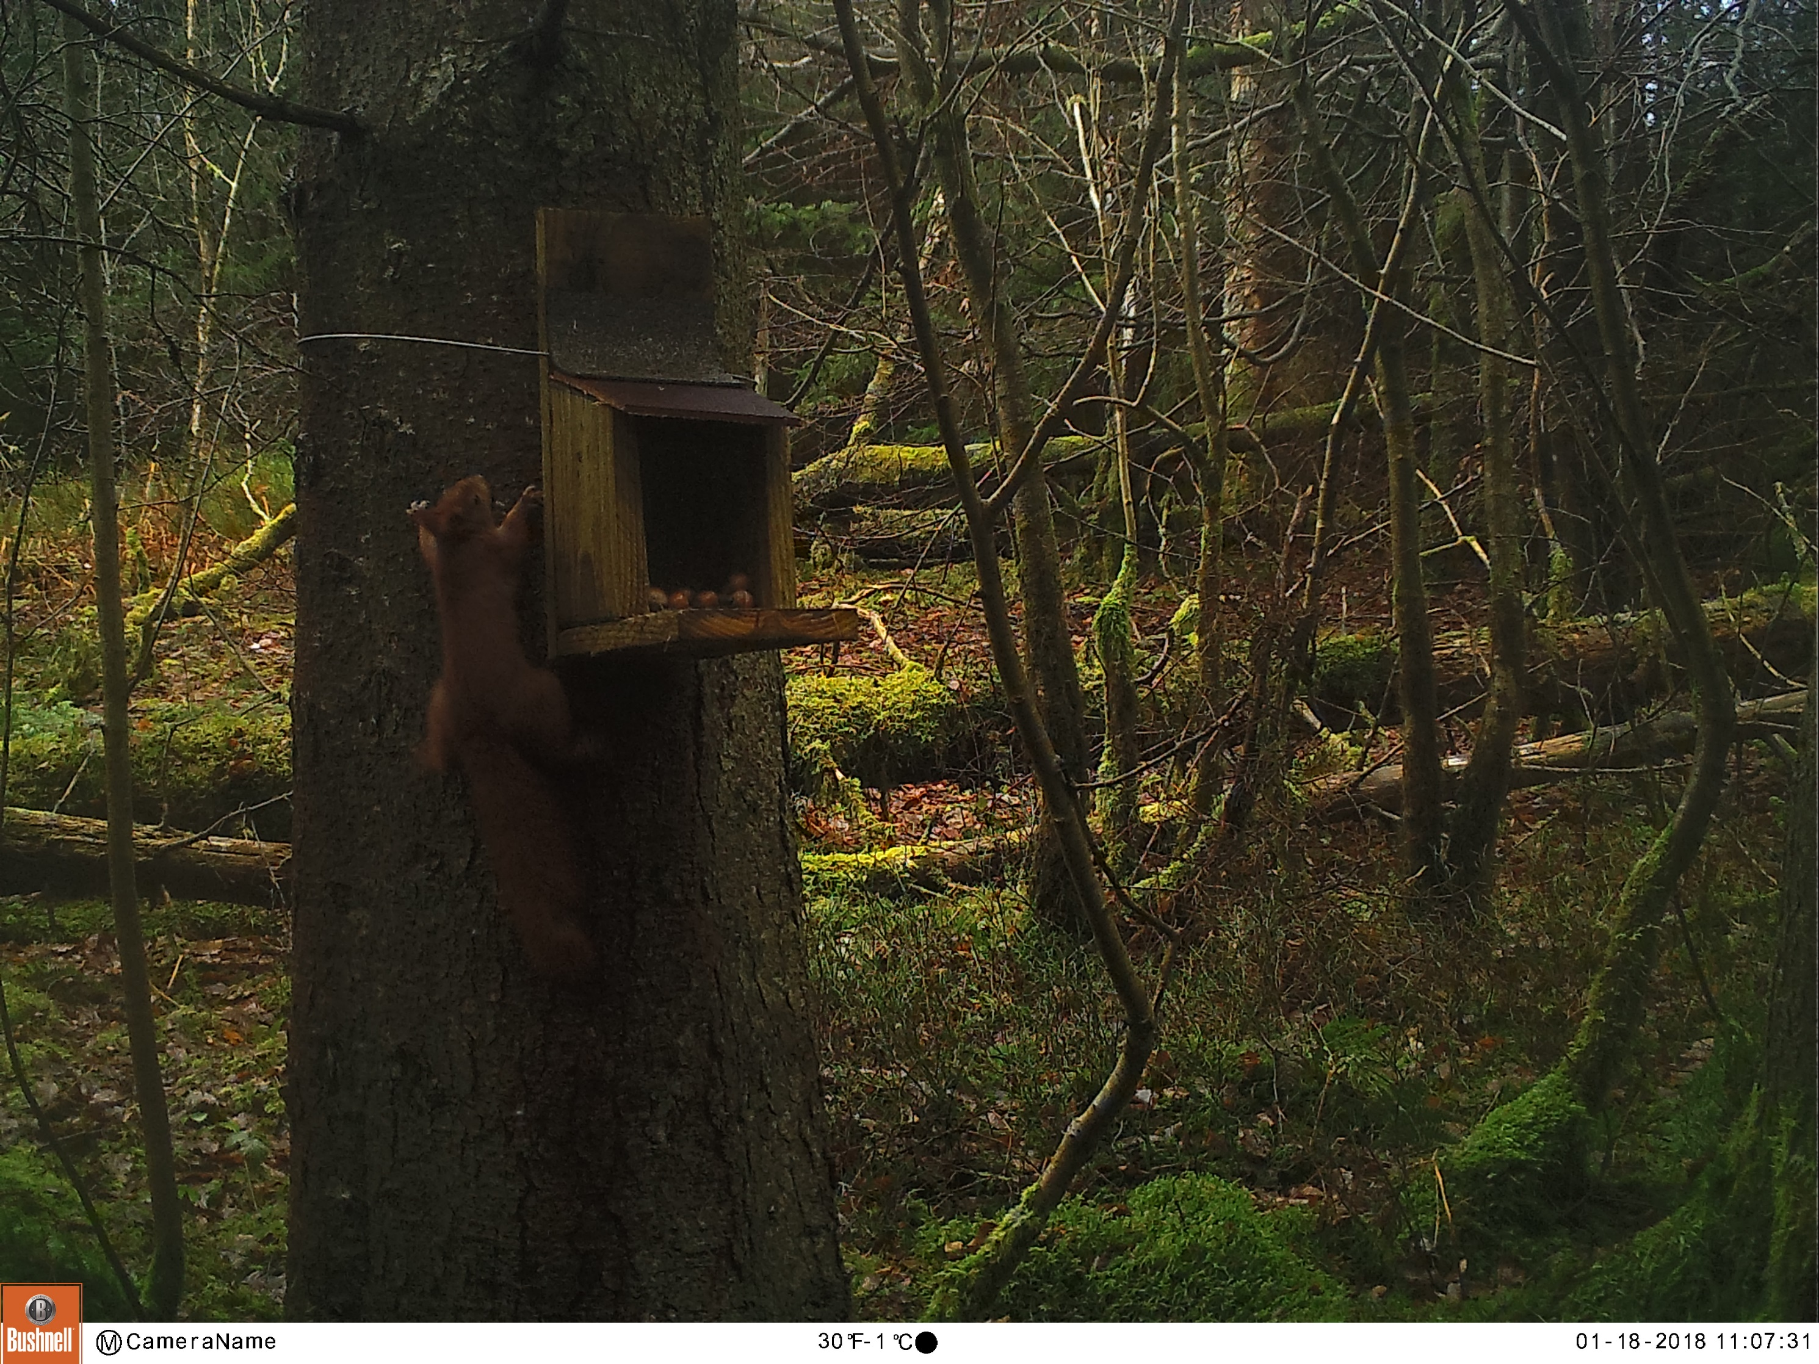
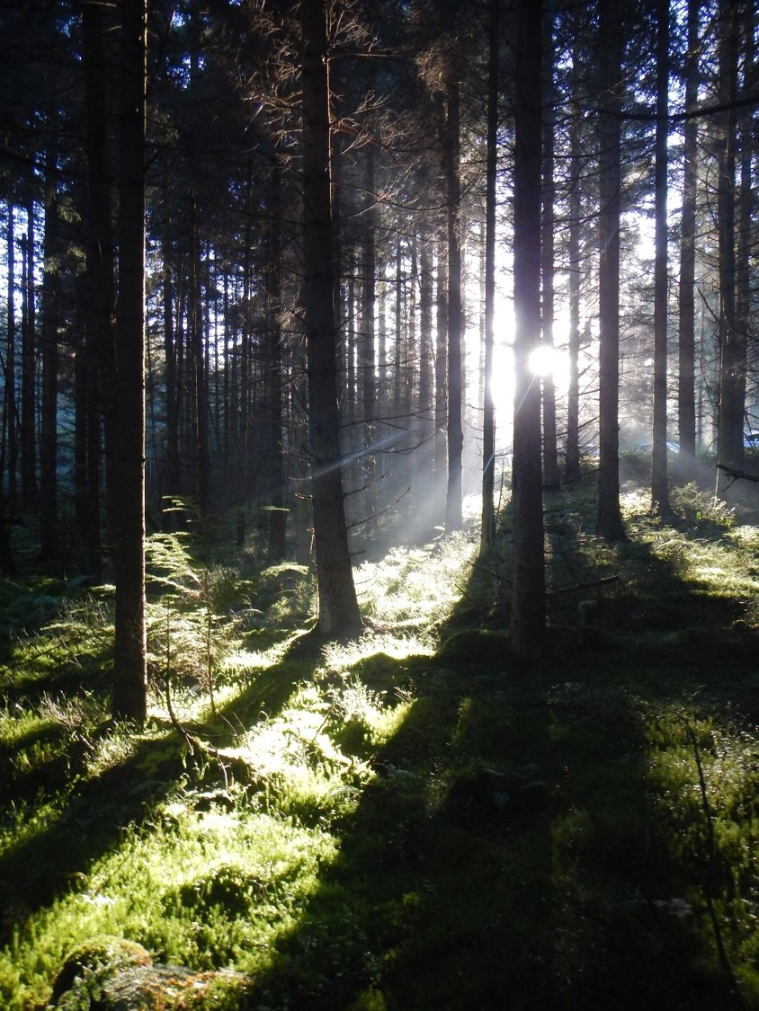
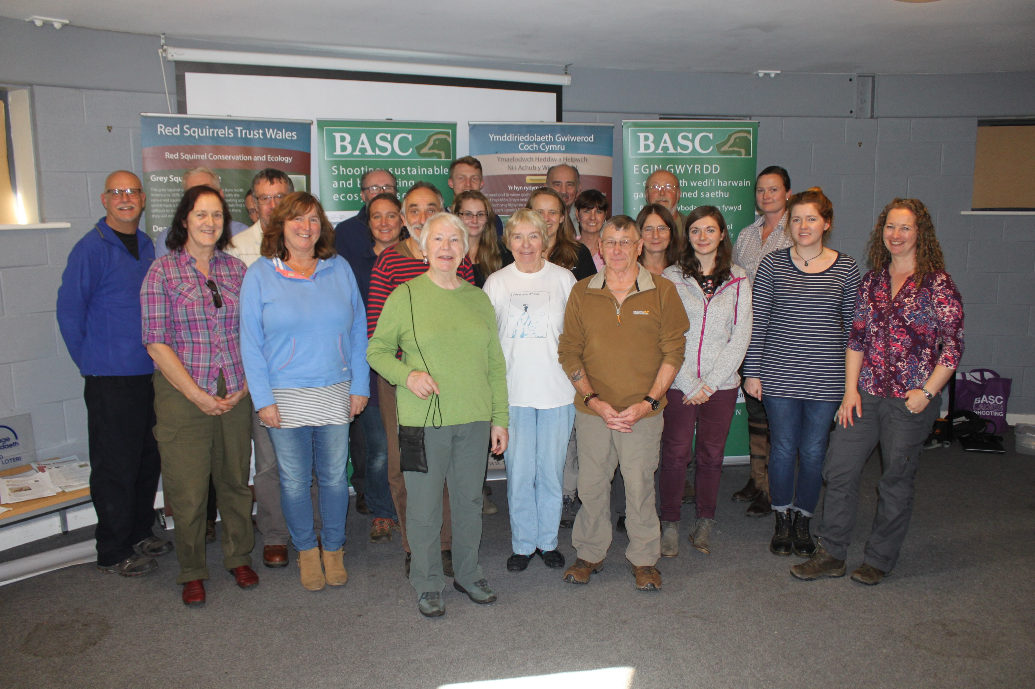
Clocaenog Forest
Holly Peek
Notes:
Cloc Forest location
Volunteer recruitment – from a zero base. Within 1 month of starting volunteers were out doing grey control and installing cameras.
Raising awareness – very few – could probably say no one! – knows that reds do still exist in Cloc Forest.
Reinforcement
Its all thanks to the vols who support the project and make up for my P/T hours.

Slide 7
Mid Wales Red Squirrel Partnership
Canolbarth Cymru Partneriaeth Gwiwerod Coch

Slide 8
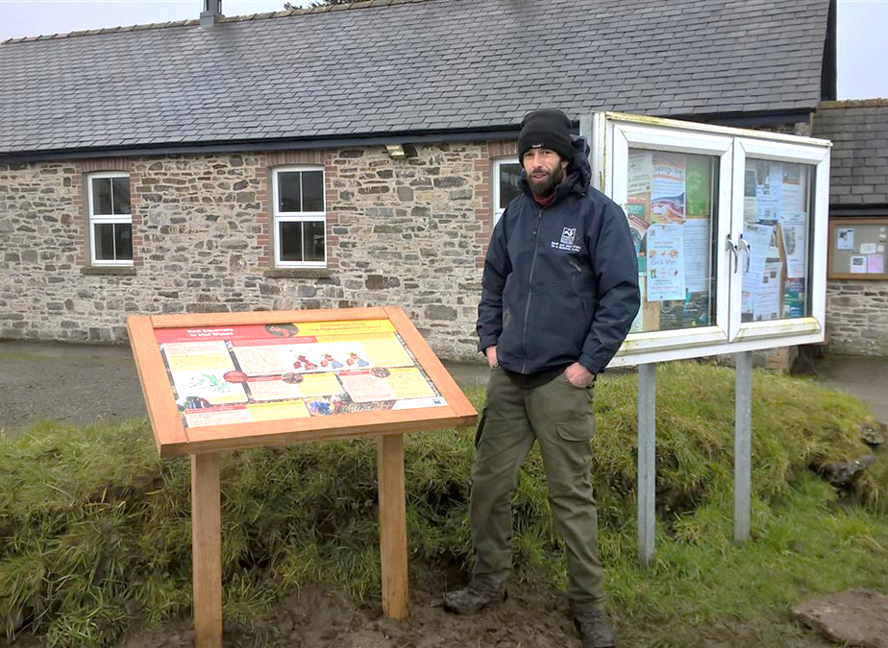
Notes:
MWRS Partnership set up in 2002, partnership of 2 x WTs, 3 x CC, NRW, private forestry companies & members of the public. Since 2016 Ben Allen GS control officer @ 2 days a week (RSU / HLF funded).

Slide 9
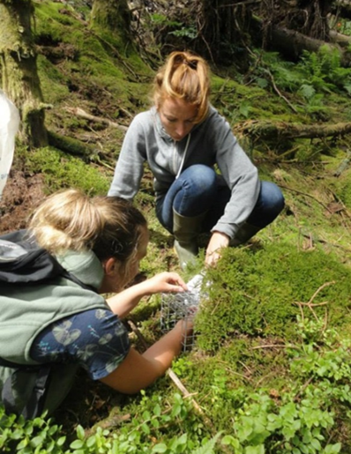
Grey Squirrel Control Officer
Network of volunteers
Local Co-Ordinators
Free loan of trapping equipment
Free access to training
Supplies of bait
Information packs
BASC TLS
Notes:
Grey squirrel control in the FS buffer – constant effort required.
Very little staff time, so GS control carried out by Private landowners under Glastir and some by NRW., but majority by trained volunteers. TLS members dispatched over 2.650 greys in past 2.5 years. Ongoing effort coordinated by volunteer coordinators = chance of sustainability once funding / project has ceased; aiming to create a trapping culture in the local area.

Slide 10
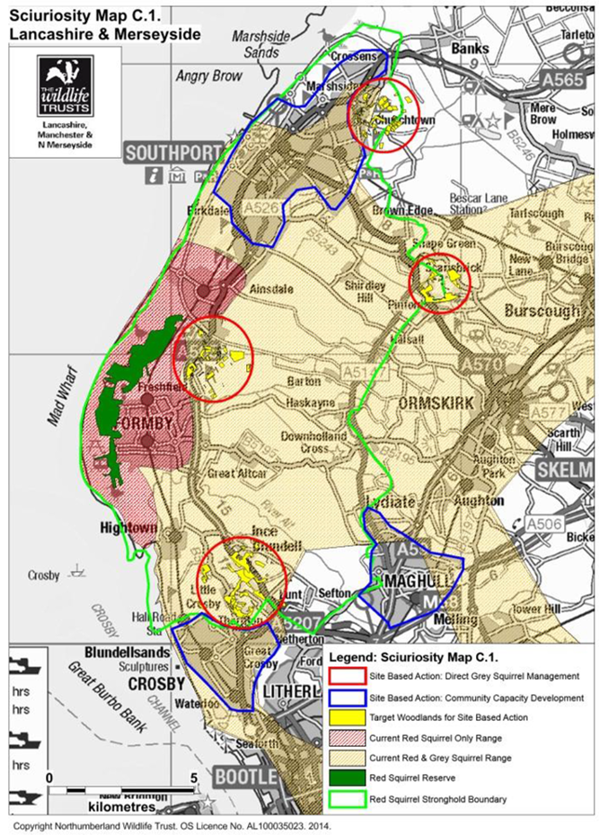
Merseyside and Lancashire
Grey squirrel control in an urban landscape

Slide 11
Urban grey squirrel management
Urban trap loan locations Sept 2016 – Jan 2018
Red Squirrel Ranger work Sept 2016 – Jan 2018

Slide 12
Squirrel monitoring
Monitoring programme
Increase in red squirrel numbers in coastal woodlands
Distribution remains stable
30 volunteers carrying out monitoring and surveying

Slide 13
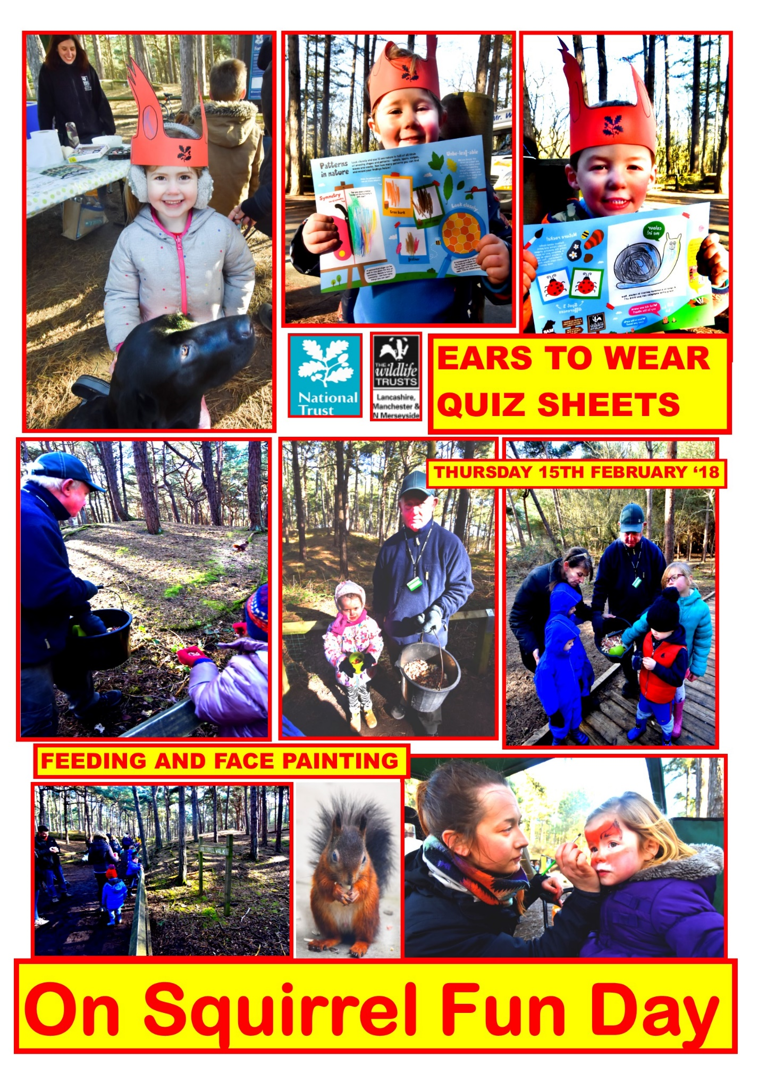
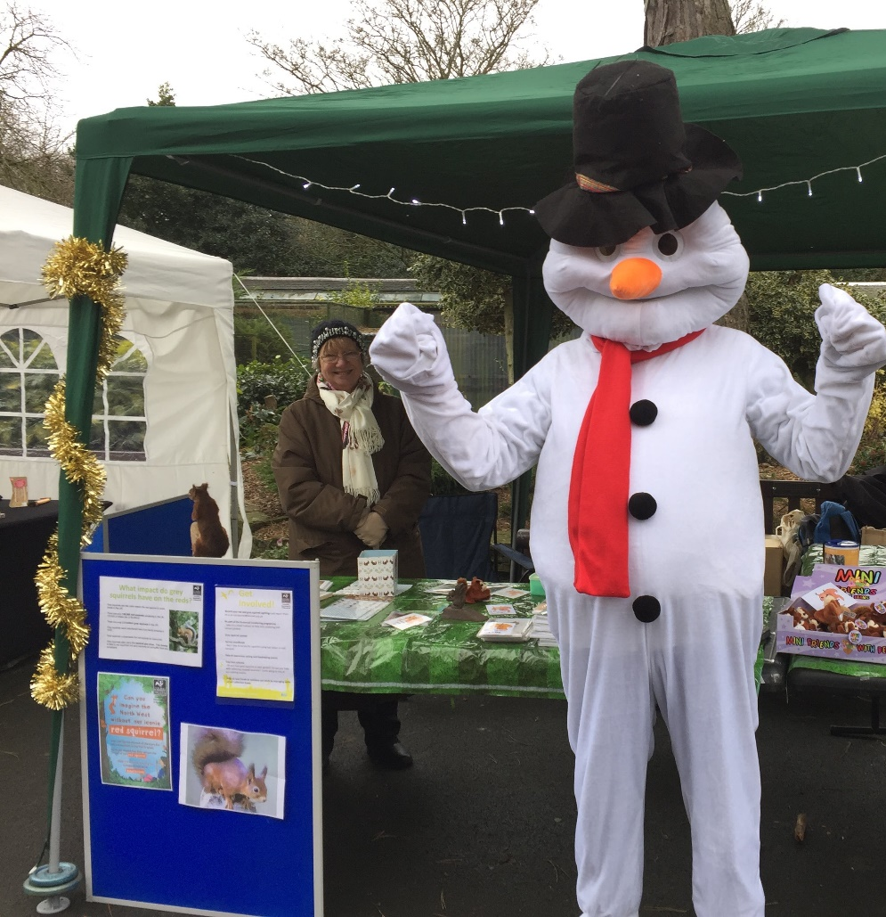
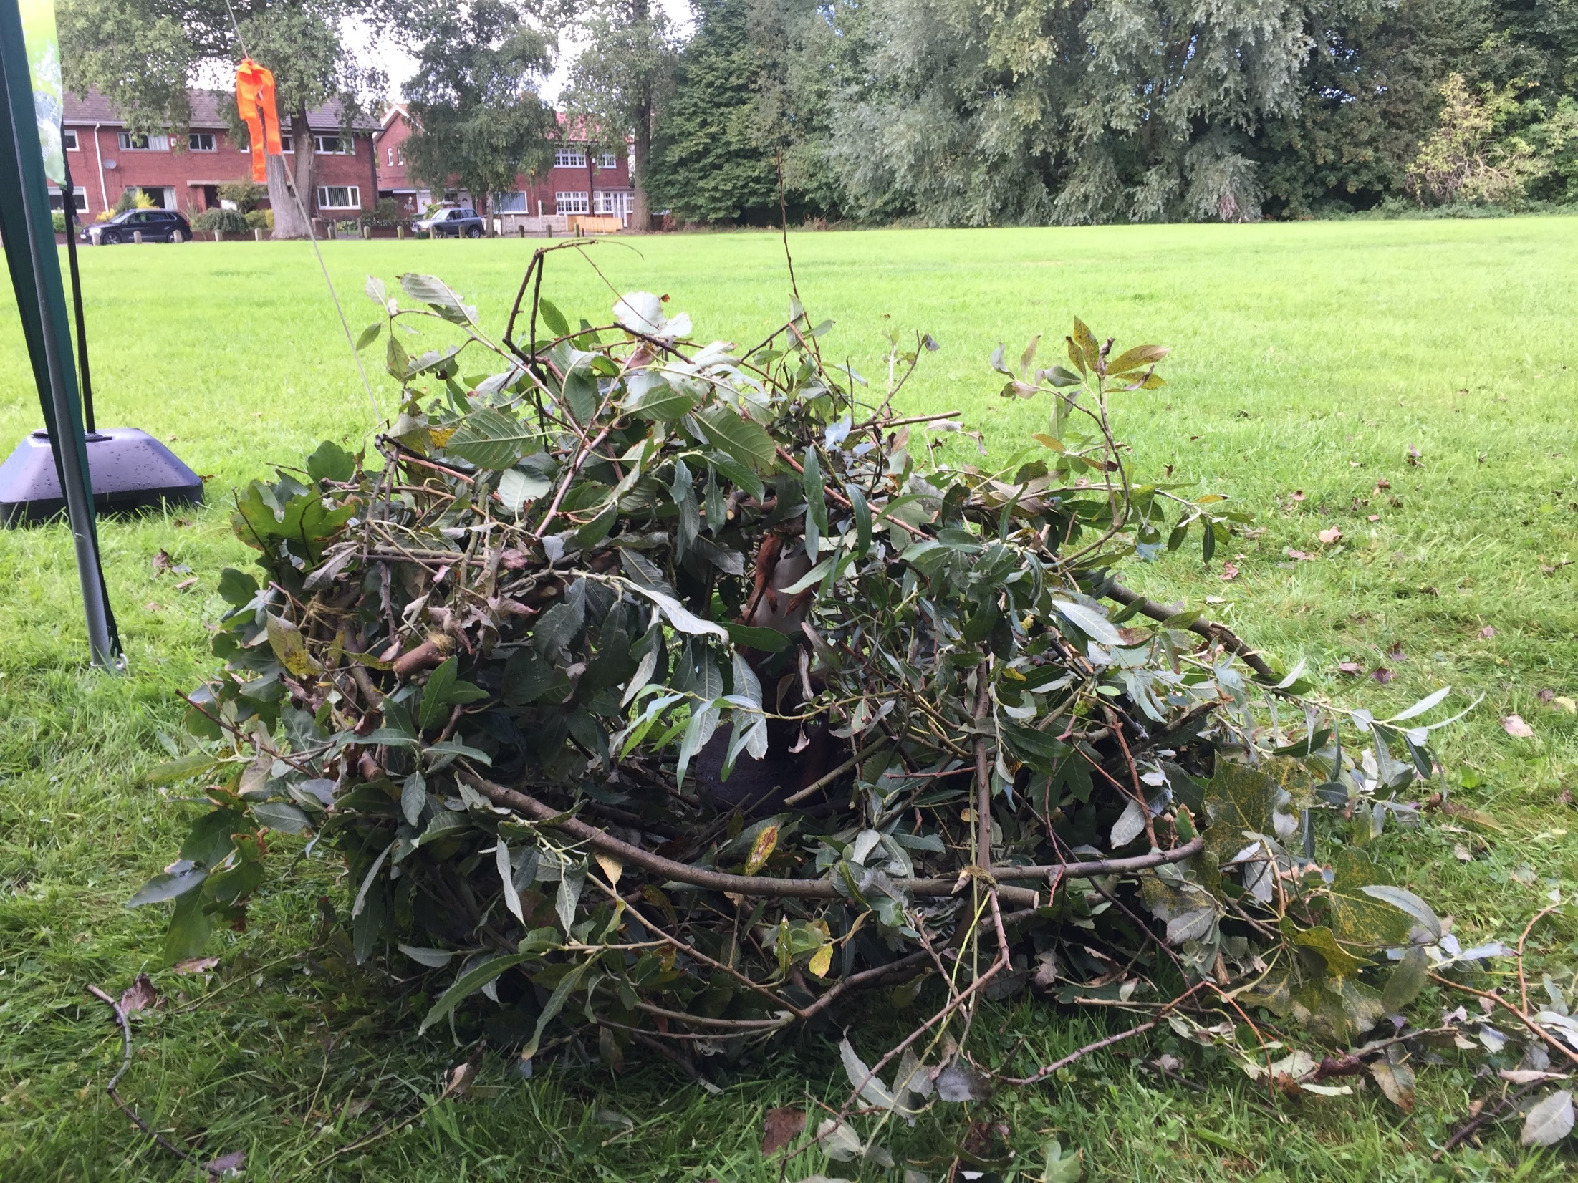
Community engagement
27 events, talks and workshops throughout Southport, Crosby, Formby and Magull
Approx. 1,000 people attended
Assisted by 20 volunteers

Slide 14
Northumberland Wildlife Trust

Slide 15
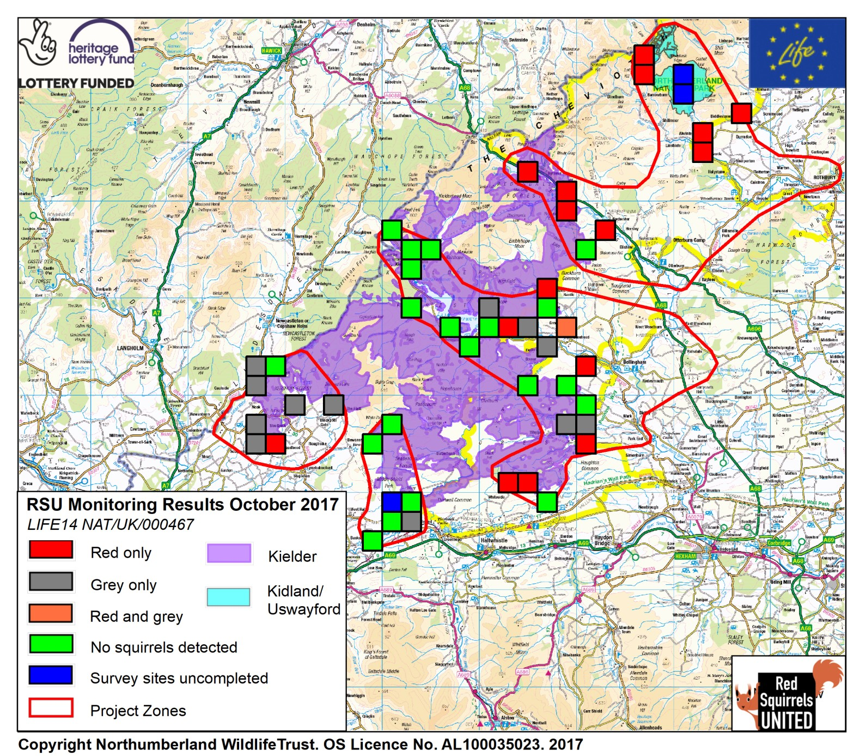
Action C3: Prevention of loss of English grey squirrel free woodlands Action lead: Northumberland Wildlife Trust
Successful protection of 350km² of woodland from grey colonisation: Kielder, Kidland & Uswayford
Establish early warning system around fringes of forests
Carry out grey squirrel management in 4 zones systematically recording all data
Increase community participation & ownership of project
Project team: Mike Green (Ranger North Cumbria) Craig Banks (Ranger North Tyne) Bonnie Sapsford (Data & Monitoring Officer 50%) Simon O’Hare (project lead 16%) & contractor sipport

Slide 16
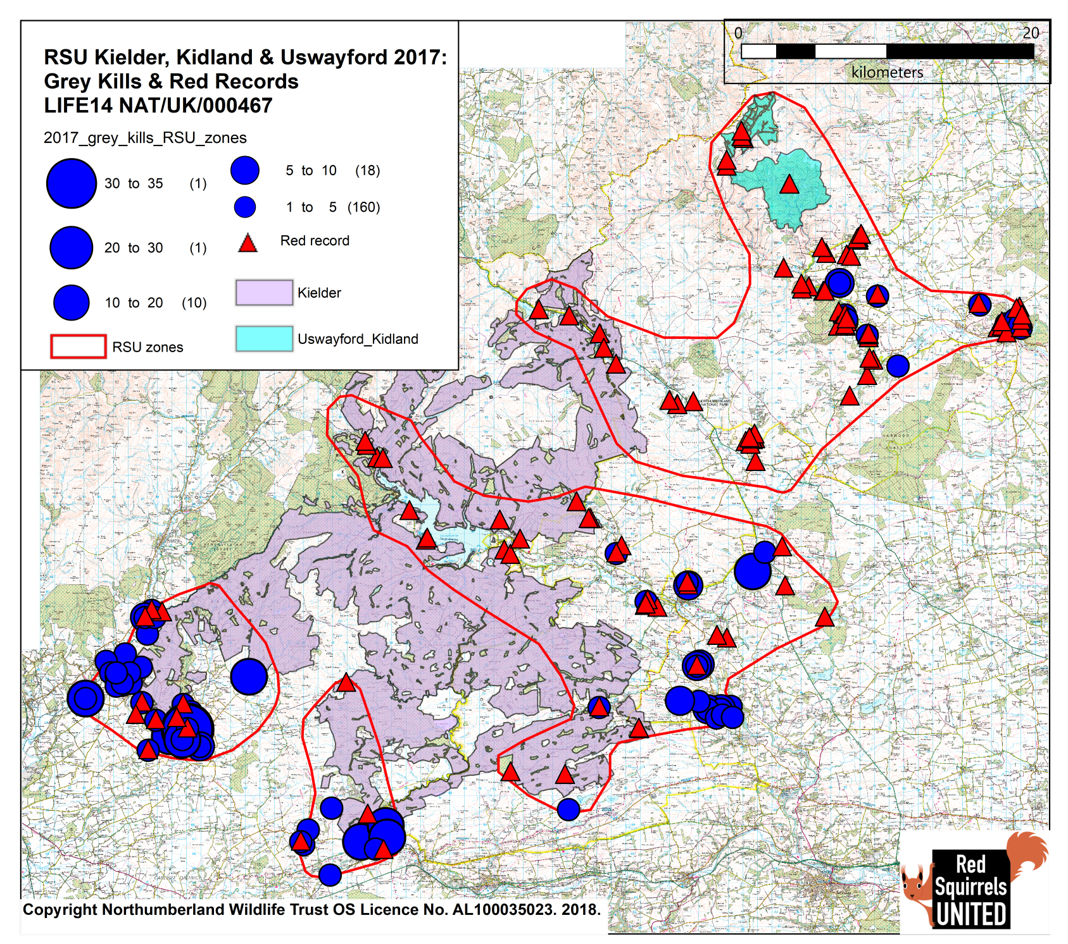
Action C3: Prevention of loss of English grey squirrel free woodlands Action lead: Northumberland Wildlife Trust
Progress to date
Ongoing grey squirrel management with minimal animals caught within main forests
6 repeats of quarterly early warning system trail cam monitoring in 50 sites
No greys detected in Kidland & Uswayford
Increase of volunteer monitoring delivery from 37% (Oct 2016) to 80% (January 2018)
No SQPV recorded in reds in main forests
Limited community participation in remote areas but successful engagement in areas of higher population (e.g. 80 attendees at event in Rothbury)
Challenges ahead
Evolving rapid response to greys captured on camera
Increasing and sustaining community participation in remote areas

Slide 17
Ulster Wildlife

Slide 18
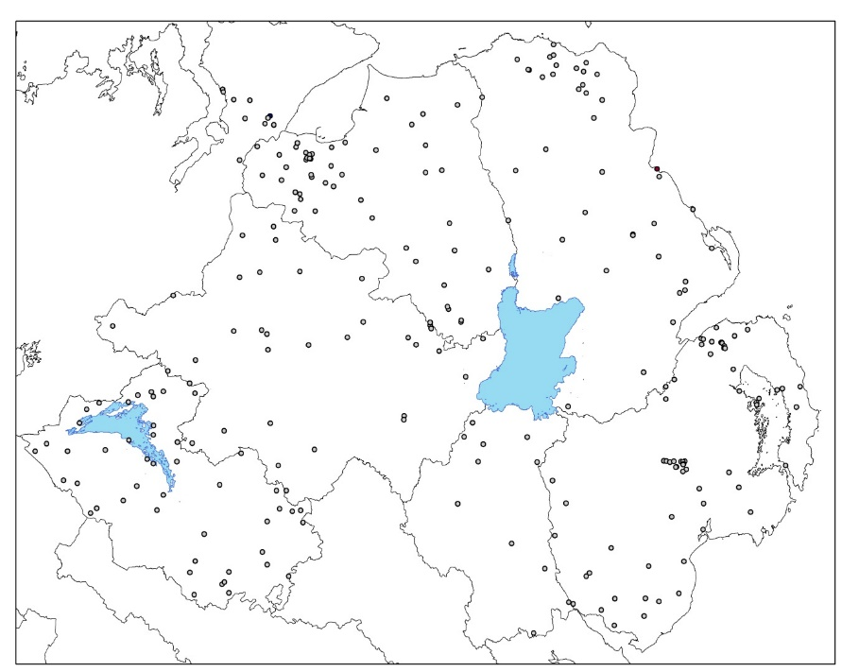
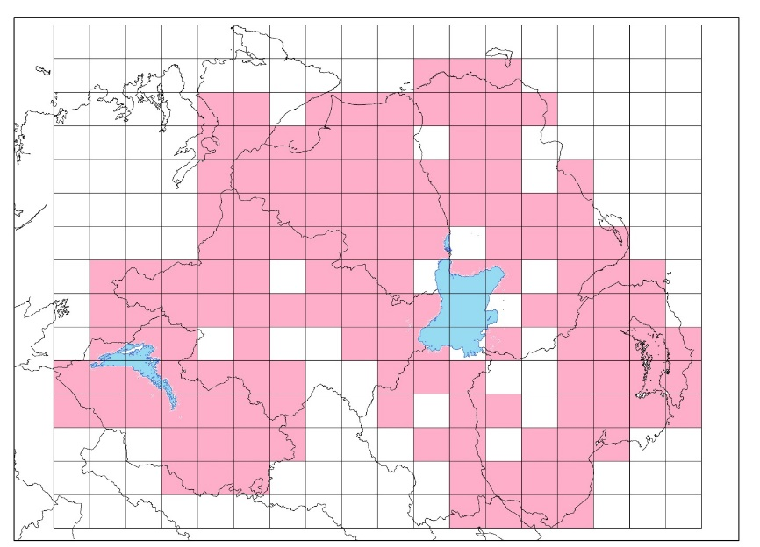
Action C.4: NI Presence/Absence Survey
County | County area (km²) | Survey sites per 10km² (effort) | Number of woodlands surveyed | No. of sites with red squirrel (%) | No. of sites with grey squirrel (%) | No. of sites with pine marten (%)
Antrim | 3095.63 | 0.14 | 41 | 15 (36.6) | 5 (12.2) | 7 (17.1)
Armagh | 1325.86 | 0.08 | 11 | 2 (18.2) | 4 (36.4) | 2 (18.2)
Donegal | 4857.44 | 0.02 | 11 | 3 (27.3) | 2 (18.2) | 0 (0)
Down | 2498.76 | 0.22 | 54 | 9 (16.7) | 23 (42.6) | 11 (20.4)
Fermanagh | 1850.59 | 0.25 | 46 | 20 (43.5) | 0 (0) | 19 (41.3)
L/Derry | 2121.13 | 0.2 | 42 | 4 (9.5) | 13 (36.0) | 0 (0)
Tyrone | 3264.88 | 0.1 | 32 | 6 (18.8) | 3 (9.4) | 4 (12.5)
Figure 1: Woodland sites surveyed in the 2017survey (n=235)
Figure 2: The number of volunteer fieldworkers recruited at each survey workshop
Table 1: Survey summary
Figure 3: Coverage in 10x10 squares of the 2017 survey (pink areas contain at least one survey site)

Slide 19
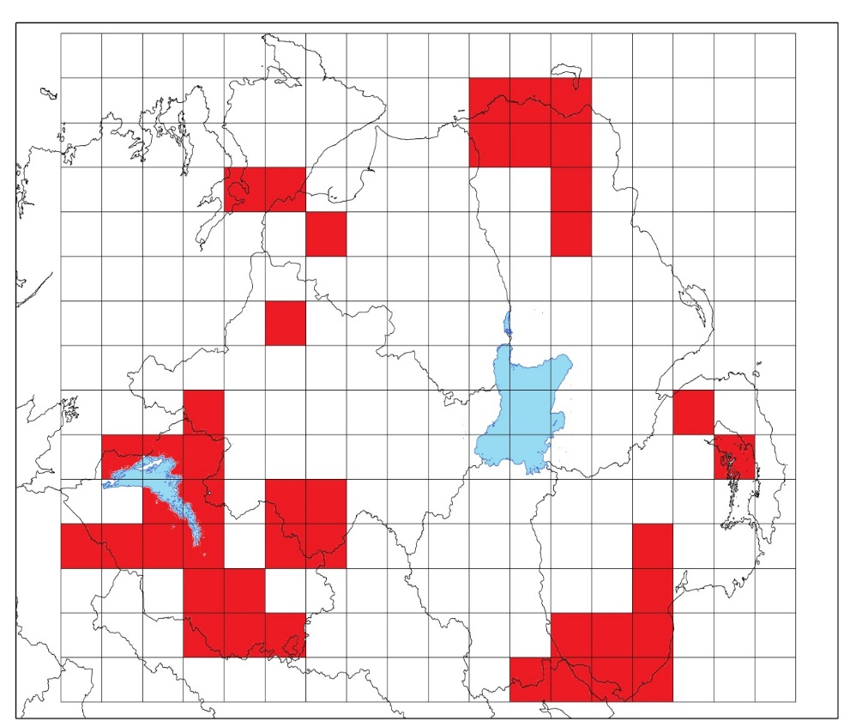
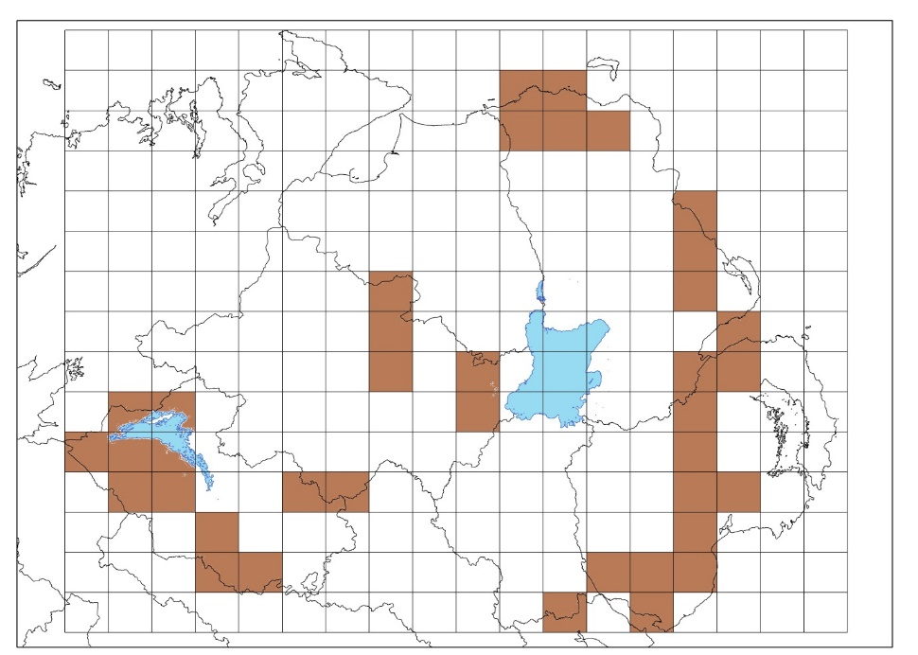
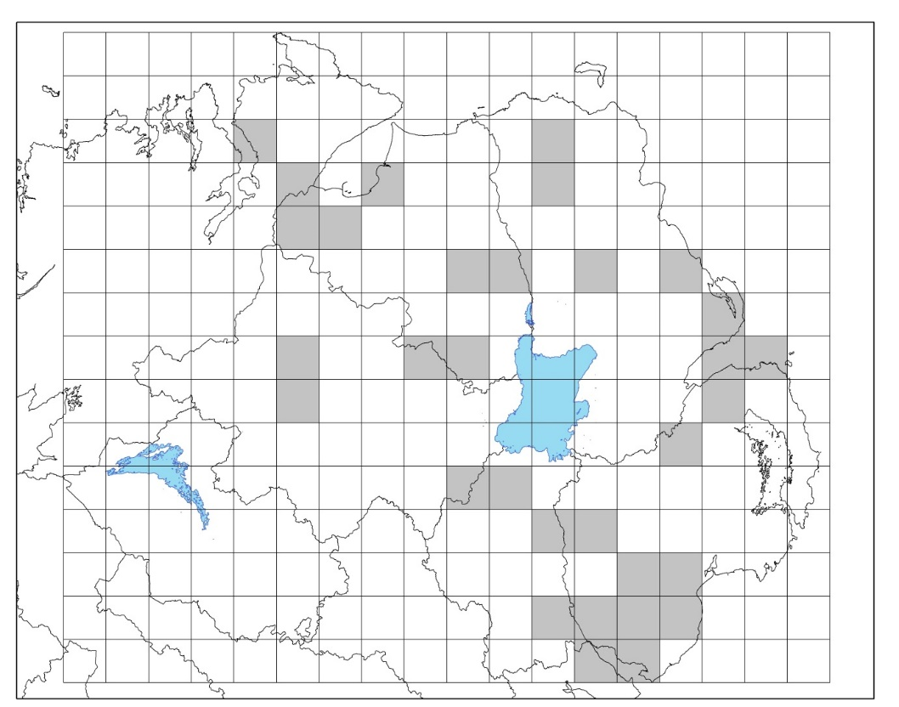
Figure 4: Squares which contain at least one record of a red squirrel during the 2017 survey
 | 2014/2015 survey | 2017 survey (not including Inishowen peninsula squares)
Coverage | Missed 41 10 km2 squares | Missed 36 (3 additional in Donegal)
Number of squares with grey | 55 | 31
Number of squares with red | 40 | 41
Number of squares with pine marten | 46 | 38
Number of squares with grey and red | 10 | 10
Number of squares with grey and pine marten | 9 | 10
Figure 8: Squares containing at least one record of pine marten during the 2017 survey
Figure 5: Squares which contain at least one record of a grey squirrel during the 2017 survey

Slide 20
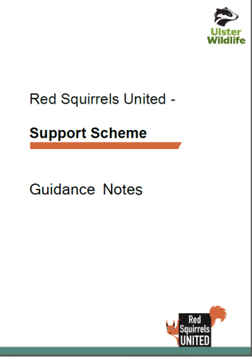
Action C.4: Key Performance Indicators
Activity | Progress
Complete eradication of IAS grey squirrels from the chosen eradication zone (either the Ards Peninsula, the Glens of Antrim or the Inishowen Peninsula) through direct grey squirrel control and creation of a community based early warning and rapid response network. | Proactive woodland surveys is picking up red squirrels inside the eradication zone, majority of the conservation activity now targeting buffer zone around Mourne Mountains
Prevention of the IAS grey squirrel colonisation of Connaught (west of the River Shannon) through the establishment of a new early warning and rapid response community group in the board region between the Rivers Shannon and Erne. | Areas of Fermanagh where greys were historically situated have been monitored and no populations found. Prevention work continuing with Derrylin gun club, west Tyrone along the Foyle and Clogher Valley, main pathways into the Fermanagh area.
Management planning and associated new IAS grey squirrel management work by 50 private landowners across northern Ireland. | Mapping work underway on a number of large landowners. Small grants scheme also underway in supporting groups to create local grey squirrel strategies to ascertain areas response is occurring.
Seven existing squirrel community groups better supported to increase their membership by 10% | Membership up to 11% but some members no longer active currently standing at 8%
3 new IAS grey squirrel management groups established in Northern Ireland. | Number of avenues being purused including local interest in North Down, Fivemiletown, Drumquin, Omagh, Rostrevor, Cityside, Larne and Broughshane.
36 local media/per year hits over 3 years (newspaper/local radio). | 52 media releases achieved with total circulation of 2,097,915
15 capacity building events held to improve effectiveness and expertise of grey squirrel control across the project life cycle. | 7 Grey Squirrel Management Events
50 community engagement activities held across Northern Ireland | 65 Commmunity Engagement Events
42 training sessions hosted for local groups in each region on topics identified by each group over course of project. These may involve topics such as grey squirrel management, squirrel surveying or community engagement. | 12 Training Sessions for Local Voluntary Groups
Other Outputs
Support Scheme Currently Live – Deadline end of February

Slide 21
Forest Research

Slide 22
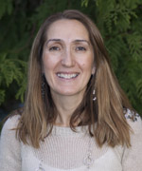
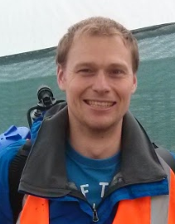
Research attitudes in case study areas and wider population
Monitor and assist with engagement and outreach
Identifying gaps & assisting with knowledge transfer
RSU project evaluation and legacy

Slide 23
Knowledge & attitudes research
Progress to date
Nationwide survey on public attitudes towards squirrels and their management (n=3758)
Interviews/focus groups in case study areas with volunteers (n=35) and project staff
Short community survey around knowledge of local action and barriers to involvement (~134 to date)
Landowners and other important local stakeholders

Slide 24
Newcastle University

Slide 25
Newcastle University: assessing progress in RSU
Our Role
‘Evaluate and inform grey squirrel management
What have we been doing?
Working with project partners to ensure all relevant data is correctly recorded
Developed recording sheets
Developed grey squirrel control advice with Evidence Review Group
Building bespoke models to evaluate the project progress in spaces and time
Notes:
No ‘off-the–shelf’ models are suitable for determining the level of success of the conservation actions so NU are building bespoke models to evaluate the project progress in space and time.
Will discuss.
Best methods for communicating findings with partners ( what is useful)
How to inform management planning ( improve on current)
Spatial model sets ( Have been constructed and will be added to)
Annual report ( completed Oct 2017)

Slide 26
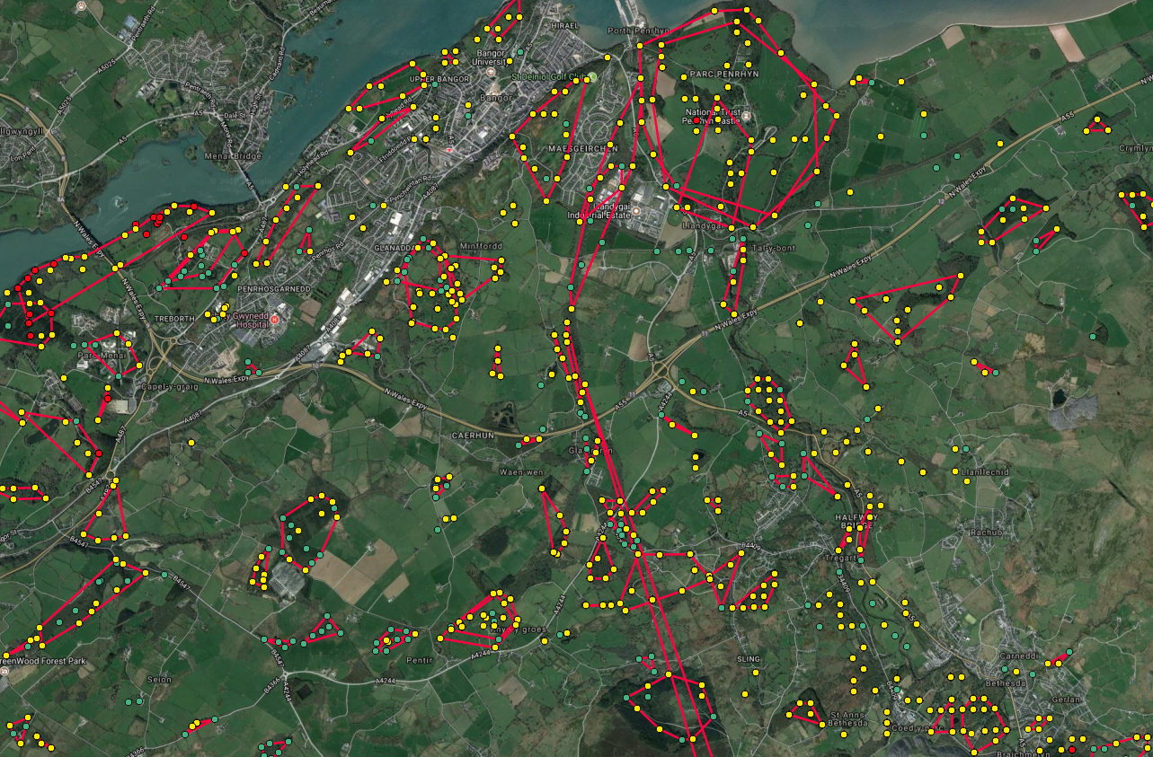
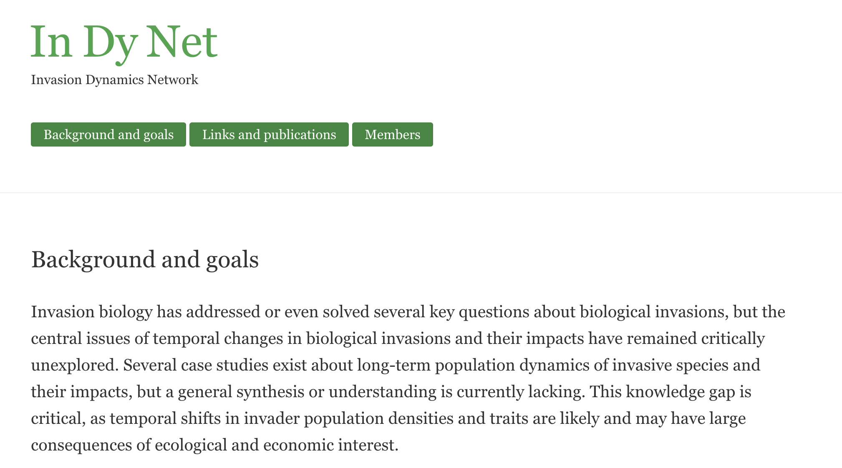
Added value
Student projects
MSc Wildlife Management student red squirrel reintroduction in Mourne Park.
BSc Zoology students: public attitudes towards squirrel management
Visiting researcher: Simone Caruso
Additional analysis for conservation actions, e.g. GIS pathways mapping for improved strategies
Enhance the suitability of the model framework for post project use
Academic visits: Berlin invasive species dynamics workshop

