Slide 1
Getting onto the front foot…
Towards a new strategy for red squirrel conservation and recovery
LIFE14 NAT/UK/000467
Stephen Trotter, CEnv MCIEEM, Chair RSU Advisory Group, Consultant Environmentalist

Slide 2
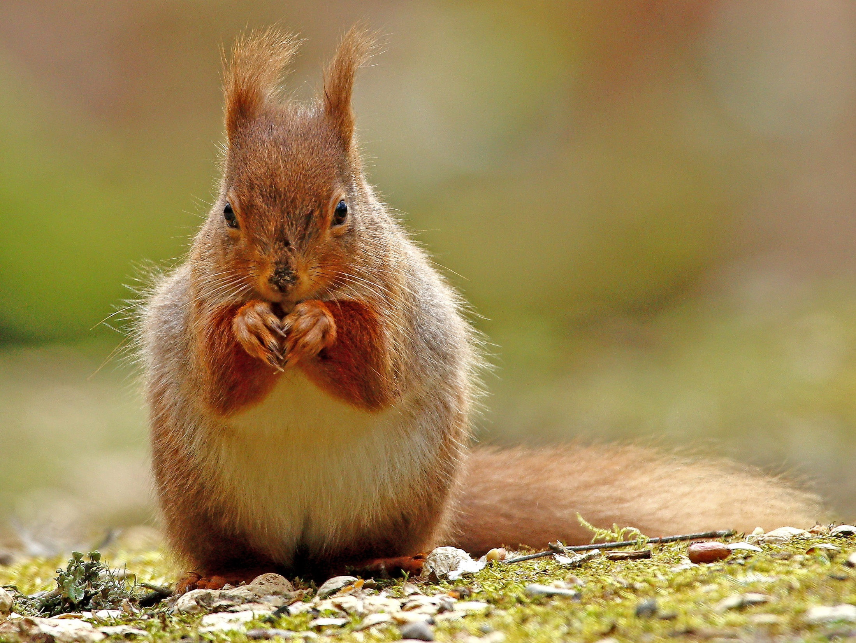

Slide 3
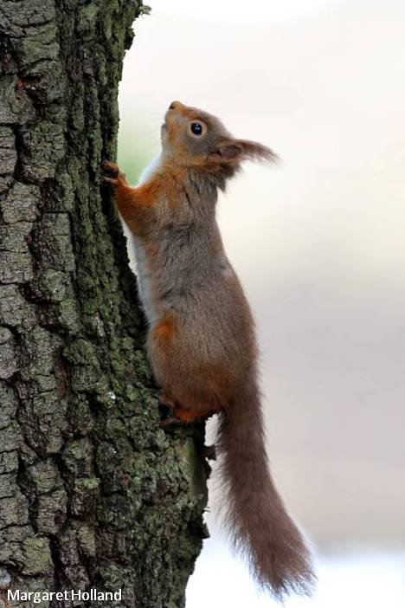
Scope of talk
How are we doing?
New policy context & red squirrels
Why a new strategy?
Vision and ambition
Developing the strategy
Immediate actions

Slide 4
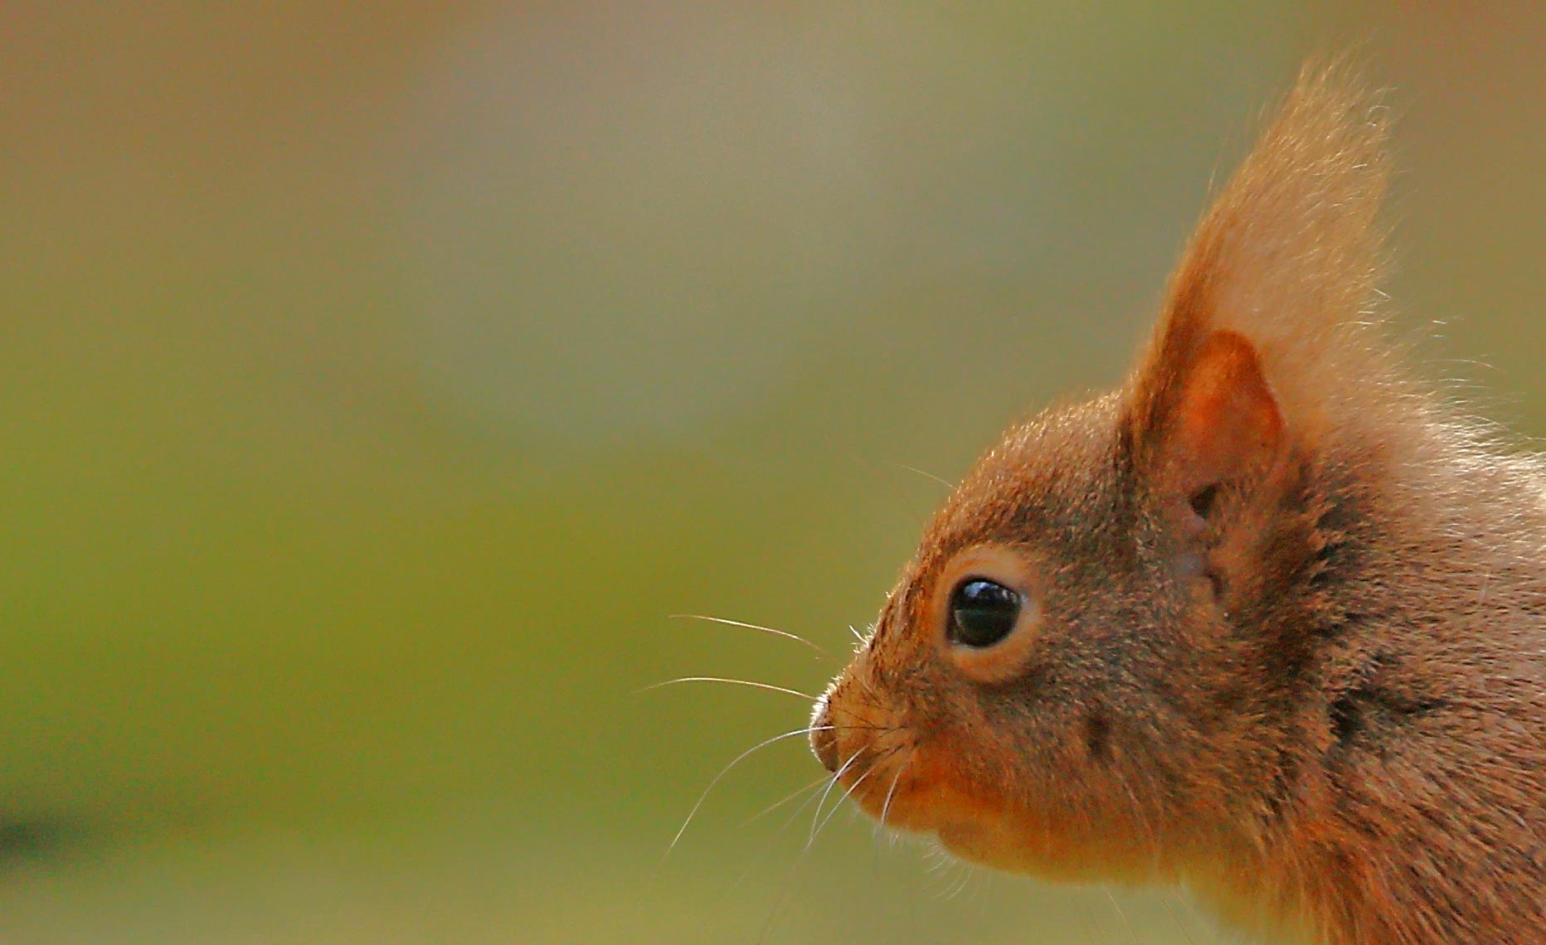
How are we doing?

Slide 5
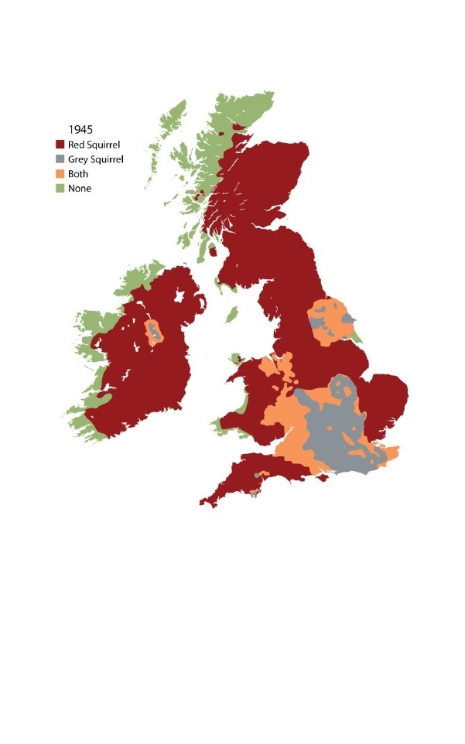
1945

Slide 6
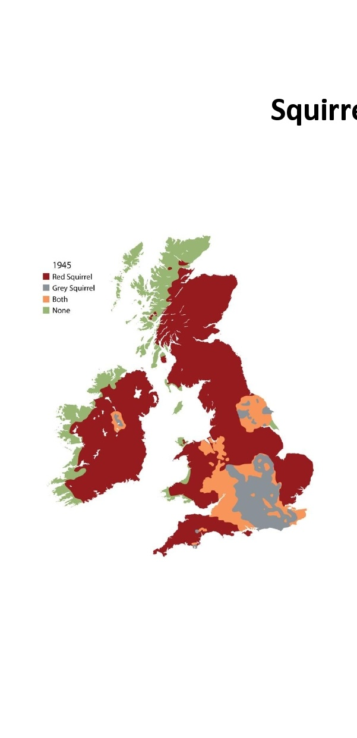
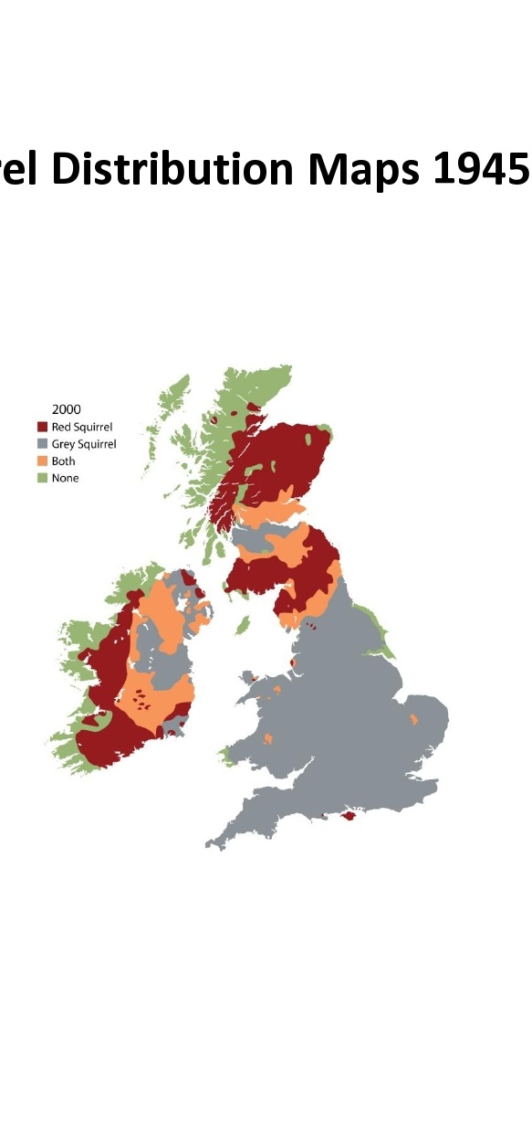
2000

Slide 7
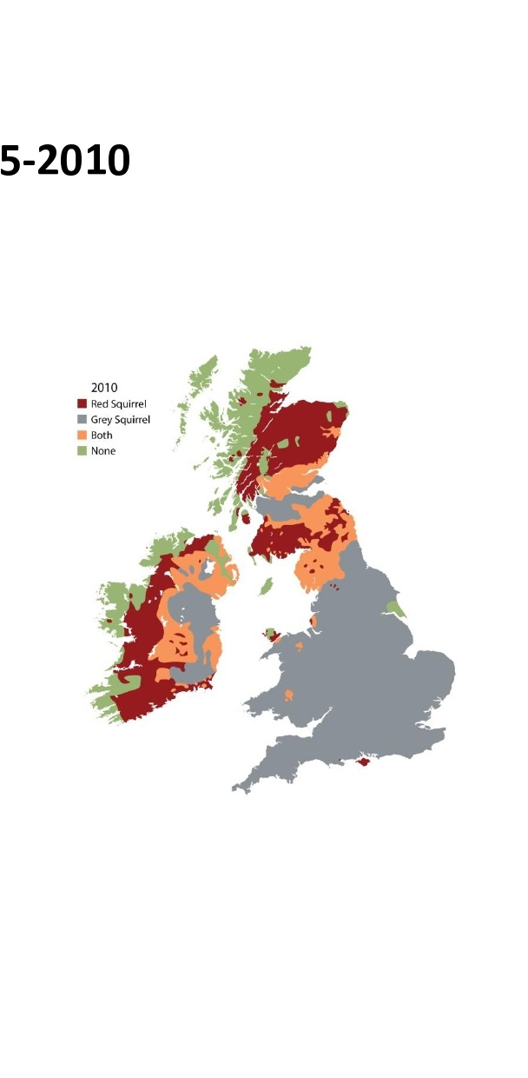
2010

Slide 8
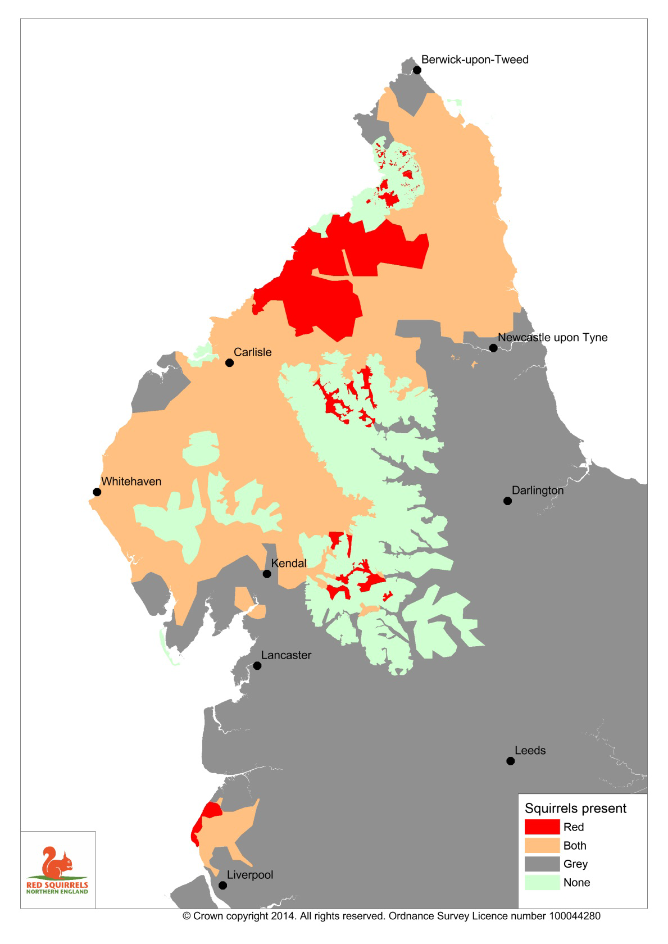

Slide 9
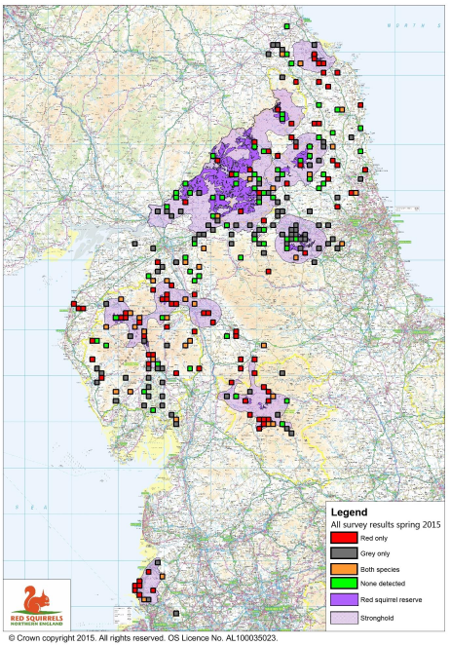
2015

Slide 10
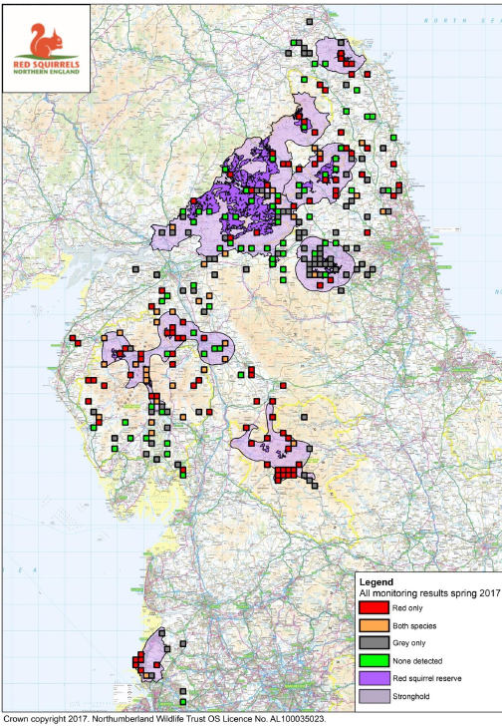
2015
2017

Slide 11
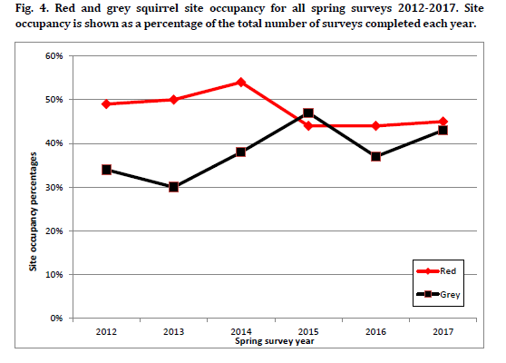
How are we doing?

Slide 12
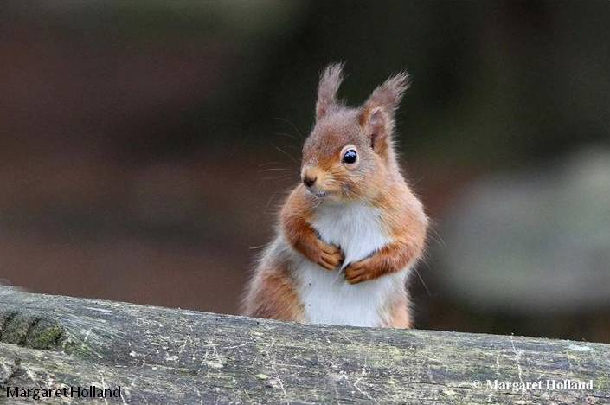
Mixed picture
Clear evidence that effective grey control does work
But the situation is precarious
Key challenges – scaling up – complete coverage of grey control – funding – exhaustion and fatigue – need new approaches to supplement the great work you are doing
Notes:
Mixed picture
Clear evidence that effective control is working
But the situation is precarious
Key challenges – scaling up – complete coverage of grey control – funding – exhaustion and fatigue – need new approaches to supplement the great work you are doing

Slide 13
Scope of talk
How are we doing?
New policy context & red squirrels
Why a new strategy?
Vision and ambition
Developing the strategy
Immediate actions

Slide 14
A new policy context
Brexit
25 Year Plan for the environment
Tree health
Funding - new approach to payments for land management

Slide 16
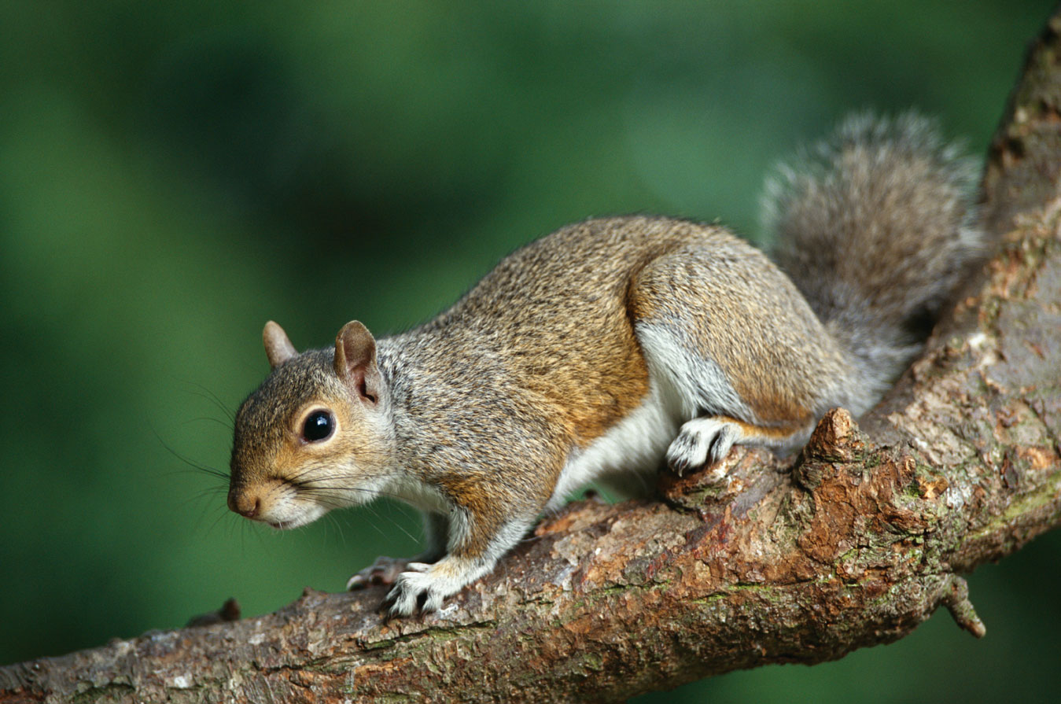
EU Regulation 1143/2014 on Invasive Alien Species came into force on 1 January 2015
Target 5 of the EU 2020 Biodiversity Strategy to combat invasive species …
By 2020, invasive alien species are identified, priority species controlled or eradicated, and pathways managed to prevent new invasive species from disrupting European biodiversity.
Notes:
The Regulation imposes strict restrictions on a list of species known as “species of Union concern”. These are species whose potential adverse impacts across the European Union are such that concerted action across Europe is required.
The first list of 37 species - 23 animals and 14 plants - was approved at a meeting of EU Member States in December 2015. The European Commission published the implementing regulation (2016/1141) in an Official Journal on 14 July 2016. The list came into force on 3 August 2016.
On 13 July 2017, the European Commission published Commission Implementing Regulation 2017/1263 which will add a further 12 species to the list of species of Union concern.

Slide 17
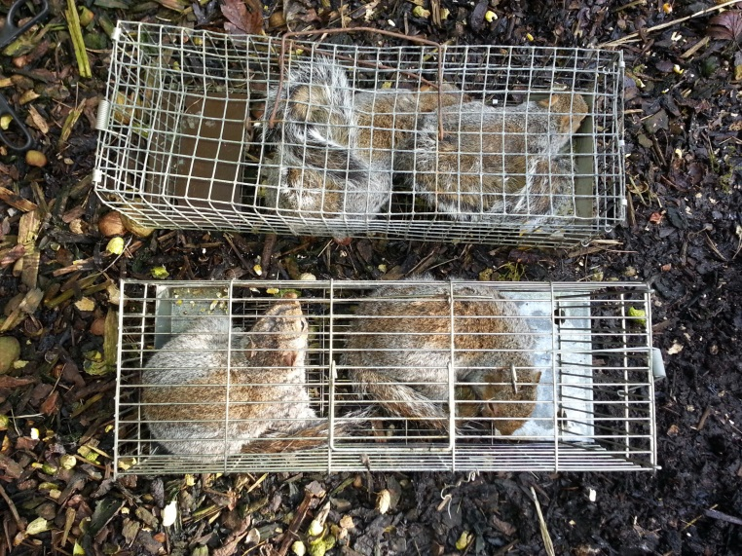
As invasive alien species do not respect borders,
coordinated action at the European level will be more effective
than individual actions at the Member State level.
Prevention:
Early detection and rapid eradication:.
Management:
Notes:
As invasive alien species do not respect borders,
coordinated action at the European level will be more effective
than individual actions at the Member State level.
Three distinct types of measures are envisaged, which follow an
internationally agreed hierarchical approach to combatting IAS:
Prevention: a number of robust measures aimed at preventing IAS of Union concern
from entering the EU, either intentionally or unintentionally.
Early detection and rapid eradication: Member States must put in place a
surveillance system to detect the presence of IAS of Union concern as early as possible
and take rapid eradication measures to prevent them from establishing.
Management: some IAS of Union concern are already well-established
In certain Member States and concerted management action is needed so that they
do not spread any further and to minimize the harm they cause.

Slide 18
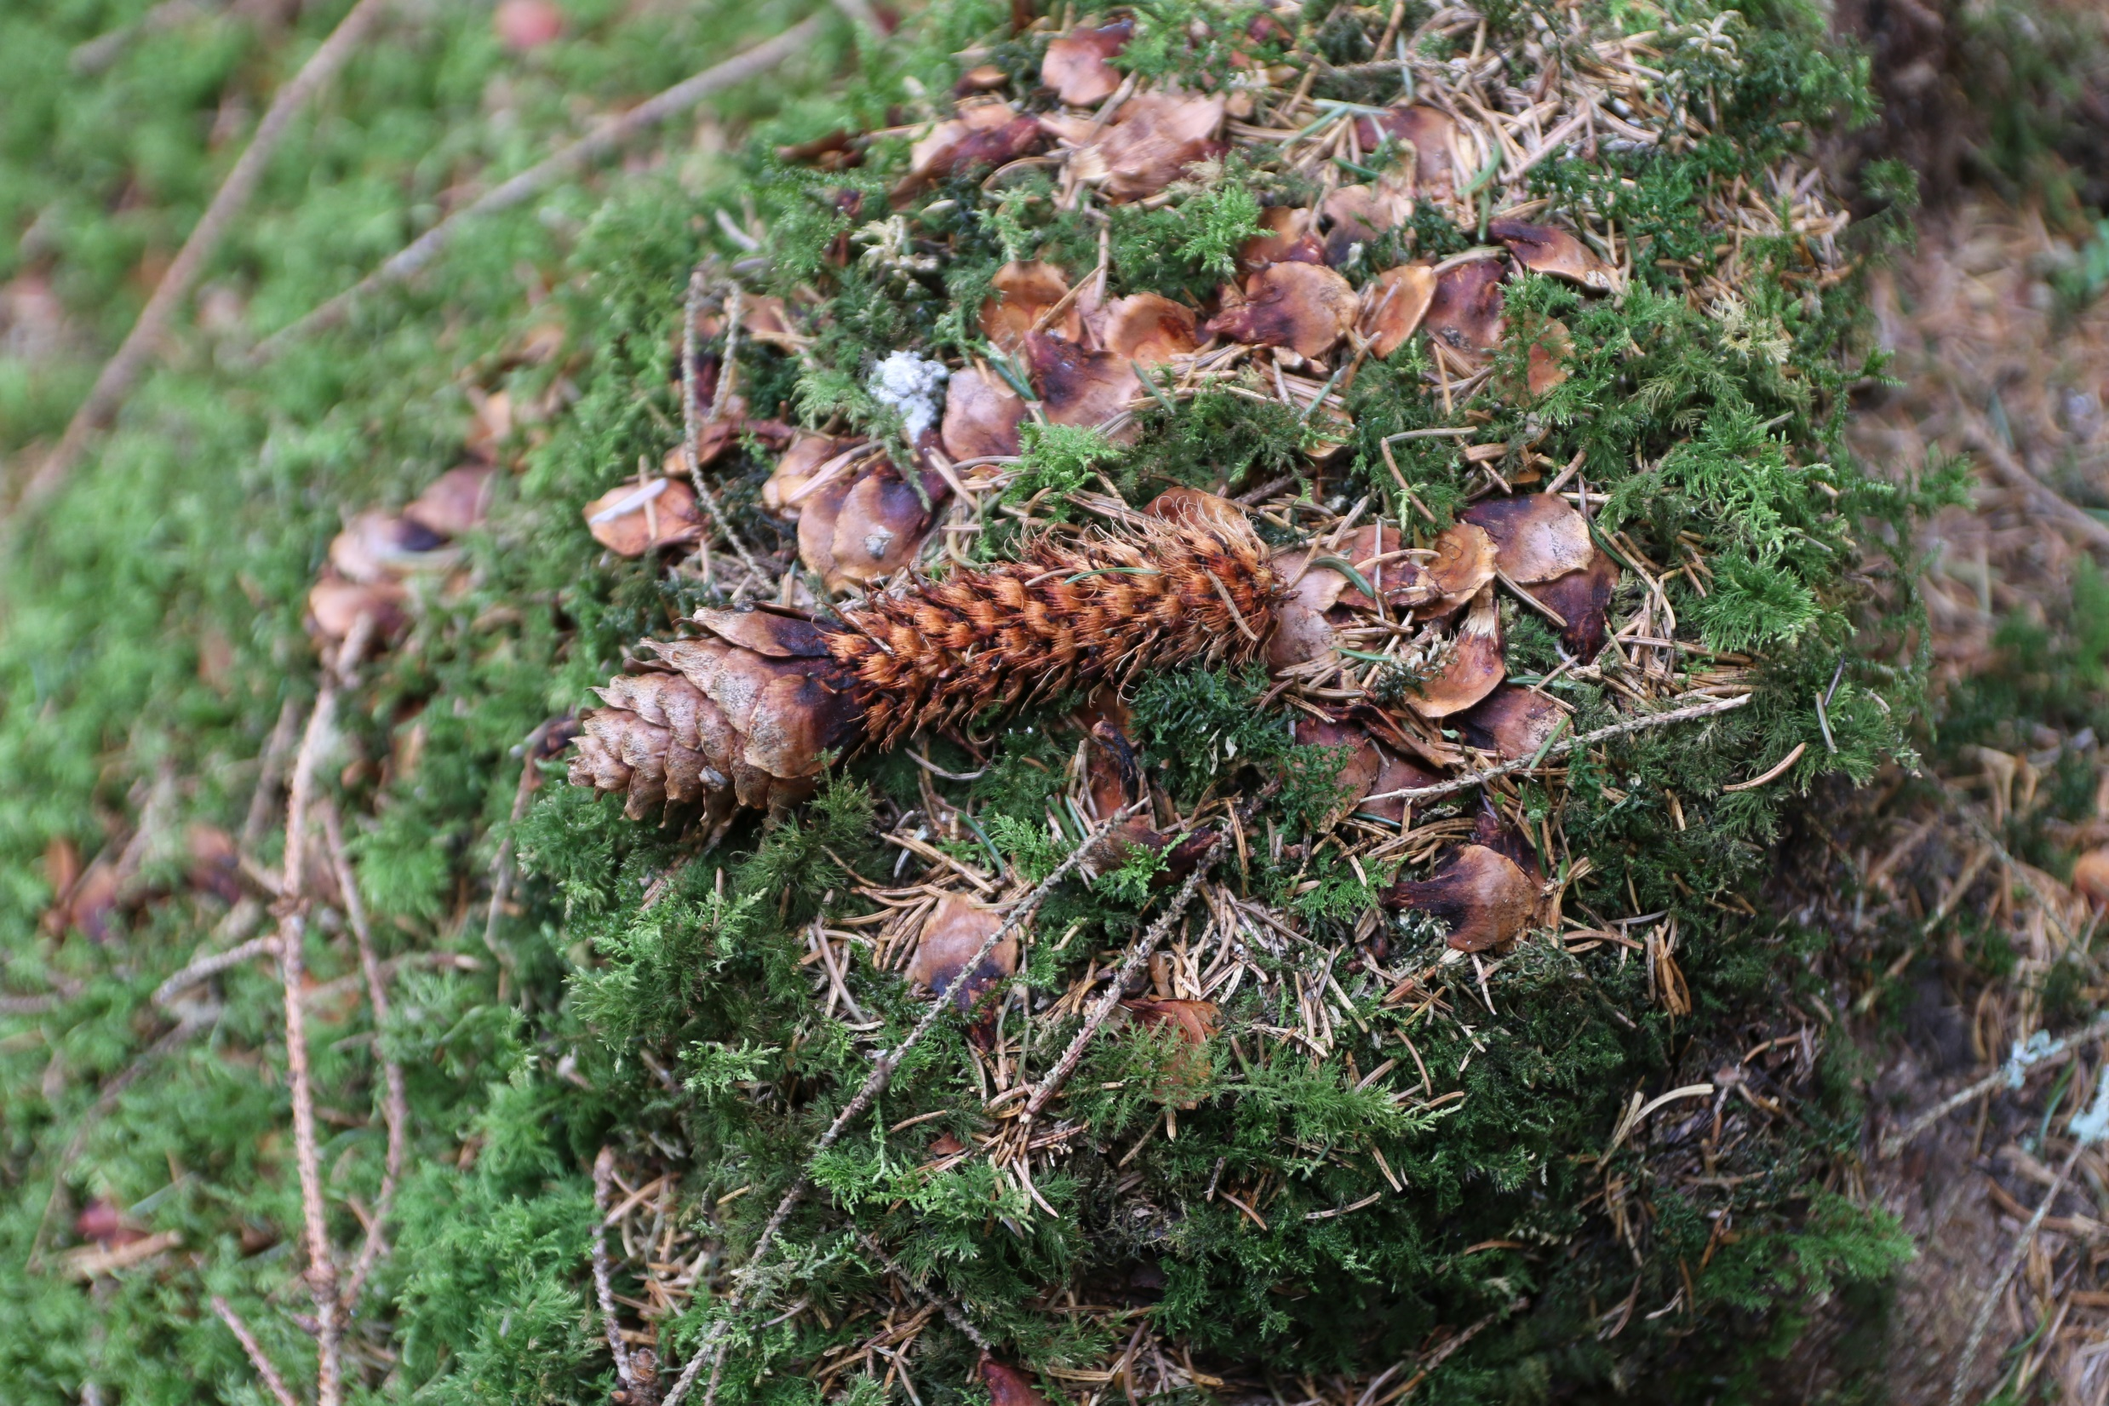
Will the EU IAS Regulation be repealed when we leave the EU?
Notes:
No, The European Union (Withdrawal) Bill, commonly referred to as the Repeal Bill, sets out the intention that EU law will in effect be converted into UK law, where possible, when the UK leaves the EU. Simply converting EU law into UK law will not be sufficient to ensure that there is a functioning statute book which provides certainty and continuity for individuals and businesses. The Repeal Bill will create temporary limited powers to make secondary legislation to enable changes to be made to the laws that do not operate appropriately once we have left the EU. It is expected, subject to the necessary legislation being laid, that the prohibitions under the EU IAS Regulation will continue to apply after we have left the EU.

Slide 19
“We want to improve the UK’s air and water quality and protect our many threatened plants, trees and wildlife species”
“Our environment plan sets out our goals for improving the environment within a generation and leaving it in a better state than we found it”

Slide 20
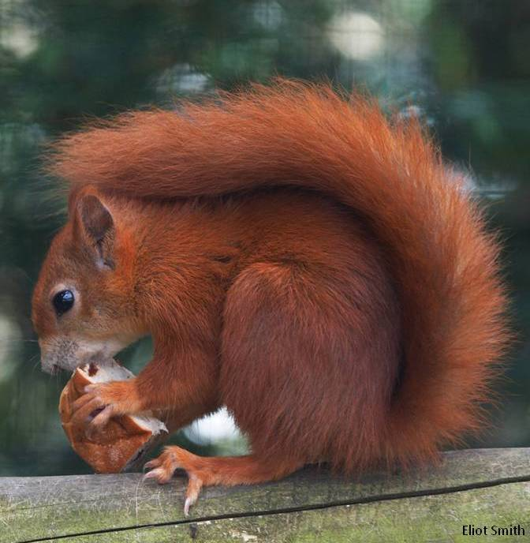
We will:
Develop a Nature Recovery Network to protect and restore wildlife, and provide opportunities to re-introduce species that we have lost from our countryside - an additional 500,000 hectares of wildlife habitat building on other plans for landscape-scale recovery for peatland, woodlands and natural flood management
We want to see local communities and businesses more involved
Voluntary partnerships and private sector sponsorship will help broaden the funding base for this exciting network

Slide 21
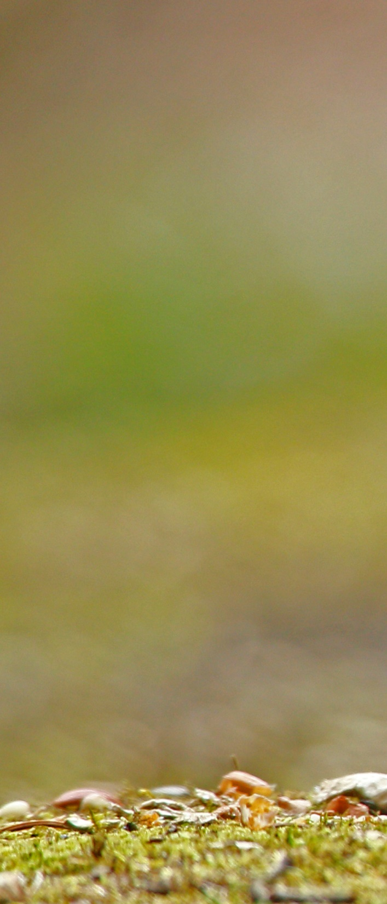
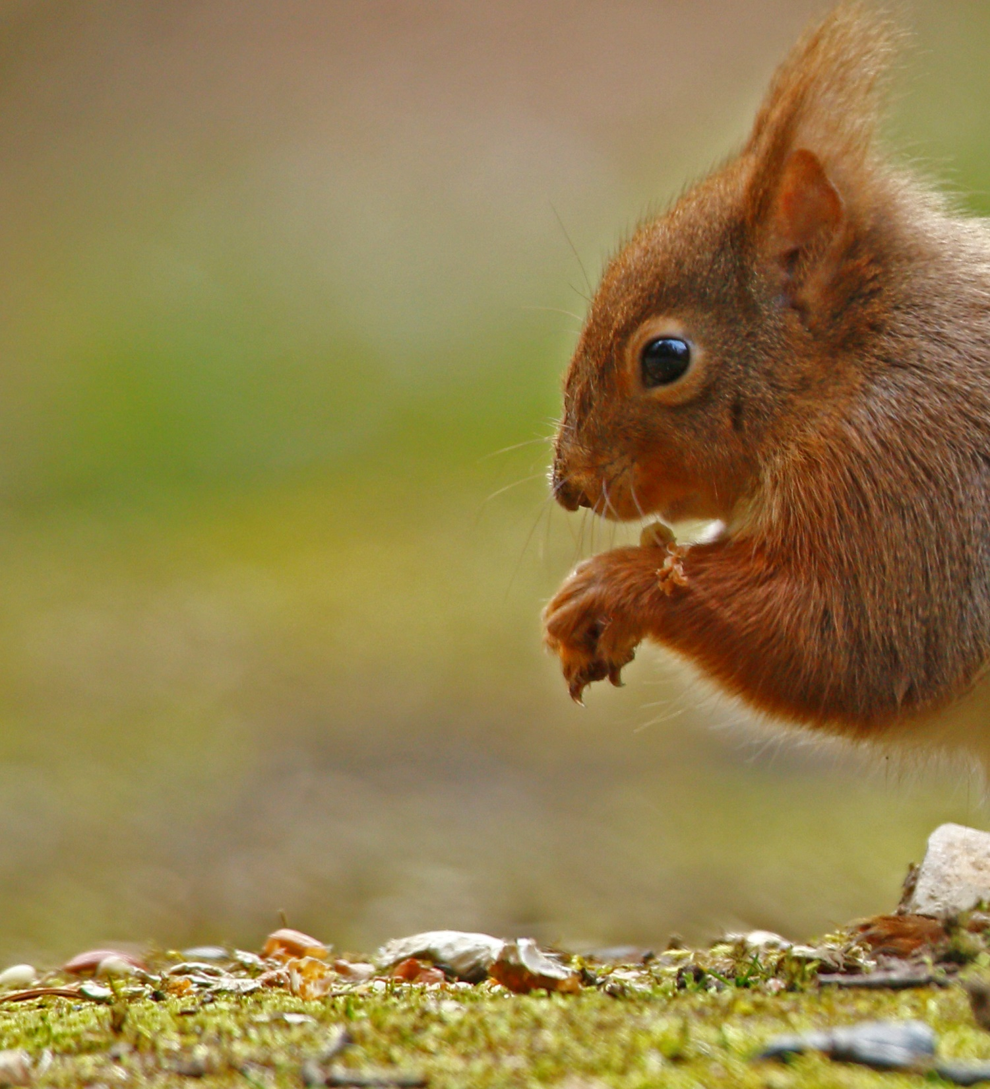
Providing opportunities for the reintroduction of native species - the pine martin
Improving biosecurity to protect and conserve nature: invasive non native species can also cause them to decline. This can lead to the threat of extinction, and costly and lasting damage to the character of rare natural habitat
Where it is not feasible to eradicate these species because they are too widely established, we will seek to neutralise their threat by managing them effectively.
We will continue to deliver the GB Invasive Non-native Species Strategy (2015) in order to protect natural capital in England from invasive non-native species.
Working with partners to raise awareness of invasive non-native species and the need for strong biosecurity.
Notes:
Providing opportunities for the reintroduction of native species - the pine martin, fen orchid or hen harrier, are found in only a few sites within their former range. Their reintroduction, when carefully planned and managed, can enrich our natural environment and provide wider benefits for people
Improving biosecurity to protect and conserve nature - Disease is not the only threat to native plant and animal species: invasive nonnative species can also cause them to decline. This can lead to the threat of extinction, and costly and lasting damage to the character of rare natural habitat
The proliferation of invasive non-native species can also prompt unwelcome changes in the wider ecosystem that climate change might further exacerbate Where it is not feasible to eradicate these species because they are too widely established, we will seek to neutralise their threat by managing them effectively.
we will continue to deliver the GB Invasive Non-native Species Strategy (2015) in order to protect natural capital in England from invasive non-native species.
Working with partners to raise awareness of invasive non-native species and the need for strong biosecurity. • Maintaining an alert system to detect high priority invasive nonnative species and implement contingency plans to rapidly eradicate them where feasible

Slide 22
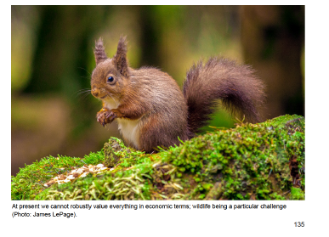
“-taking action to recover threatened, iconic or economically important species of animals, plants and fungi,
- increasing woodland in England in line with our aspiration of 12% cover by 2060: this would involve planting 180,000 hectares by end of 2042”
“… and tackling invasive non-native species”

Slide 23
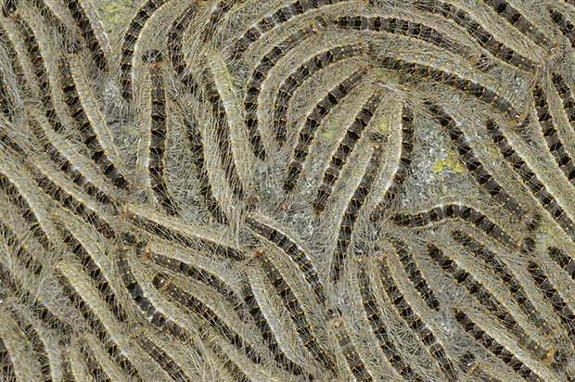

Slide 24
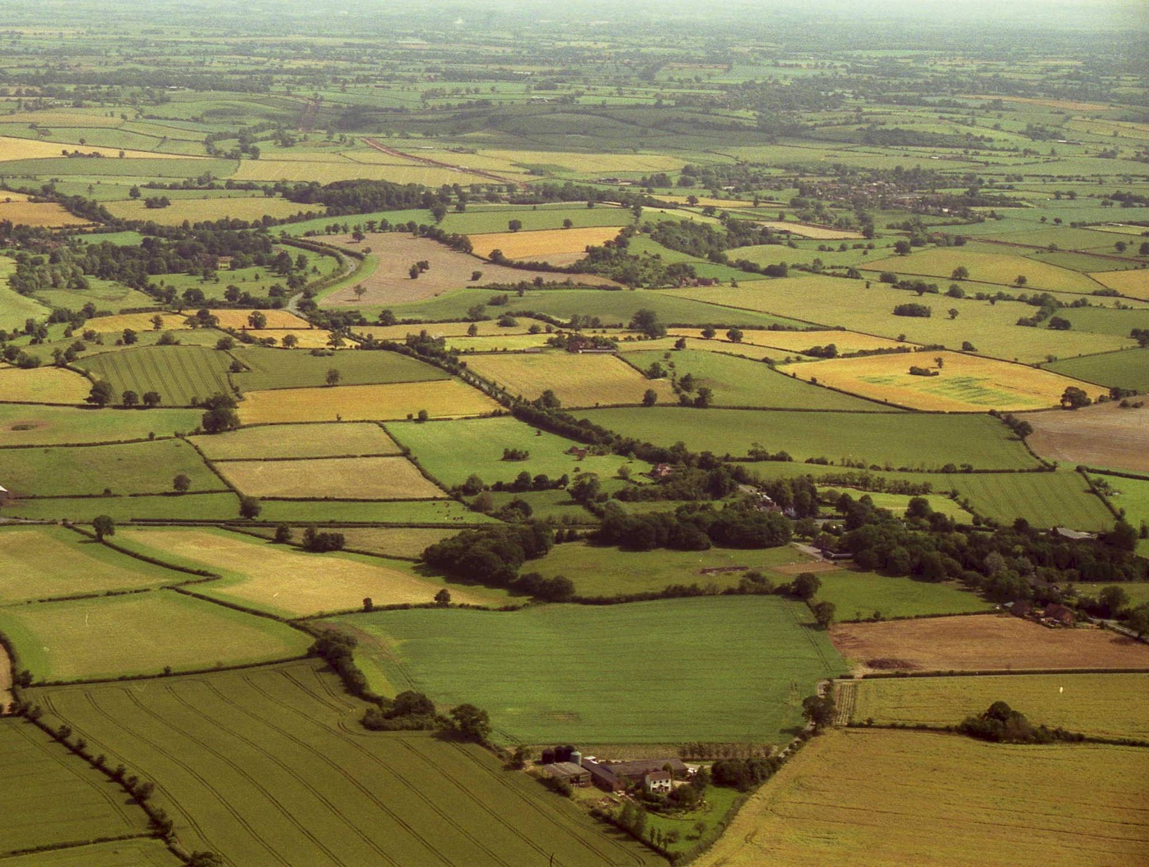
Too small – too fragmented – poorly managed

Slide 25
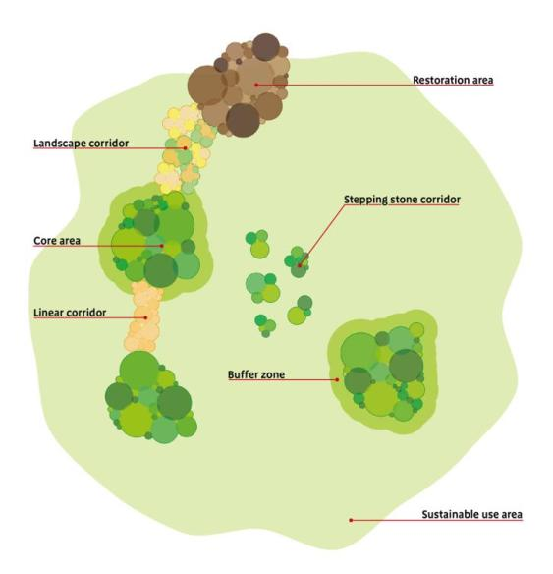
More, bigger, better and joined
Warwickshire
Ecologically coherent networks in local plans
Notes:
The answer is that we need to create more space for nature – as outlined by John Lawton, formrely Chair of Yorkshire WT in a recent report
25

Slide 26
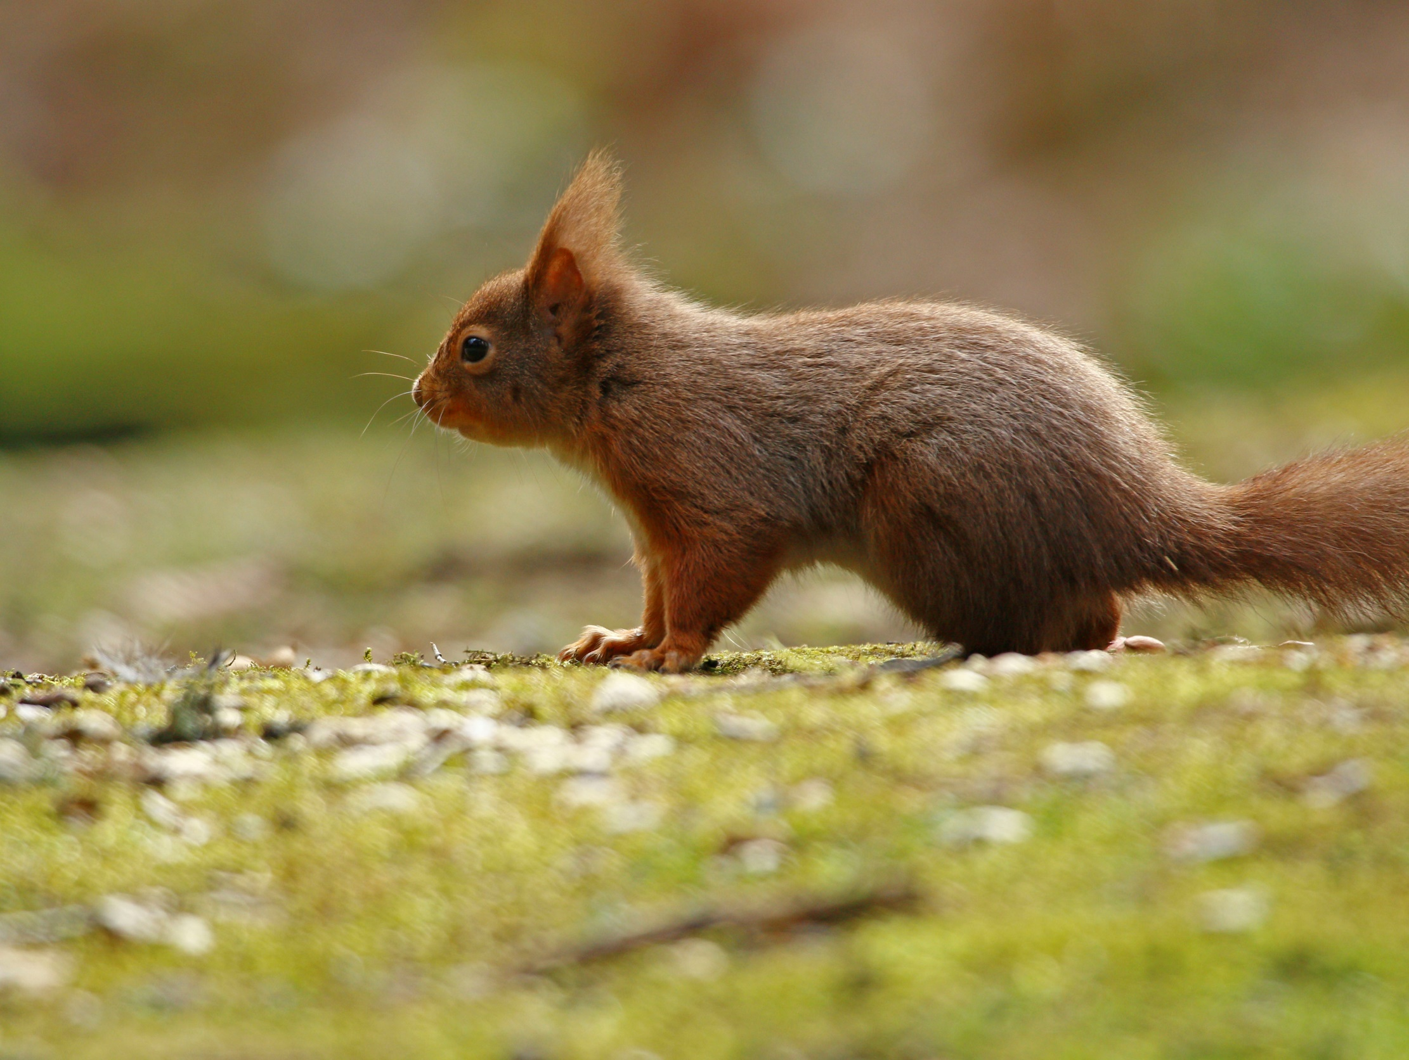
An Environment Act Now
The 25 YEP - we welcome the intention to retain strong targets for wildlife, water and air – we look forward to seeing clear short term targets set in line with this ambition. But will require law on the page, cash in the coffers, and a watchdog with teeth.
Notes:
The charities are urging the UK Government to:
Establish, legally-binding targets for the whole public sector within a new Environment Act in England.
Ensure sufficient resources to deliver these plans and to fund the new environmental statutory watchdog body
Work closely with the devolved nations to develop a co-designed and co-owned common framework for the whole of the UK’s environment
Embed EU environmental protections into UK law in their entirety, including enshrining important environmental principles, such as ‘the polluter pays’
The coalition is encouraging the Government to align other new legislation with the goals set out in the Plan, such as the forthcoming Agriculture and Fisheries Bills, and policies such as the Clean Growth Plan and Industrial strategy, to ensure they contribute to the successful delivery of the Environment Plan

Slide 27
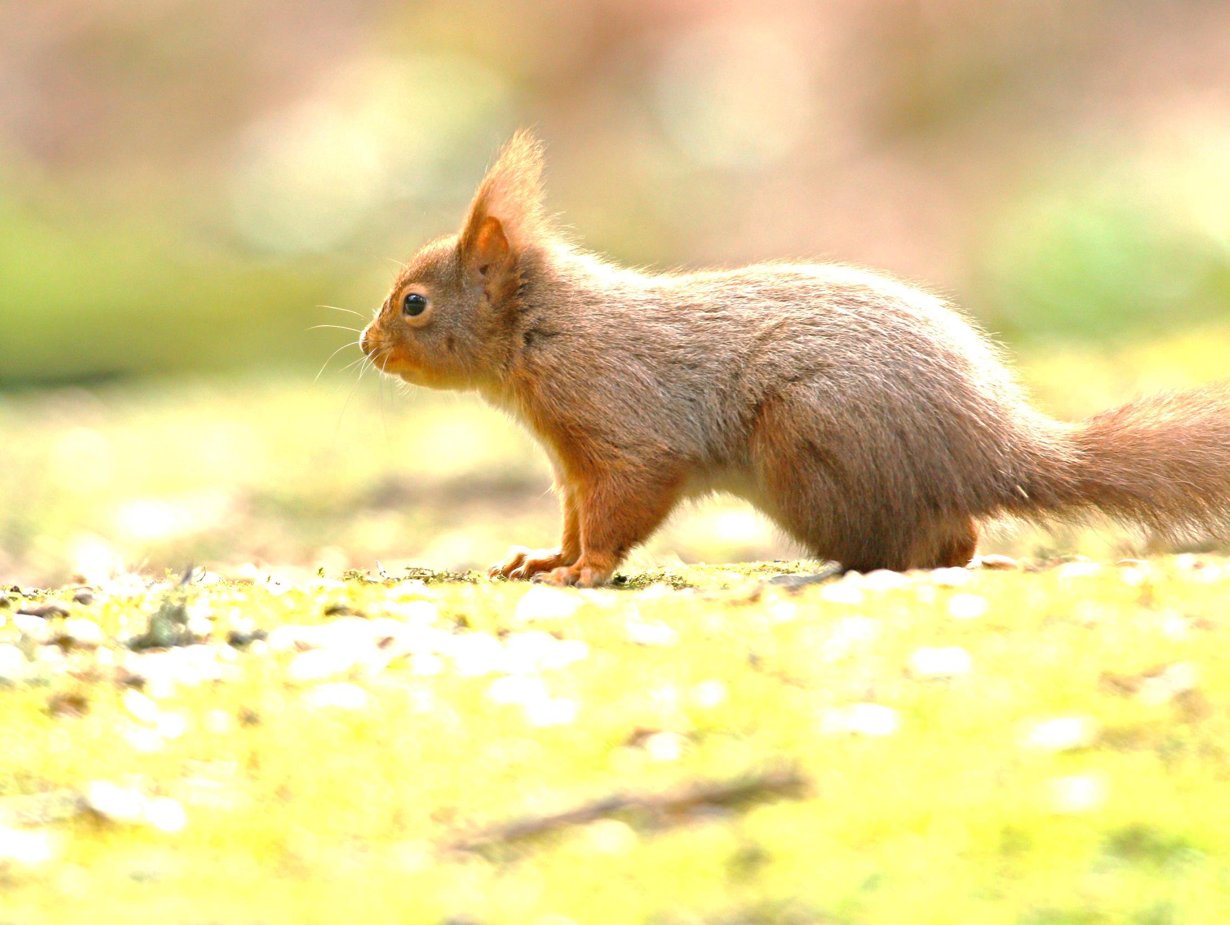
Funding - Current Government consultation
Health and Harmony: the future for food, farming and the environment in a Green Brexit
11. Protecting crop, tree, plant and bee health
We are keen to find ways to support landowners to enable them to take appropriate and timely action in response to pest and disease outbreaks. This could include support to fell infected trees or shrubs, treat infection, as well as supporting pre-emptive action through the removal of pest reservoirs.
We are also keen to work with landowners to support recovery from pest and disease outbreaks in landscapes through replanting with appropriate species. This would build resilience and help reduce the impact of any future outbreak.
Notes:
We are keen to find ways to support landowners to enable them to take appropriate and timely action in response to pest and disease outbreaks. This could include support to fell infected trees or shrubs, treat infection, as well as supporting pre-emptive action through the removal of pest reservoirs.
We are also keen to work with landowners to support recovery from pest and disease outbreaks in landscapes through replanting with appropriate species. This would build resilience and help reduce the impact of any future outbreak.

Slide 28
Consultation questions
Where there are insufficient commercial drivers, how far do you agree or disagree that government should play a role in supporting:
a) Industry, woodland owners and others to respond collaboratively and swiftly to outbreaks of priority pests and diseases in trees?
b) Landscape recovery following pest and disease outbreaks, and the development of more resilient trees?
c) The development of a bio-secure supply chain across the forestry, horticulture and beekeeping sectors?
Where there are insufficient commercial drivers, what role should government play in:
a) Supporting industry, woodland owners and others to respond collaboratively and swiftly to outbreaks of priority pests and diseases in trees?
b) Promoting landscape recovery following pest and disease outbreaks, and the development of more resilient trees?
What support, if any, can the government offer to promote the development of a bio-secure supply chain across the forestry, horticulture and beekeeping sectors?
Notes:
Where there are insufficient commercial drivers, how far do you agree or disagree that government should play a role in supporting:
a) Industry, woodland owners and others to respond collaboratively and swiftly to outbreaks of priority pests and diseases in trees?
b) Landscape recovery following pest and disease outbreaks, and the development of more resilient trees?
c) The development of a bio-secure supply chain across the forestry, horticulture and beekeeping sectors?
Where there are insufficient commercial drivers, what role should government play in:
a) Supporting industry, woodland owners and others to respond collaboratively and swiftly to outbreaks of priority pests and diseases in trees?
b) Promoting landscape recovery following pest and disease outbreaks, and the development of more resilient trees?
What support, if any, can the government offer to promote the development of a bio-secure supply chain across the forestry, horticulture and beekeeping sectors?

Slide 29
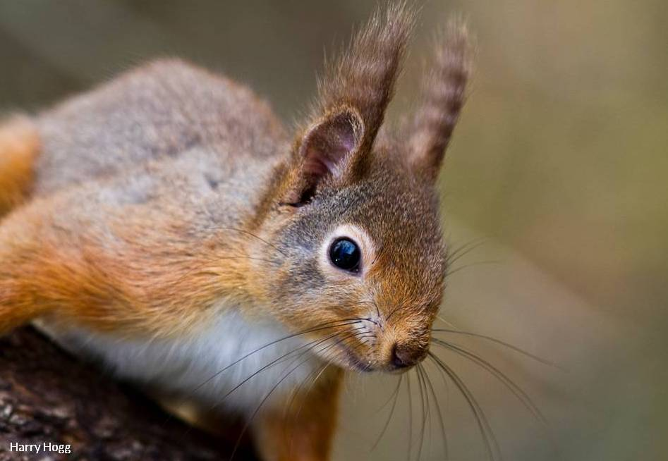
The UK Squirrel Accord - a unique position
Notes:
HRH The Prince of Wales has stated his readiness to assist the UK Squirrel Accord and Lord Gardiner (as Defra Minister with responsibility for Non Native Invasive Species) has offered practical support.
UK Ministers have emphasized that as a body with a single voice speaking for both squirrel and associated woodland issues the Accord will be listened to by government, its departments and agencies.
Where the Accord speaks for its signatories it brings greater weight and attention to their arguments, especially with especially with Ministers and the Heritage Lottery Fund, than individual actors can achieve on their own.

Slide 30
Scope of talk
How are we doing?
New policy context & red squirrels
Why a new strategy?
Vision and ambition
Developing the strategy
Immediate actions

Slide 31
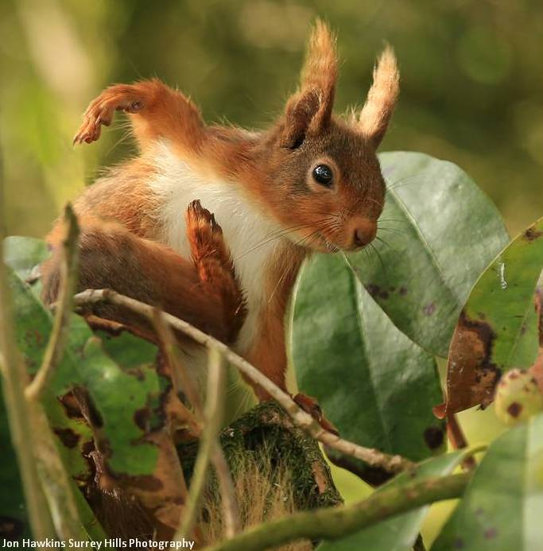
Need for a new strategy
Notes:
A partially successful approach but where next?
How do we ensure we’re all pulling in the same direction?
Is the current approach enough to save mainland red squirrels let alone achieve our ambitions for recovery? Need to find methods we can apply sustainably at scale
More difficult to fund control programmes – increased need to help funders see the bigger picture
Need to show leadership and set the direction of travel for Governments, agencies, land owners and voluntary effort
Need to support local volunteers and groups better

Slide 32
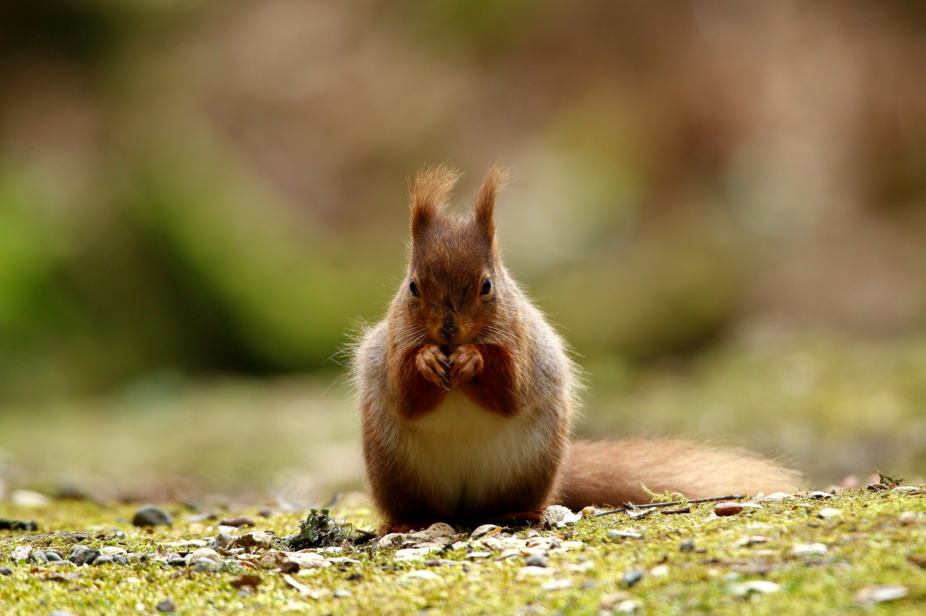
Public support
Notes:
New and refreshed communications plan
First hand access for more people to enjoy and be inspired by reds
Counter the arguments of those who oppose culling and controlling grey squirrels

Slide 33
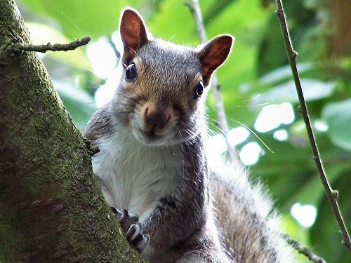
Counter the arguments of those who disagree with conservation of RS
GS have already won
RSs are not a conservation priority
Not cost-effective
Should fall back to island populations
Its not ethical to remove GS

Slide 34
Scope of talk
How are we doing?
New policy context & red squirrels
Why a new strategy?
Vision and ambition
Developing the strategy
Immediate actions

Slide 35
From this …

Slide 36
To this by 2042

Slide 37
My thoughts on vision and ambition
Recovery of RS across mainland UK – cant escape the imperative of removing grey squirrels from our ecosystems
Mustn’t treat red squirrels as being apart from the wider conservation effort and the need for widespread environmental restoration

Slide 38
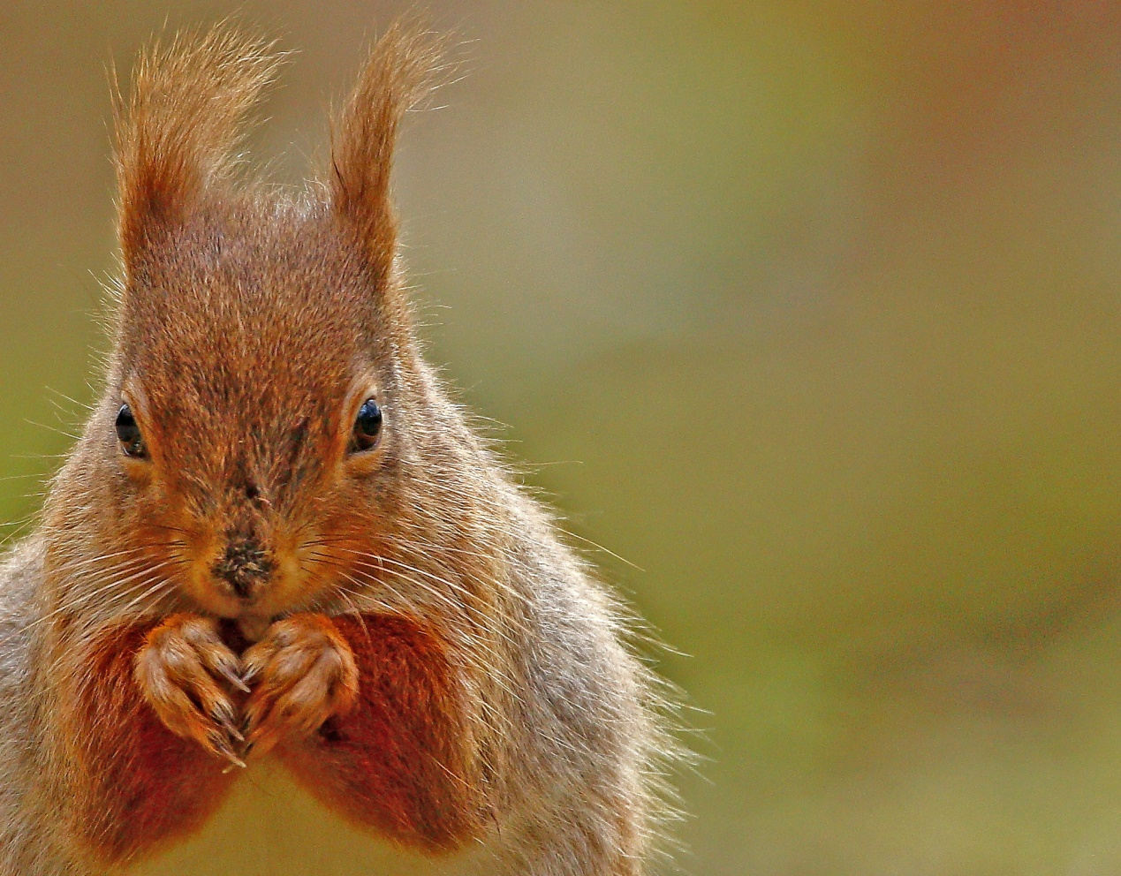
Building blocks
Science, survey and monitoring
Notes:
Science, survey and monitoring
Coordination of effort – involvement of all partners who can have an impact
How? Strategy must be to scale up control of greys and take a spatially coordinated approach
Mustn’t treat red squirrels as being apart from the wider conservation effort and need for widespread restoration
Need to scale up what we know and use new approaches – grounds for great optimism at present – four approaches:

Slide 39
Building blocks
Science, survey and monitoring
Coordination of effort – involvement of all partners who can have an impact
Notes:
Science, survey and monitoring
Coordination of effort – involvement of all partners who can have an impact
How? Strategy must be to scale up control of greys and take a spatially coordinated approach
Mustn’t treat red squirrels as being apart from the wider conservation effort and need for widespread restoration
Need to scale up what we know and use new approaches – grounds for great optimism at present – four approaches:

Slide 40
Building blocks
Science, survey and monitoring
Coordination of effort – involvement of all partners who can have an impact
How? Strategy must be to scale up control of greys and take a spatially coordinated approach
Notes:
Science, survey and monitoring
Coordination of effort – involvement of all partners who can have an impact
How? Strategy must be to scale up control of greys and take a spatially coordinated approach
Mustn’t treat red squirrels as being apart from the wider conservation effort and need for widespread restoration
Need to scale up what we know and use new approaches – grounds for great optimism at present – four approaches:

Slide 41
Building blocks
Science, survey and monitoring
Coordination of effort – involvement of all partners who can have an impact
How? Strategy must be to scale up control of greys and take a spatially coordinated approach
Need to scale up what we know and use new approaches – grounds for great optimism at present – four approaches:
Notes:
Science, survey and monitoring
Coordination of effort – involvement of all partners who can have an impact
How? Strategy must be to scale up control of greys and take a spatially coordinated approach
Mustn’t treat red squirrels as being apart from the wider conservation effort and need for widespread restoration
Need to scale up what we know and use new approaches – grounds for great optimism at present – four approaches:

Slide 42
Reasons to be cheerful …
Volunteers
Fertility control
Good nature trap
Pine marten and other predators

Slide 44
Oral contraceptives as a control method
Traditionally culling has been used as a control method e.g. eradication from Anglesey
Oral contraceptives delivered in baits have potential as an additional tool, to reduce population size as well as the rate of population recovery after culling
5 year study funded by the Defra and the UK Squirrel Accord

Slide 52
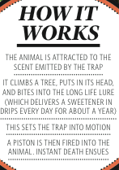
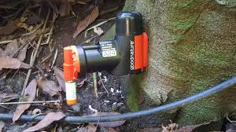
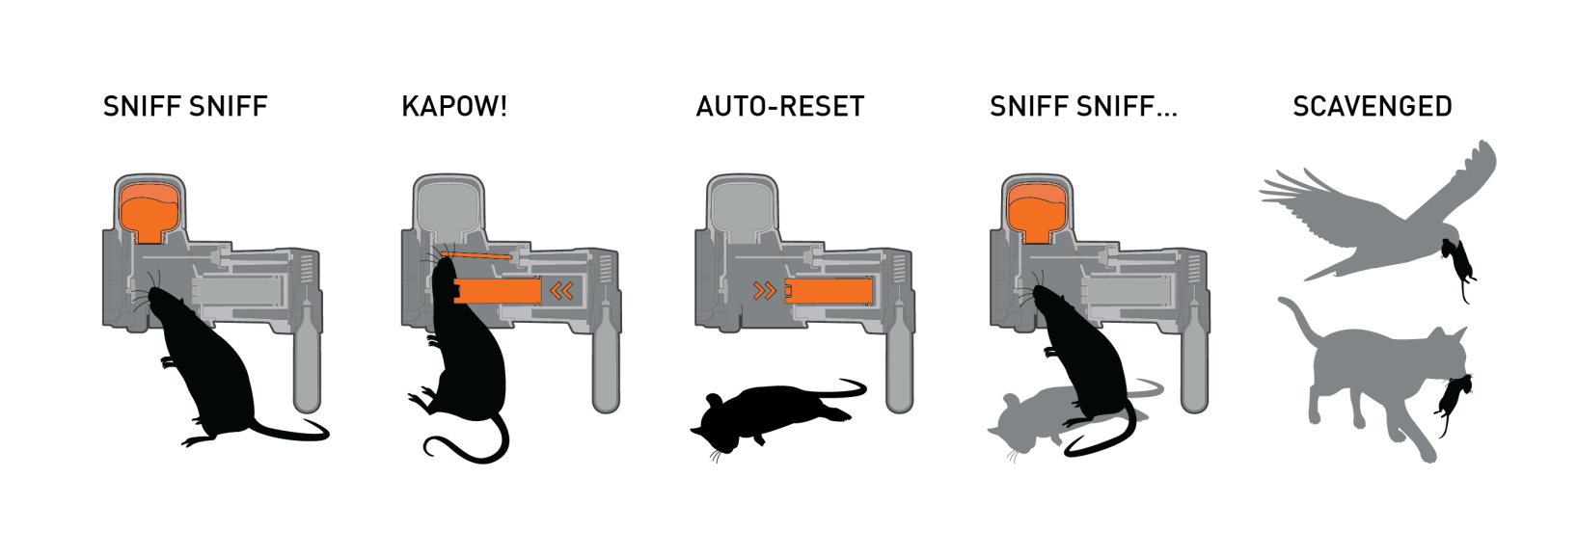
GoodNature trap
A24 currently passed for rats and stoats

Slide 53
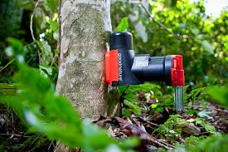
Goodnature trap for squirrels
Pros
Lightweight
Easy to set up
Baited
Re-sets itself
Cons
Trap visible
Carcasses visible (predation?)
Non-target risk

Slide 54
The enemy of my enemy is my friend
Xavier Lambin, Emma Sheehy, Chris Sutherland
Katherine O’Reilly

Slide 55
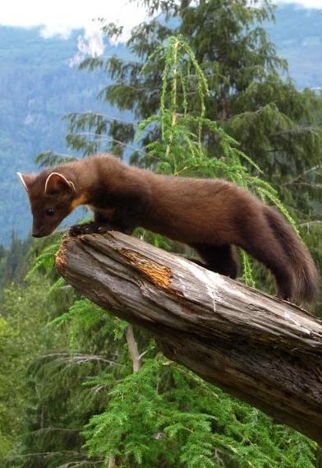
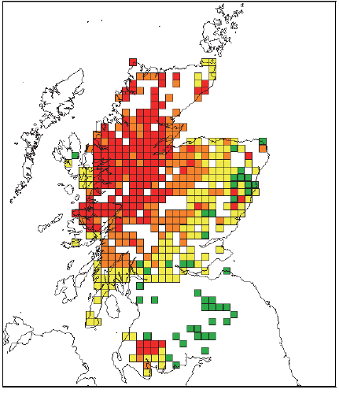
The recovery of the pine marten since protection in 1981 (37 years)
1980ies
1990ies
2012
2013
Notes:
It took 40 years to re-occupy Scotland, only a small part of their natural range

Slide 56
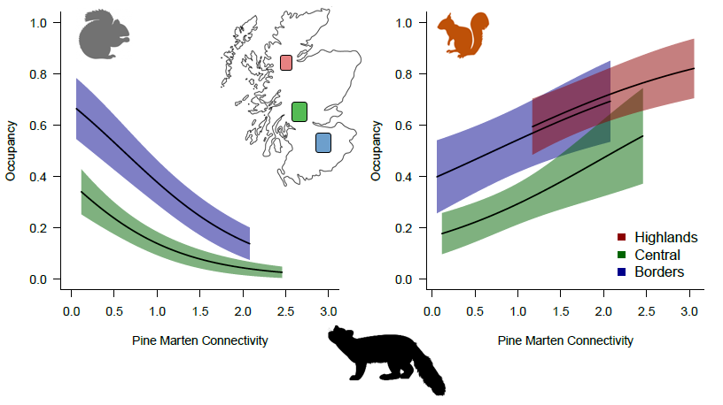
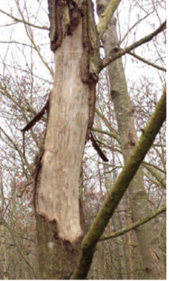
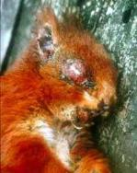
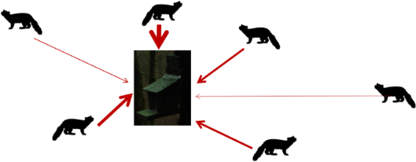
What we found: Pine martens control grey squirrel effectively, they deliver a crucial ecosystem service

Slide 57
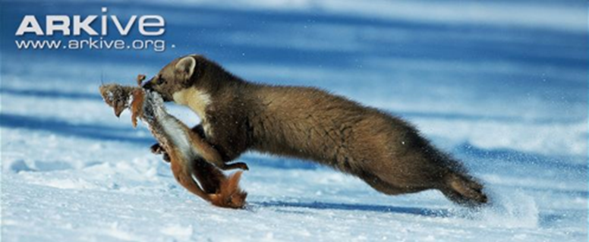
The enemy of my enemy is my friend … at the population level
What we found: NIL evidence that martens deplete red squirrel populations when they have finished off grey squirrels
What about red squirrels?
Notes:
Some of you might have witnessed pine marten preying upon red squirrel. It is rare but it does happen
You can be re-assured that the good work that has been done by the Accord and RSST member to conserve red will not be undone by pine marten

Slide 58
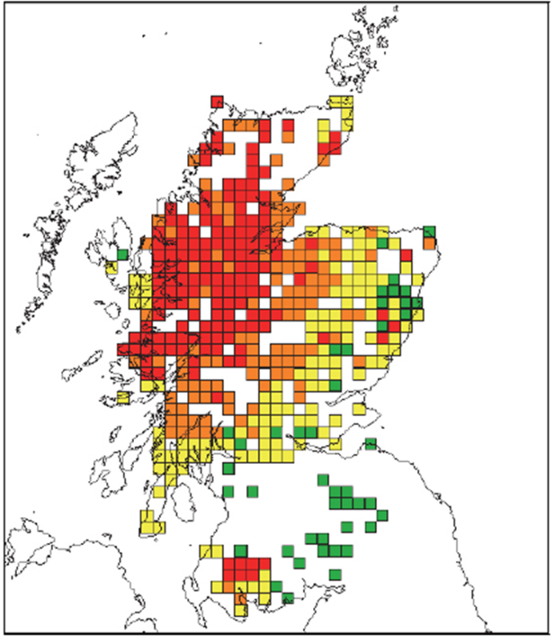
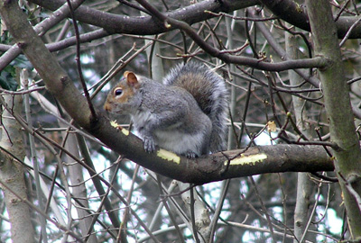
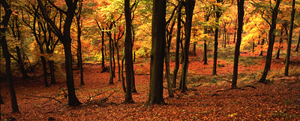
40 years to recolonise Scotland … how long before English woodlands are protected from grey squirrels?

Slide 59
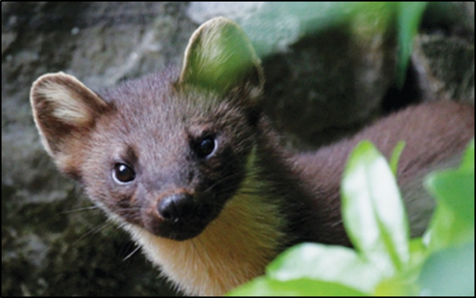
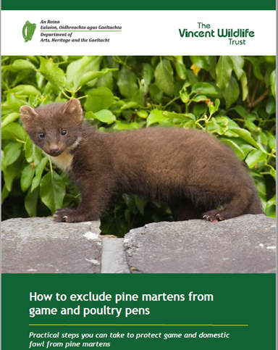
Summing up: native pine marten recovery reverses the decline of the red squirrel by suppressing grey squirrel populations
Wide inter, and intra-region variation in marten density
Pine martens control grey squirrel, effectively, to near extinction level
Red squirrel populations benefit from the presence of martens
We must work together to ensure red squirrel and
tree conservation wins the day.

Slide 60
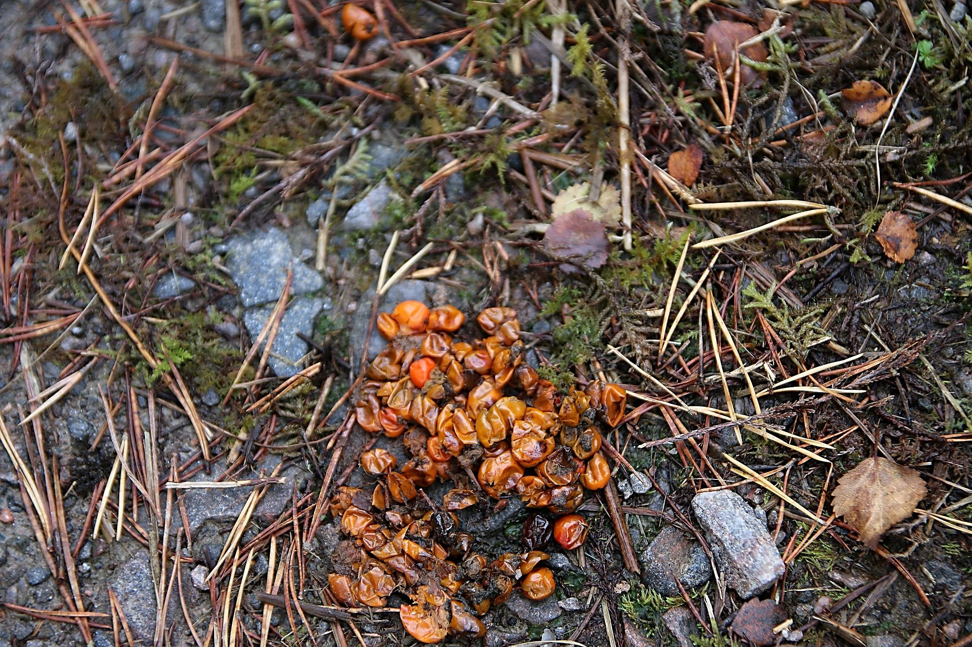

Slide 61
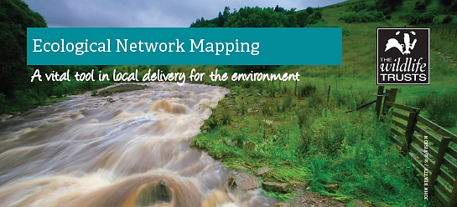
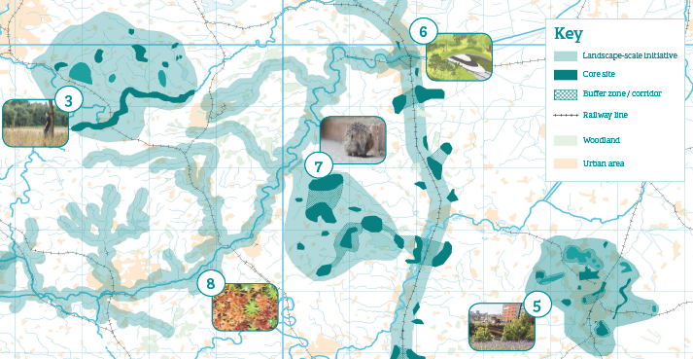

Slide 62
Scope of talk
How are we doing?
New policy context & red squirrels
Why a new strategy?
Vision and ambition
Developing the strategy
Immediate actions

Slide 63
Developing the strategy
UK Squirrel Accord sub-group – 12/18 months – needs to engage and get support of the membership – a collaborative and inclusive approach
Must be devolution sensitive and proofed
Bottom up and top down – respecting roles, learning from and listening to views of volunteers
Flexible and tailored
Identify new funding approaches and sustainability
This weekend is start of preparations

Slide 64
Possible key priorities …
Keep defending strongholds
Continue to improve coordination
Roll out fertility control
Roll out the good nature trap
Funding and new models for delivery
– making the links to tree health and biosecurity
Pine marten – re-intoductions / reinforcement / quiet encouragement

Slide 65
Scope of talk
How are we doing?
New policy context & red squirrels
Why a new strategy?
Vision and ambition
Developing the strategy
Immediate actions

Slide 66
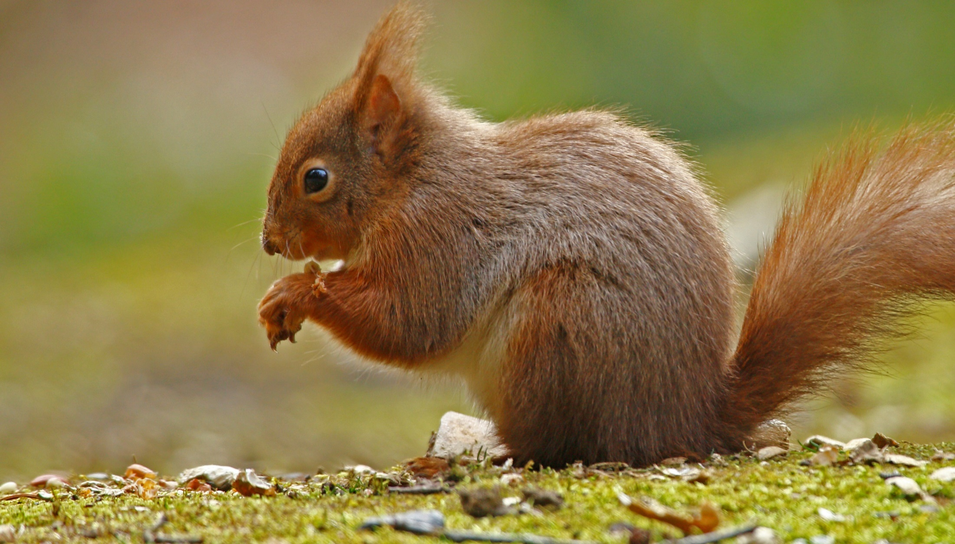
Immediate actions
Need to hear your views and experience
Respond to the Defra consultation about funding

