Slide 1
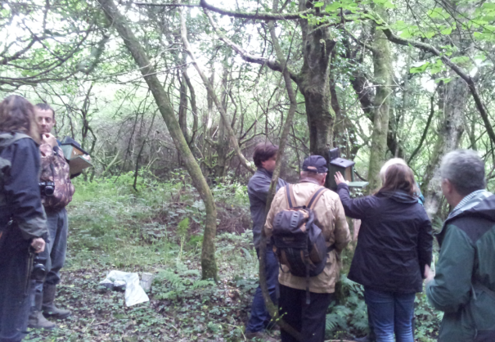
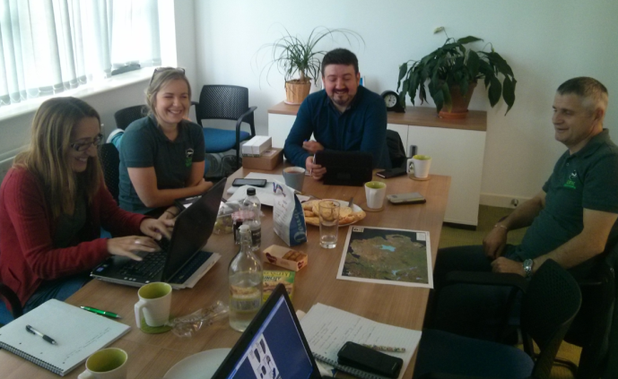
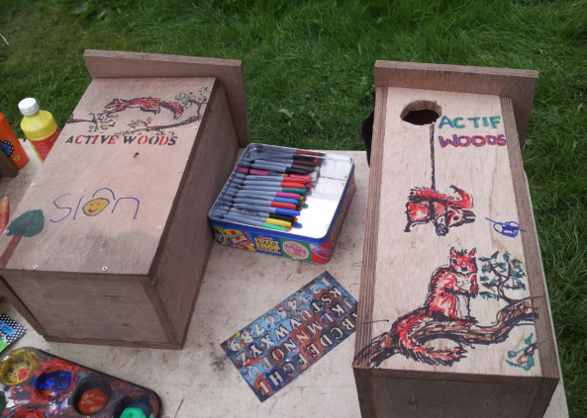
People and Squirrels
Attitudes, motivations and challenges
LIFE14 NAT/UK/000467

Slide 2
Knowledge & Attitudes Research
Nationwide survey on public attitudes towards squirrel and their management (n = 3758)
Interviews/focus groups in case study areas with volunteers (n = 35) and project staff
Short community survey around knowledge of local action and barriers to involvement (~134 to date)
Landowners and other important local stakeholders

Slide 3
Nationwide survey findings
A preference for seeing Reds, but also a desire to see Greys
Acceptance that controls are necessary in some circumstances
A need to see evidence before supporting any management of squirrels, BUT knowledge of Grey squirrel impacts is lacking
Knowledge of a relationship between red and grey squirrel populations

Slide 4
Nationwide survey findings
Not all Grey squirrel control methods are equally acceptable
Humaneness is the most important factor in perceived acceptability
Acceptability of controls positively associated with:
- Males
- Older generations
- Those most closely connected to the countryside
- Those most knowledgeable about squirrels
- Those aware of local conservation/control efforts

Slide 5
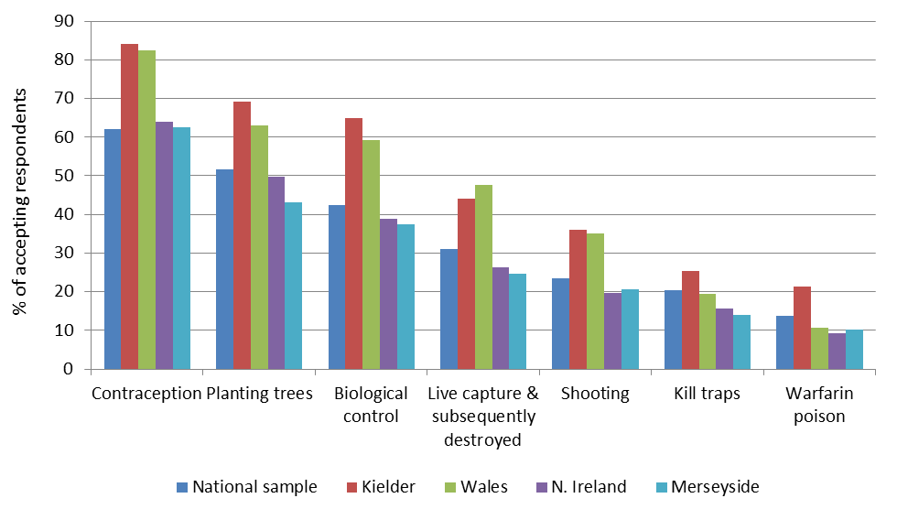
Acceptability in case study areas

Slide 6
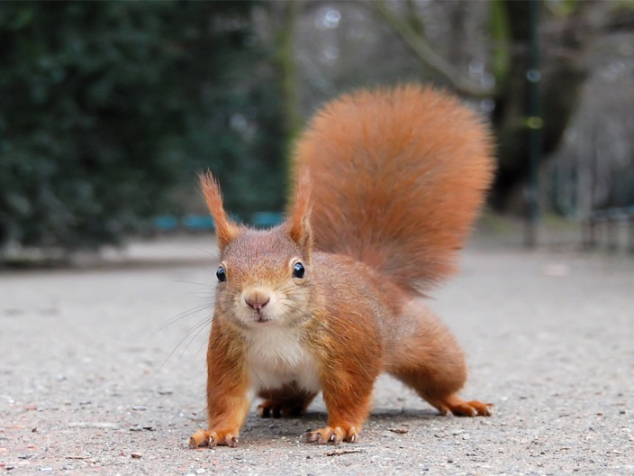
Motivations
Desire to see and/or protect red squirrels
Sense of purpose
Opportunity to acquire new knowledge and learn new skills
Social, physical and mental benefits
Notes:
Interest and involvement ideas = 1) highlighting benefits of having red squirrels (native, fewer negative impacts, tourism); 2) activities that represent entertainment for the family, 3) Engage and collaborate with different groups 4) promote social/health benefits to involvement.
Time – but if fulfilling a different role maybe more willingness. Also, may overestimate time needed (Don’t need to be a squirrel expert to make an impact)

Slide 7
Challenges and Barriers
Difficult to gain interest and involvement from communities
Insufficient time a key barrier to greater involvement
Lack of awareness about the different types of roles volunteers can do
Some skills and knowledge gaps (e.g. trapping and dispatch)
Limited access and landscape-level collaboration
Notes:
Interest and involvement ideas = 1) highlighting benefits of having red squirrels (native, fewer negative impacts, tourism); 2) activities that represent entertainment for the family, 3) Engage and collaborate with different groups 4) promote social/health benefits to involvement.
Time – but if fulfilling a different role maybe more willingness. Also, may overestimate time needed (Don’t need to be a squirrel expert to make an impact)

Slide 8
Experiences with RSU
Opportunities to learn, train and network, but timing of events is important
1/3 of volunteers interviewed unaware of RSU project
Fear that reliance on RSU may undermine a local groups’ future (post-RSU)
What local Red Squirrel Groups need/want from RSU varies
Feedback/impact of volunteer efforts is highly valued

Slide 9
Some lessons so far
1. The Greys label as a ‘pest’ is not always accepted.
2. Many ‘don’t know’ responses in the survey (apathy/uncertainty among people most easily swayed)
3. Commonly used methods aren’t particularly acceptable and are likely considered inhumane. Their use needs to be justified, and the myth of ‘lethal = inhumane’ disentangled
4. Those exposed to conservation/controls are among the most accepting. We should be open about Sq. management, not secretive
5. Community involvement and ownership is more powerful in changing beliefs than education alone. Knowledge and acceptance may spread with effective engagement
6. There are a diverse range of volunteer roles but many are unaware of these different opportunities
Notes:
Pest label - Many wish to see greys, but perhaps this would change with greater awareness of impacts, or the promise of an influx of reds
Don’t knows – opportunity to gain further support
Controls – Need to engage in why methods are used (yes it will spark some controversy, but those who understand are more sympathetic)
Similarly, don’t be secretive about activities
Comm Inv – work with groups
Groups themselves – events, roles, time, promote other benefits.

