Slide 1
Grey Squirrel Management - Trapping
LIFE14 NAT/UK/000467

Slide 2
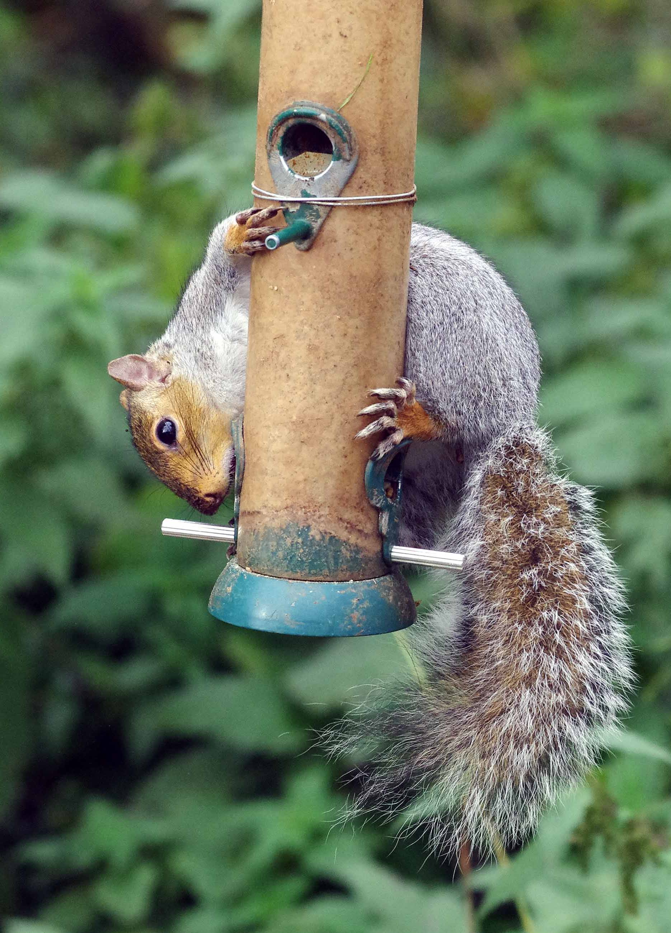
Page title

Slide 3
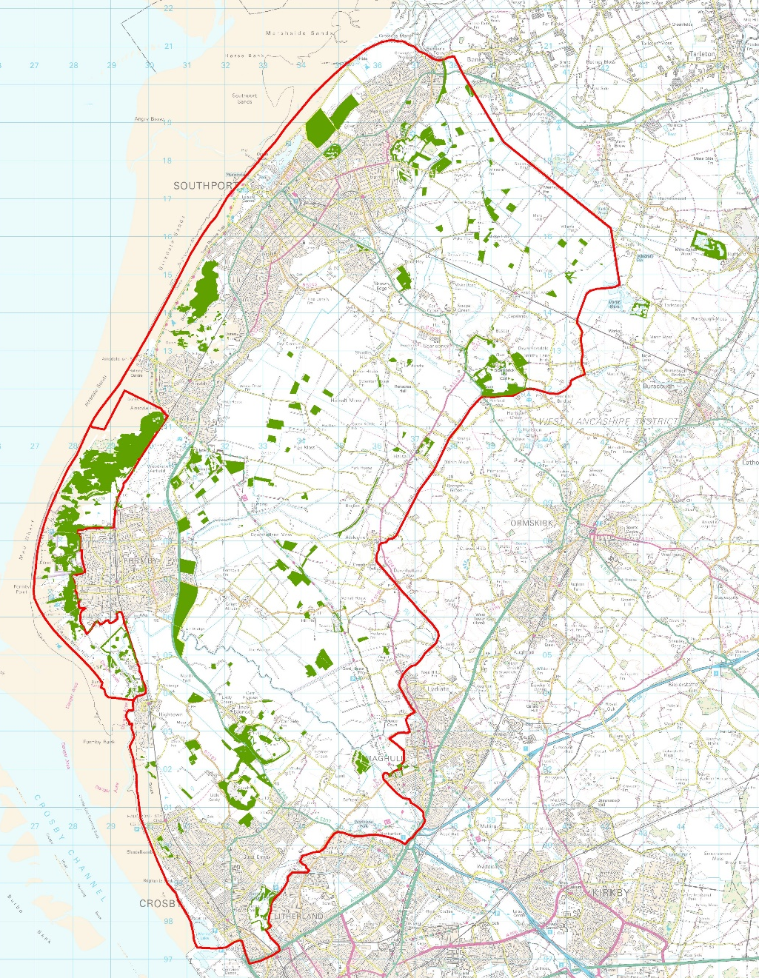
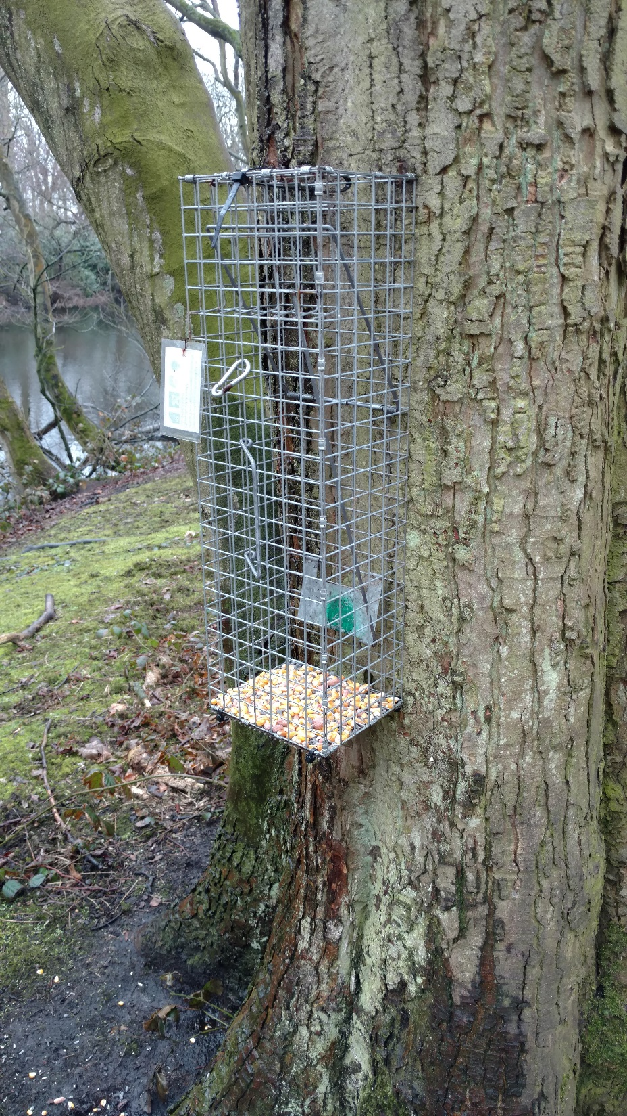
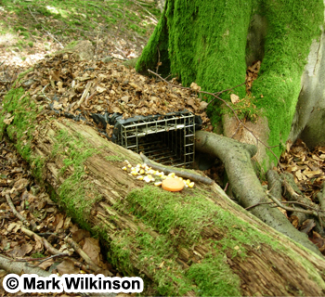
Page title

Slide 4
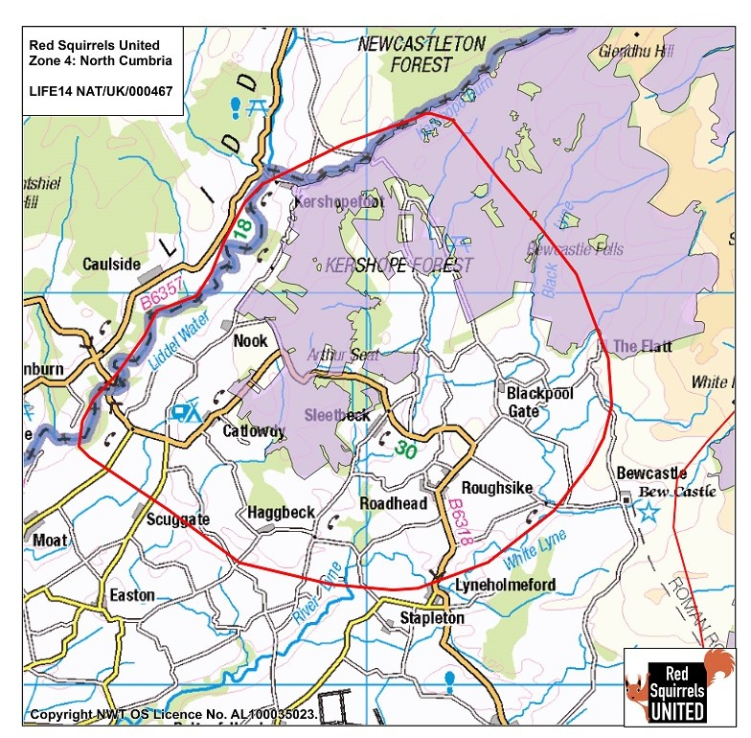
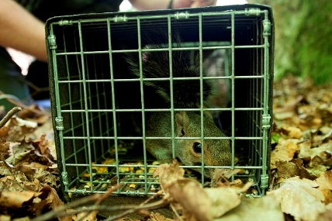
Page title

Slide 5
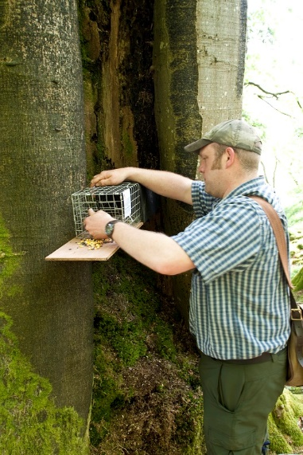
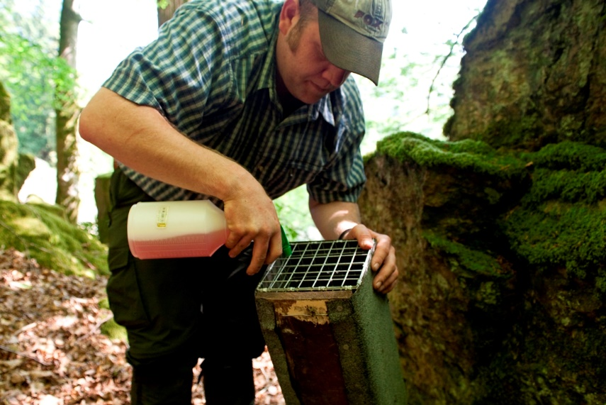
Page title

Slide 6
Trapping topics for discussion
Bait
Trap types
Trap placement
Trap density
Legal requirements
Disturbance and vandalism
Disinfecting/biosecurity
Dispatch – cranial vs shooting
By-catch
Length of trapping session – overnight, weather, breeding season, density of reds in woodland

Slide 7
Legislation
Wildlife & Countryside Act 1981
Animal Welfare Act 2006
Protection of Mammals Act 1996
Pest Control Order 1954

