Slide 1
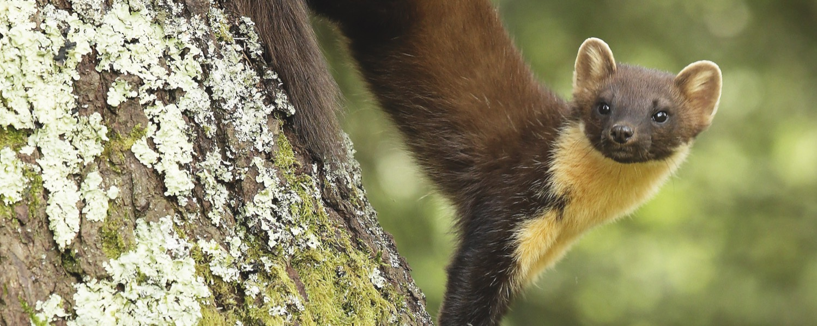
Pine Marten Recovery in Wales
First steps

Slide 2
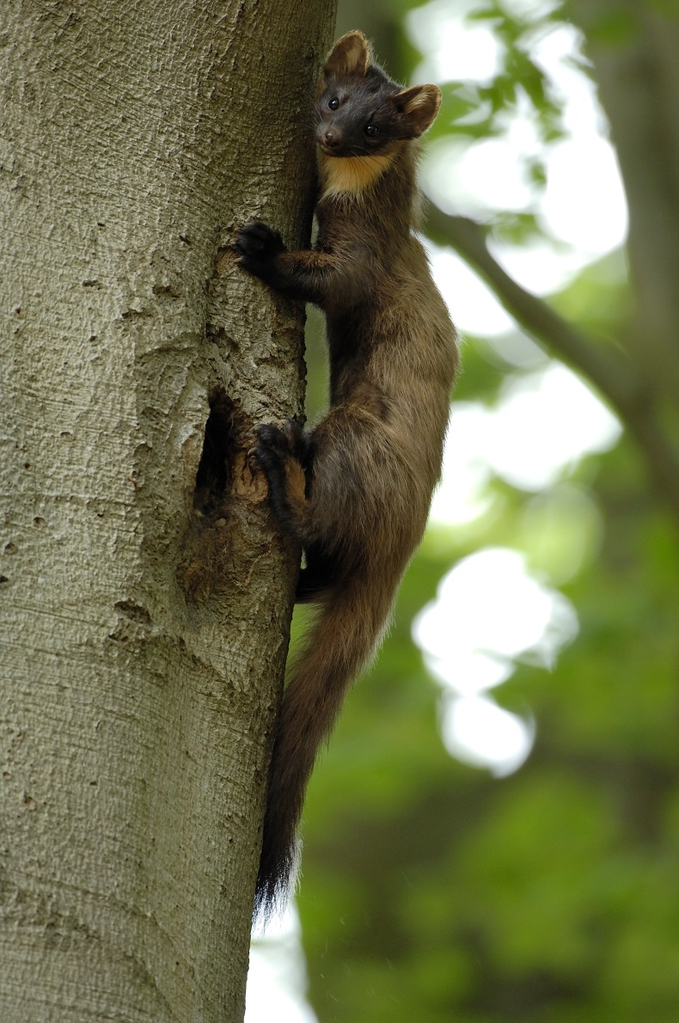
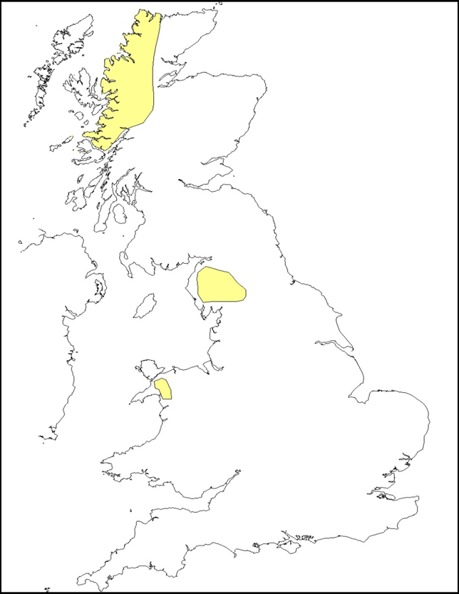
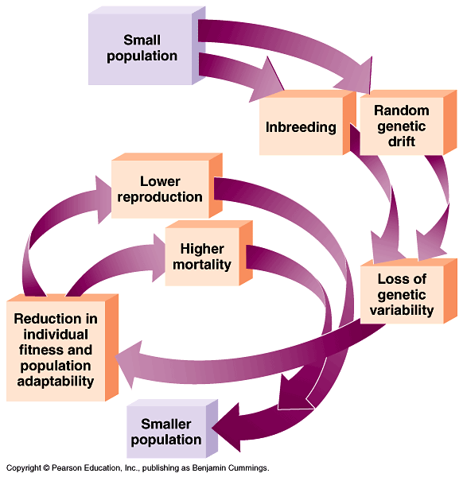
Pine Marten Recovery Project
c. 1915
Research Education Conservation

Slide 3
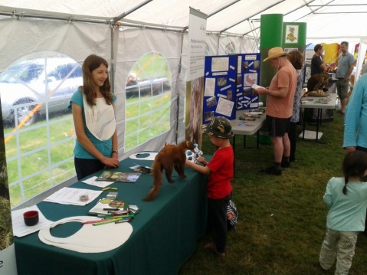
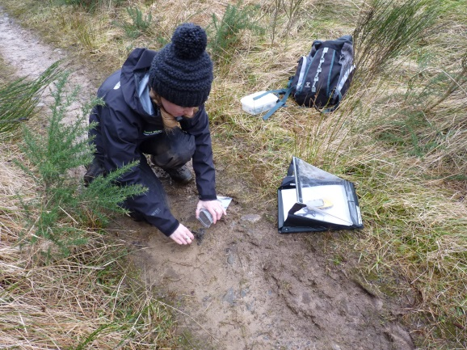
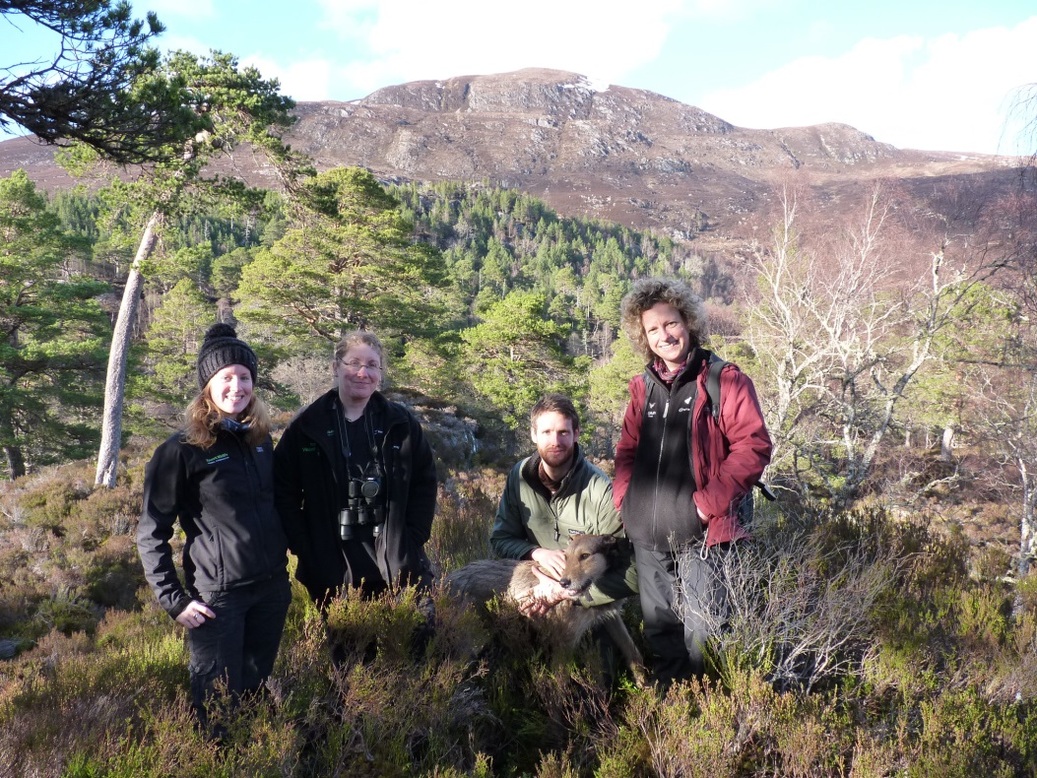
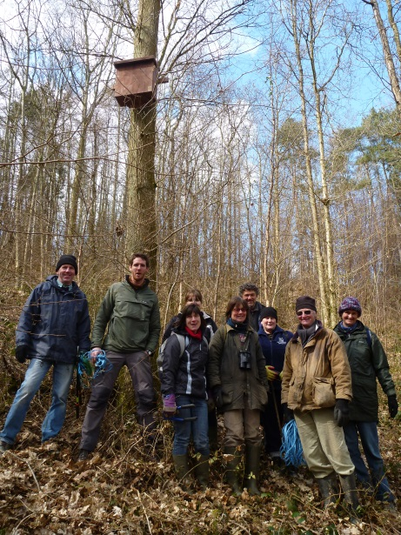
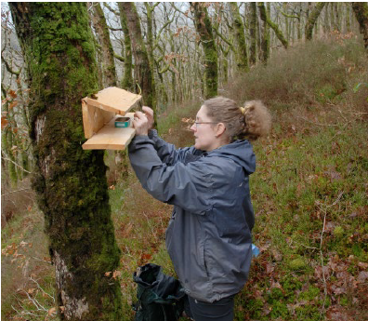
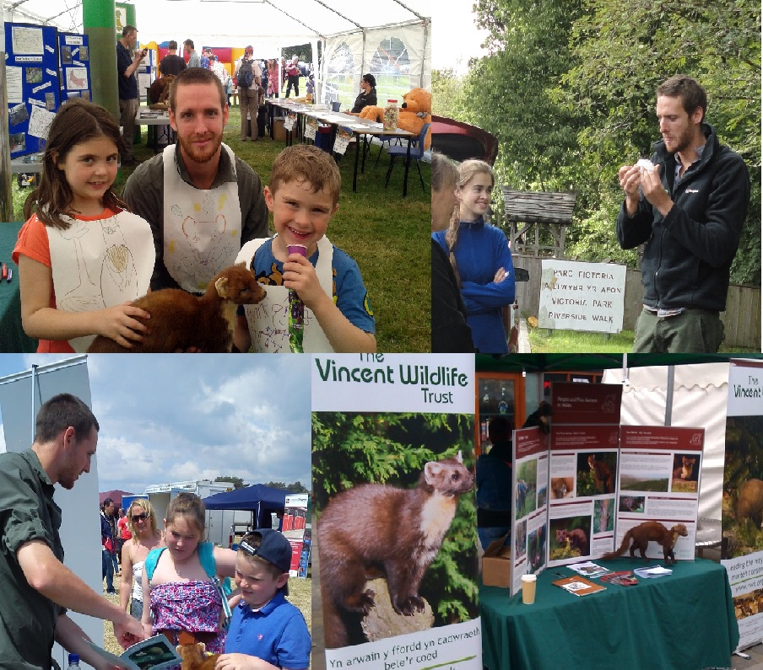
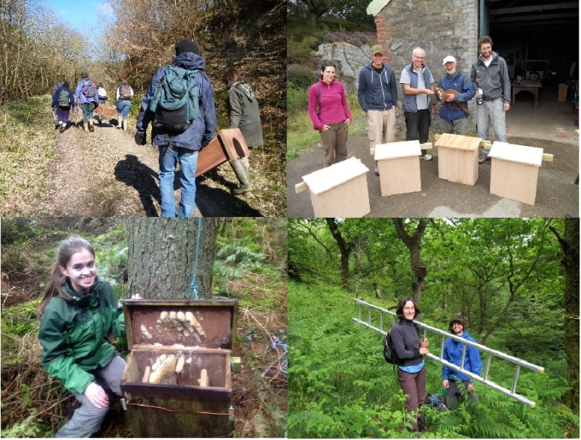
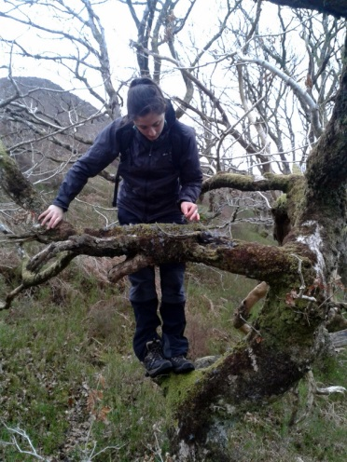
Notes:
Glangwy camp site

Slide 4
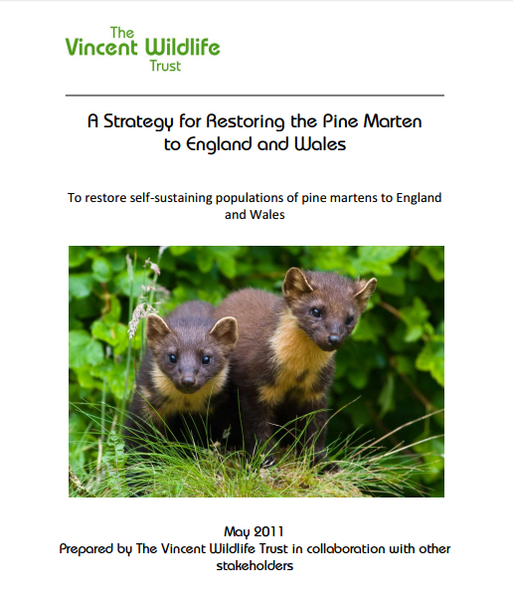
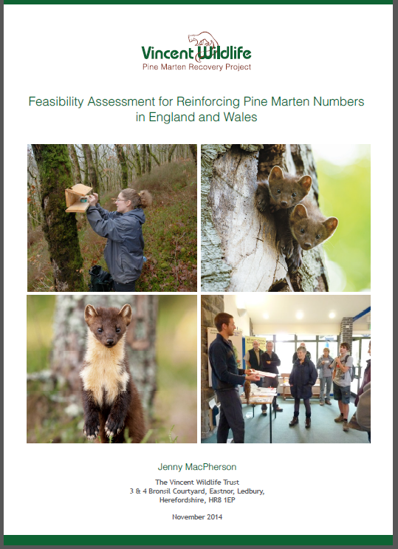
Pine Marten Recovery Project Feasibility Study
Jordan, N. The Vincent Wildlife Trust. 2011.
Research Education Conservation

Slide 5
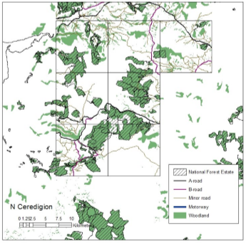
Pine Marten Recovery Project Feasibility Study
3 PRRs prioritised for field surveys and stakeholder engagement in 2014-15
North Ceredigion chosen
Research Education Conservation
Notes:
More details of further analyses done or being done at present. Sites in the north of England are not being considered in the first tranche as they are more likely to be re-colonised naturally. However sites in the lake district are on the b list. N Ceredigion is shown as a corridor

Slide 6
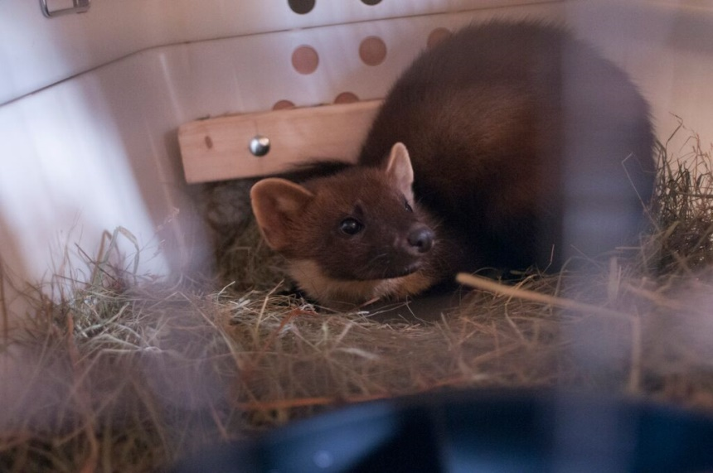
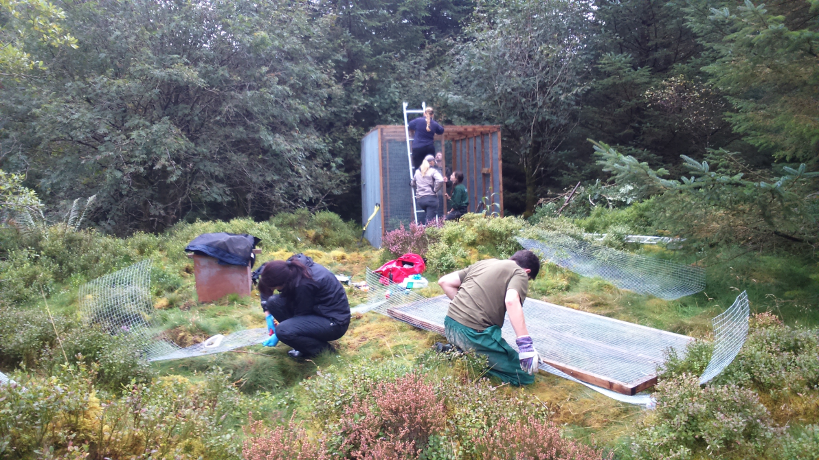
Translocation
51 martens translocated from Scotland from 2015 - 2017
(Approx 1:1 sex ratio)
All animals radio collared.
Soft released from custom pens; collaboration with Chester Zoo.

Slide 7
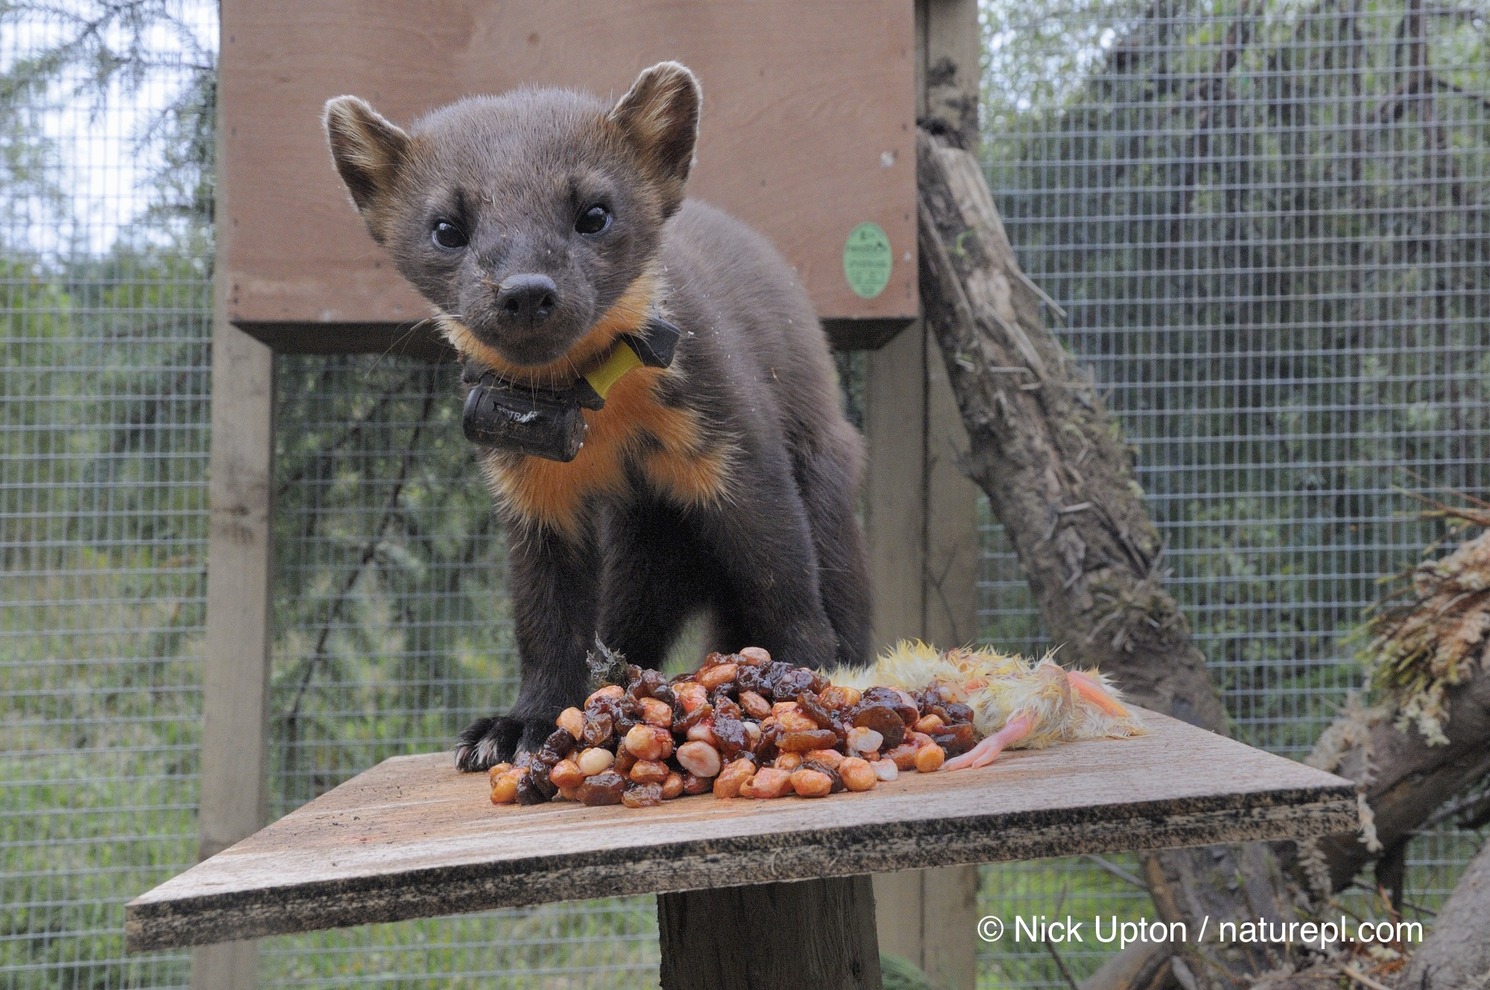
Translocation

Slide 8
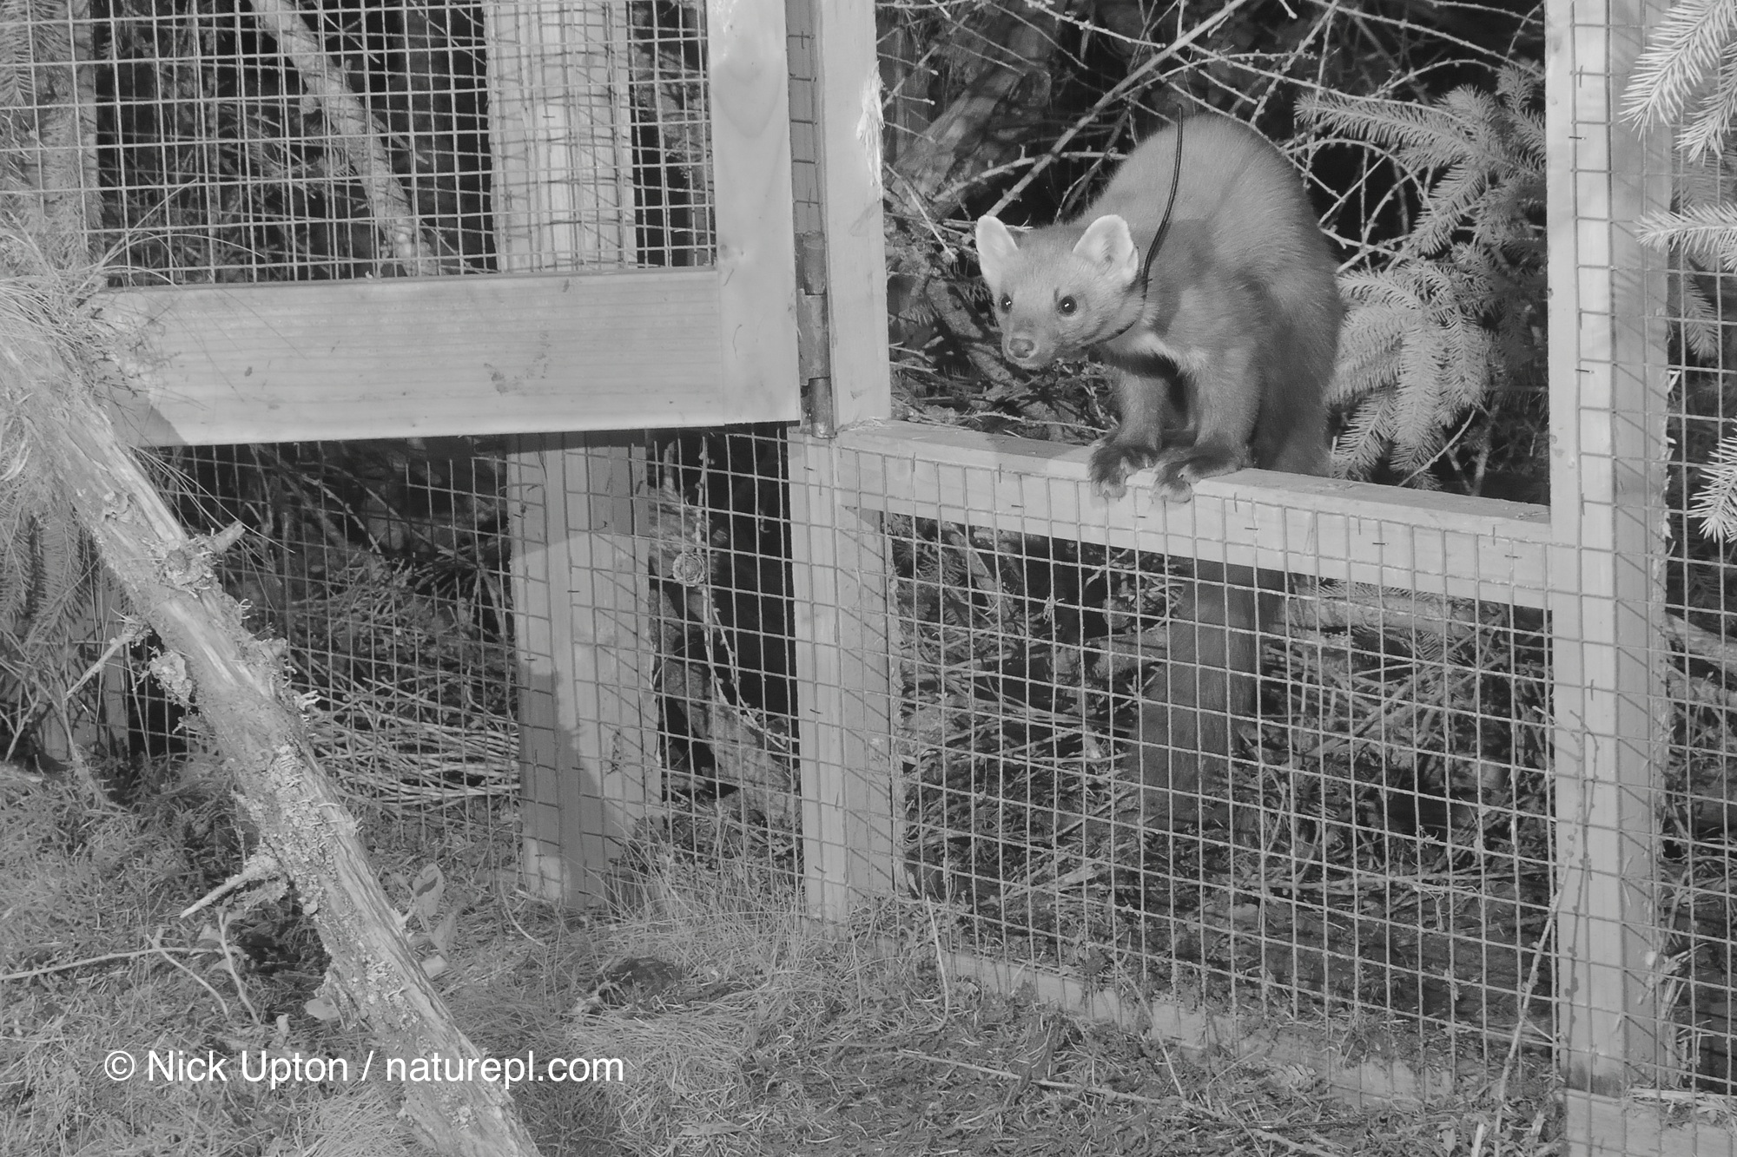
Translocation

Slide 9
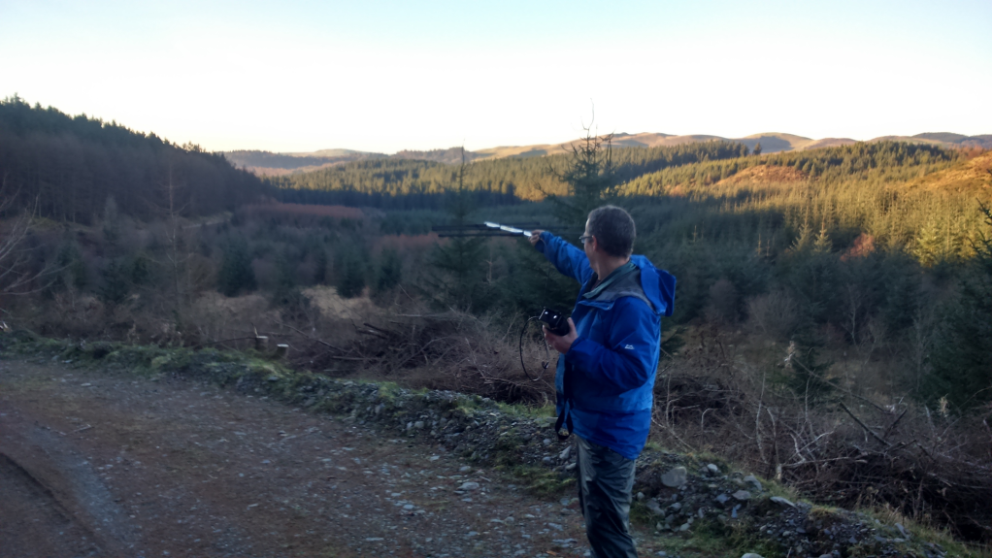
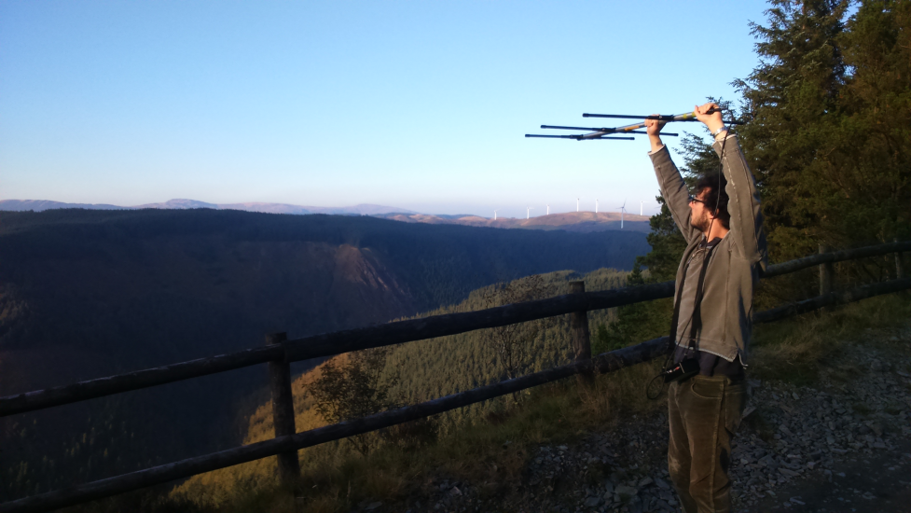
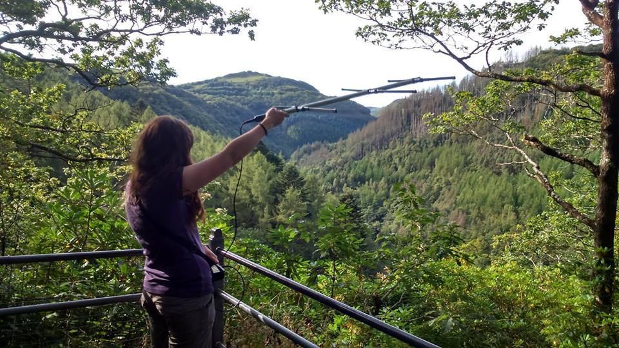
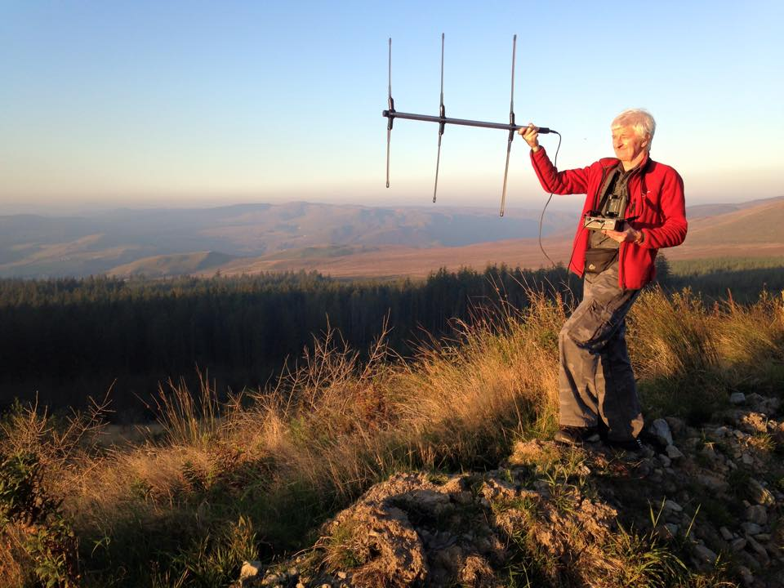
Radio tracking

Slide 10
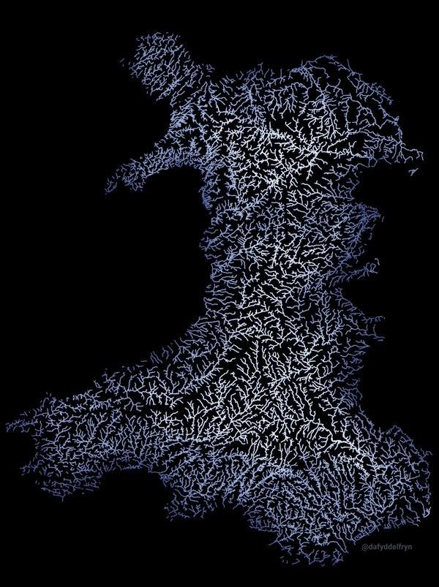
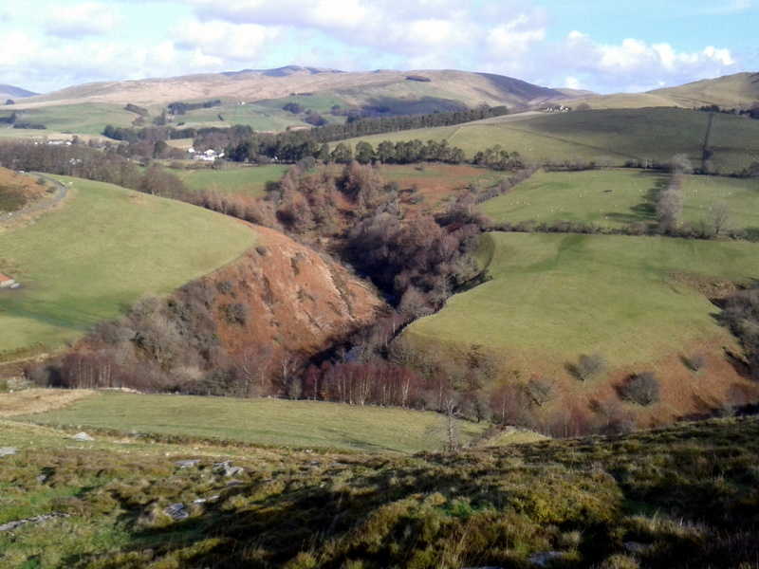
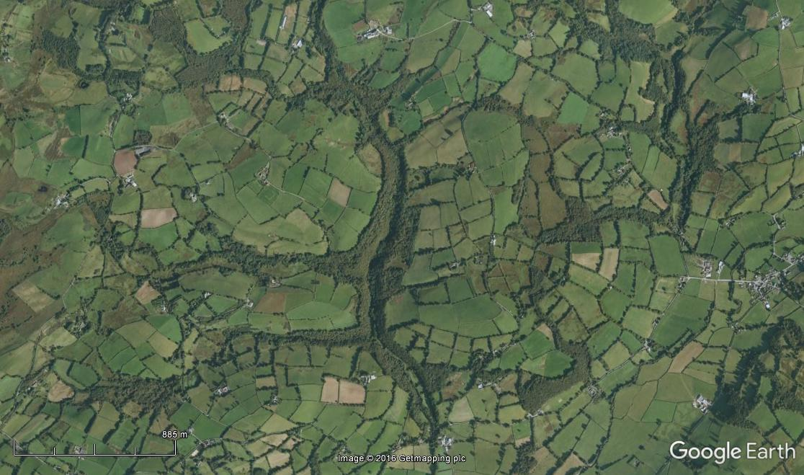
Movement
Avoiding open land
Following wooded corridors – rivers important
Also found in Italy (Balestrieri et al. 2014)

Slide 11
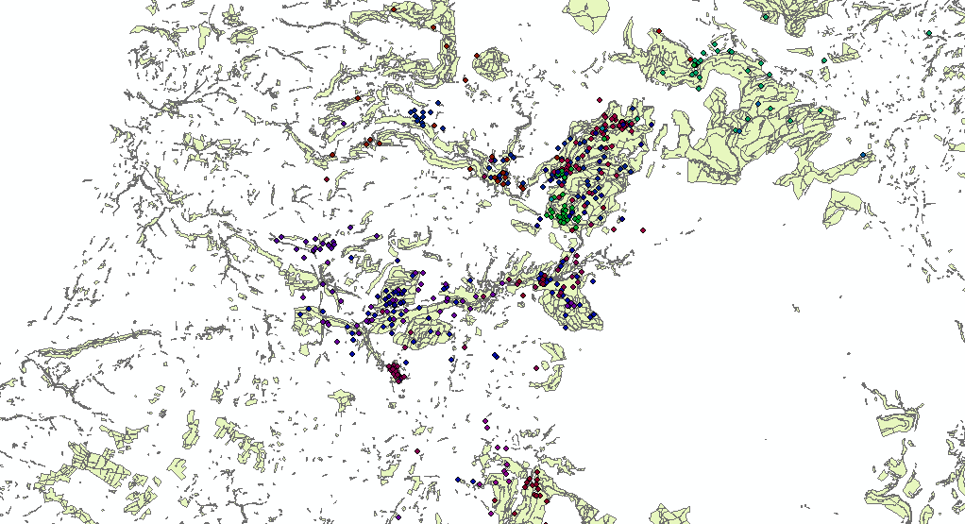
Movement
100 Km!

Slide 12
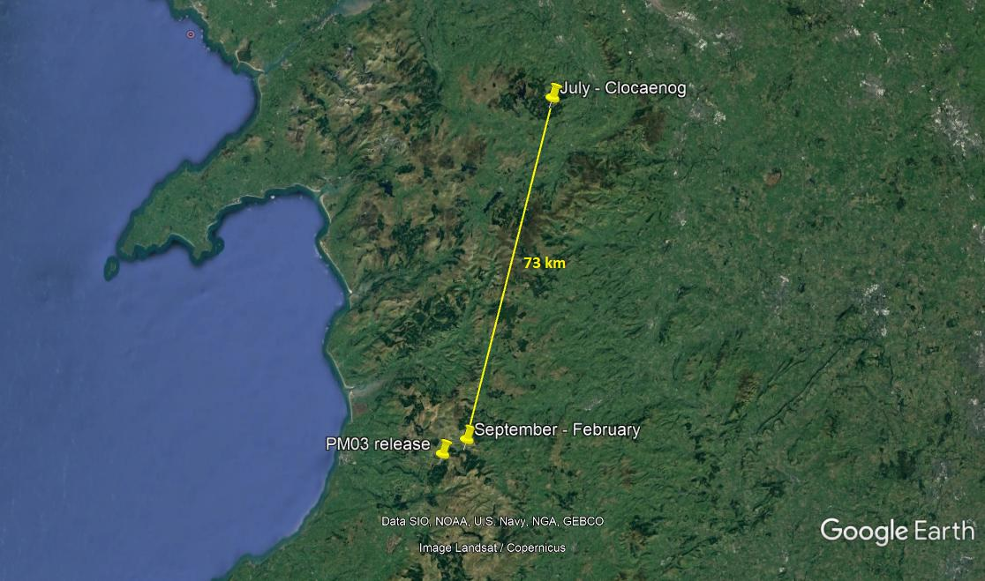
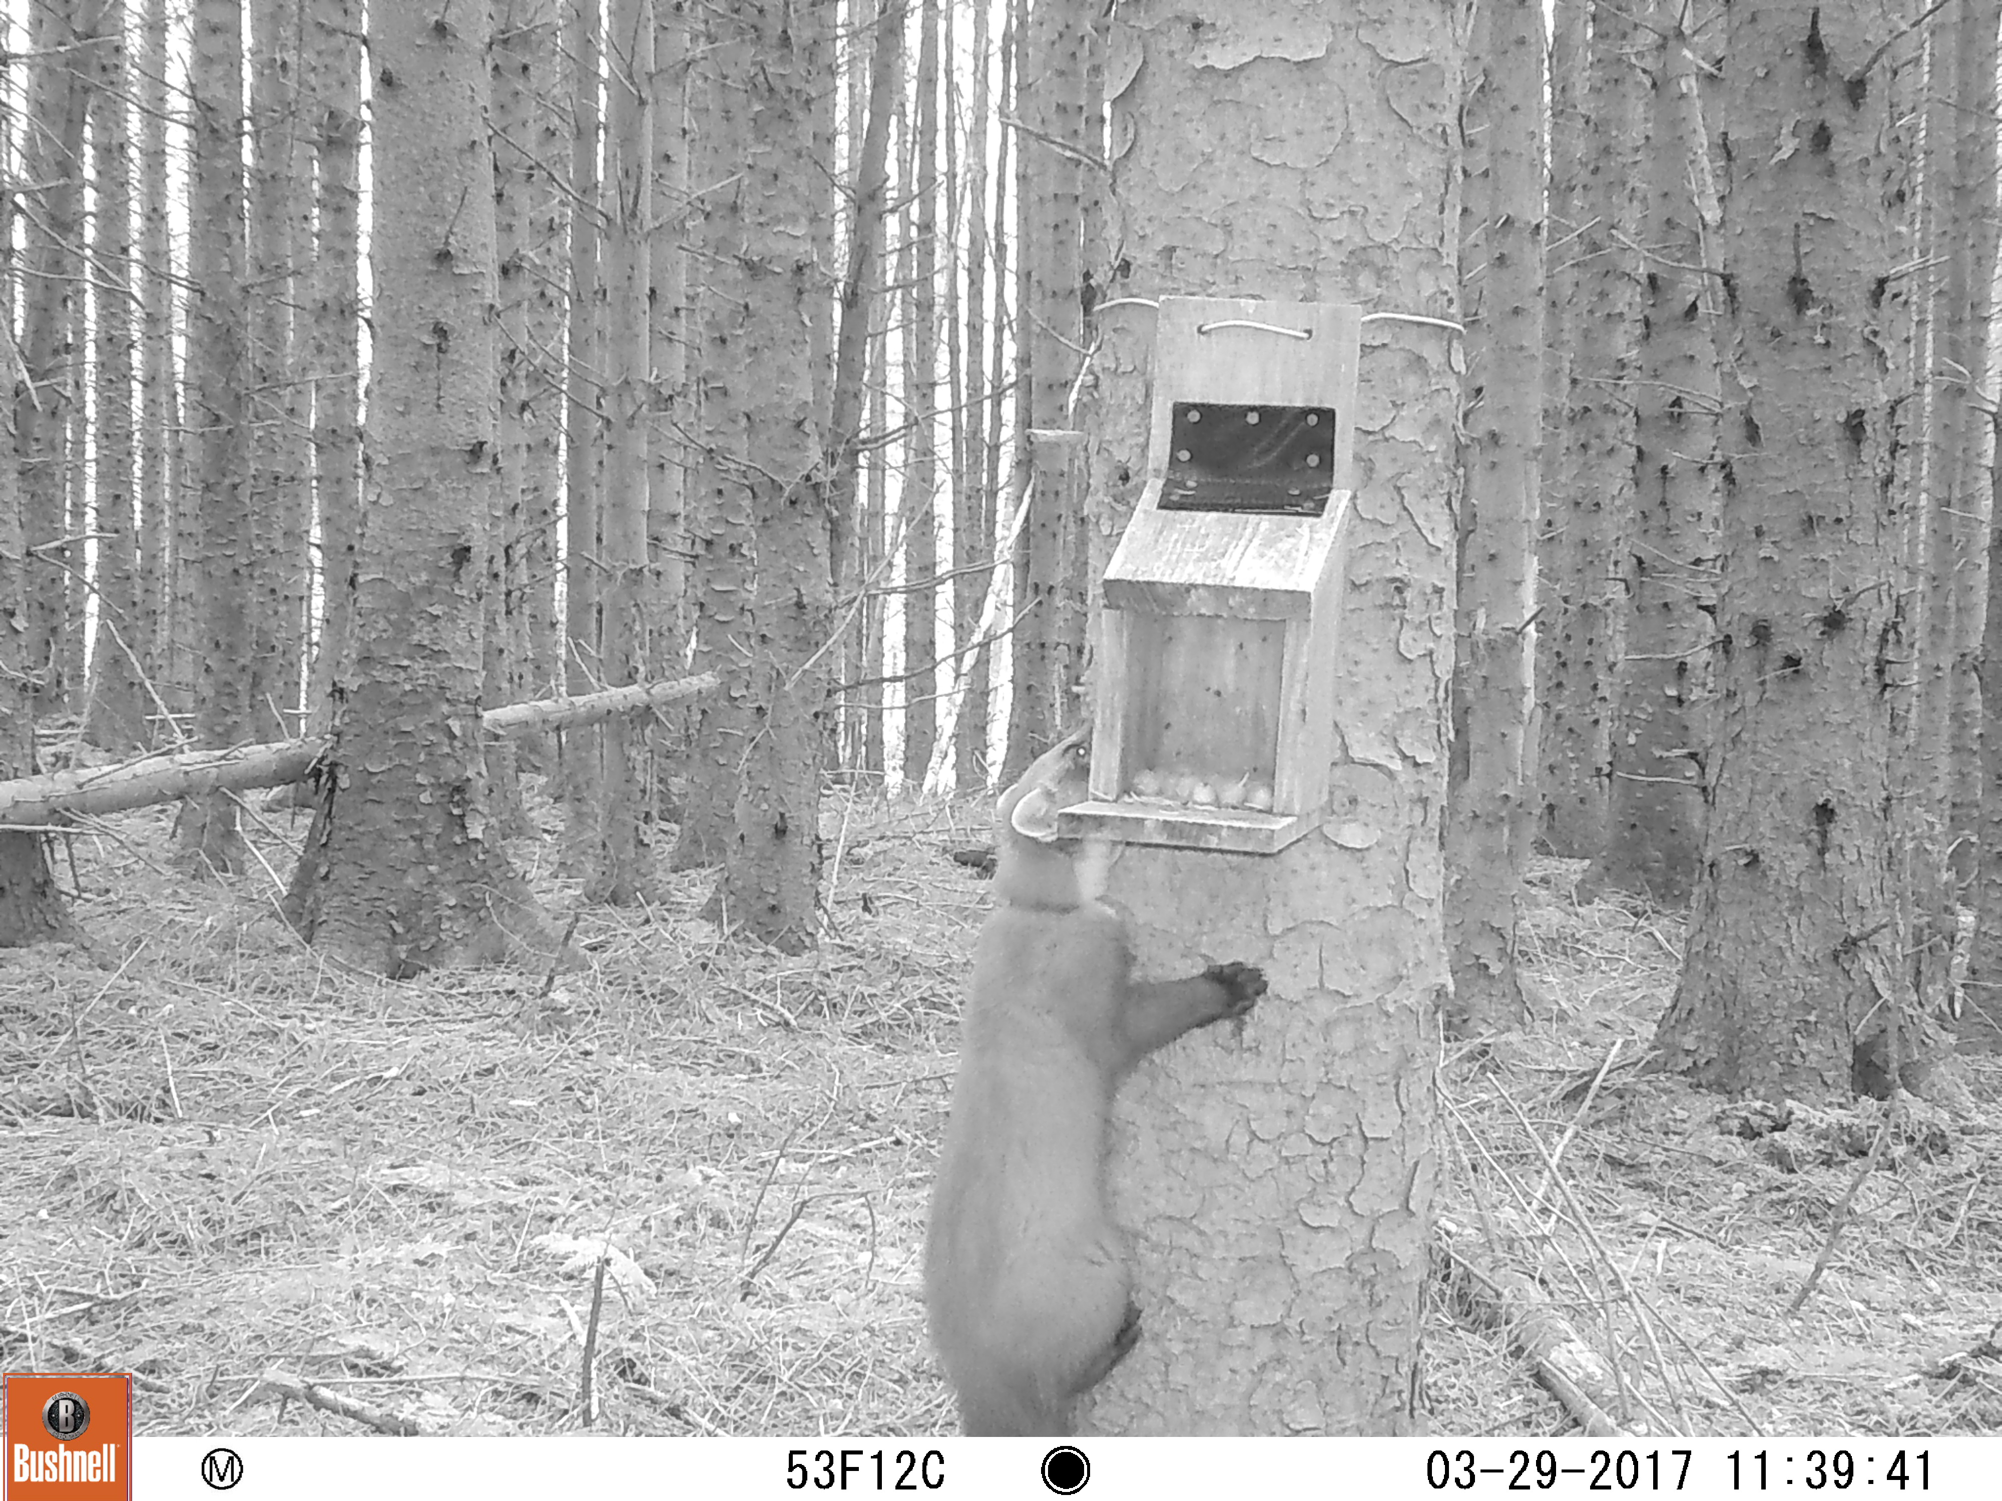
Dispersal
100 Km!

Slide 13
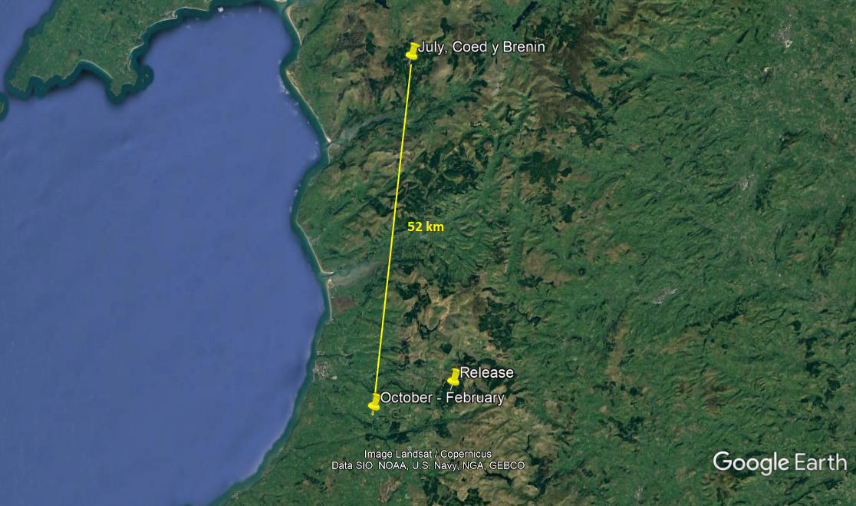
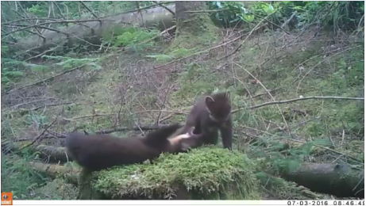
Dispersal
100 Km!

Slide 14
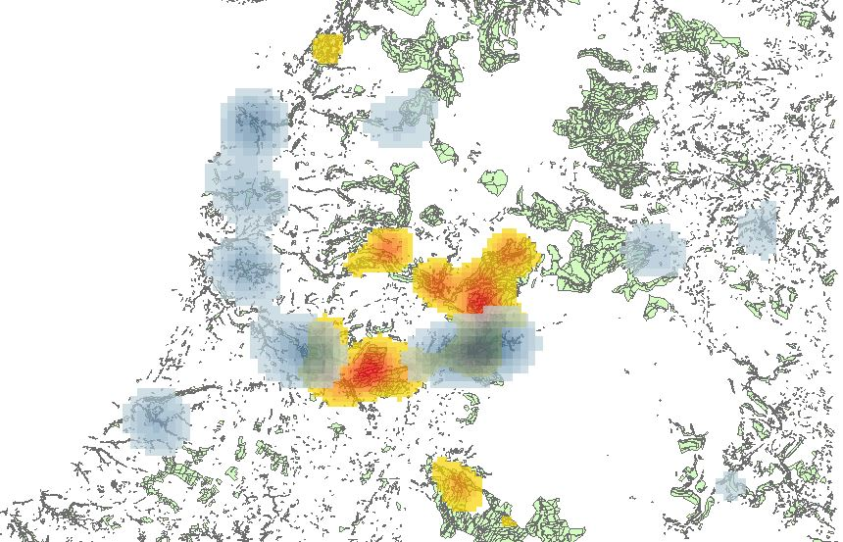
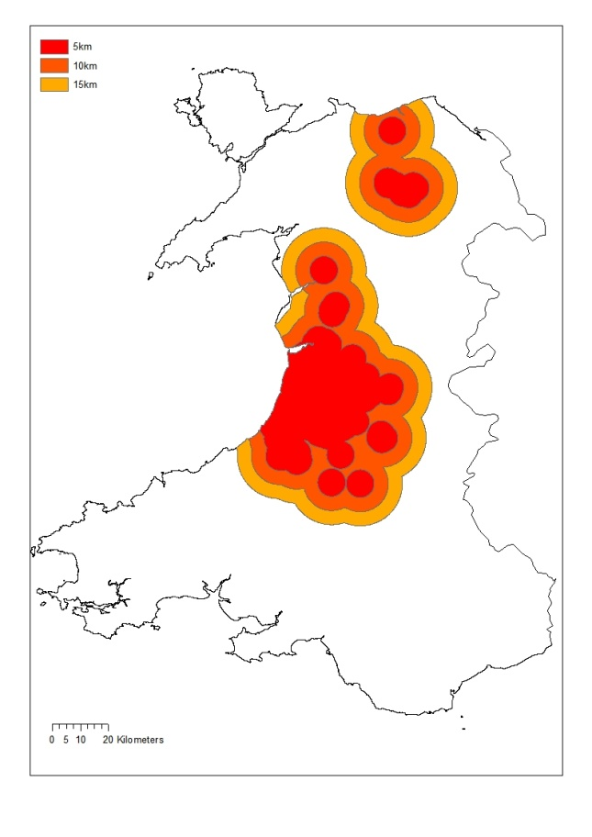
Tranche 1 & 2, density of RT fixes.
Phase 1
Phase 2

Slide 15
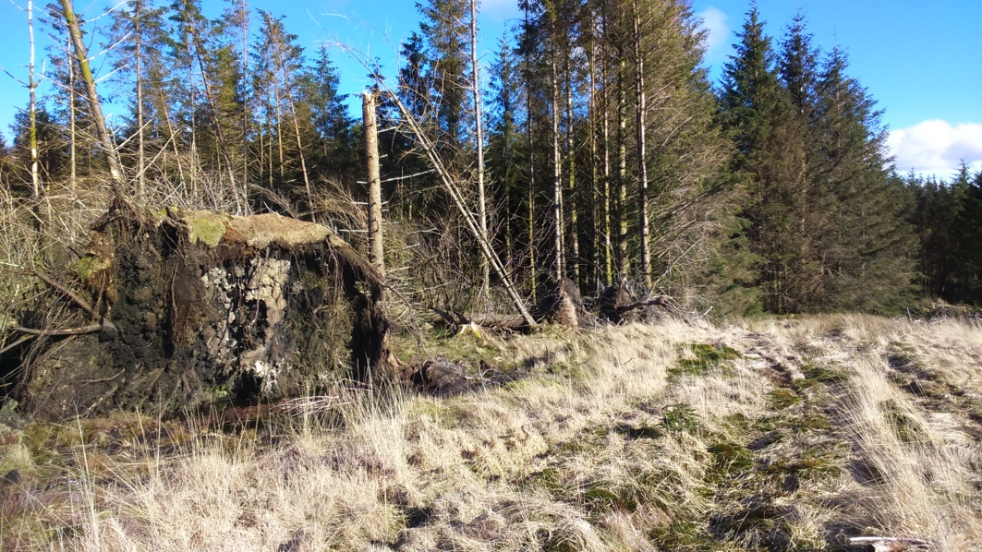
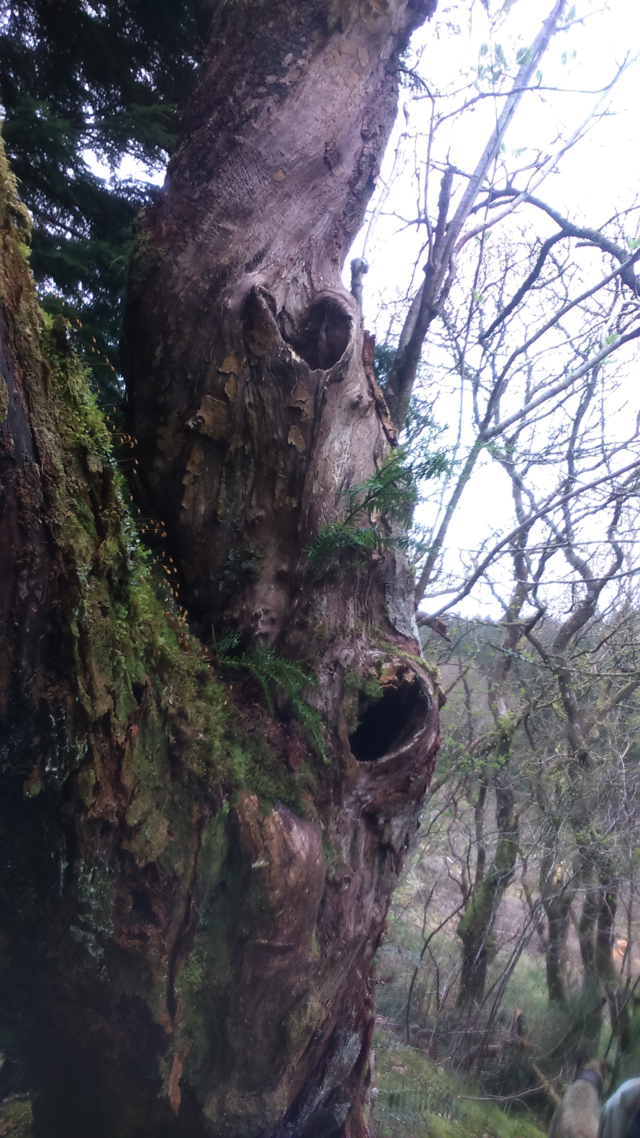
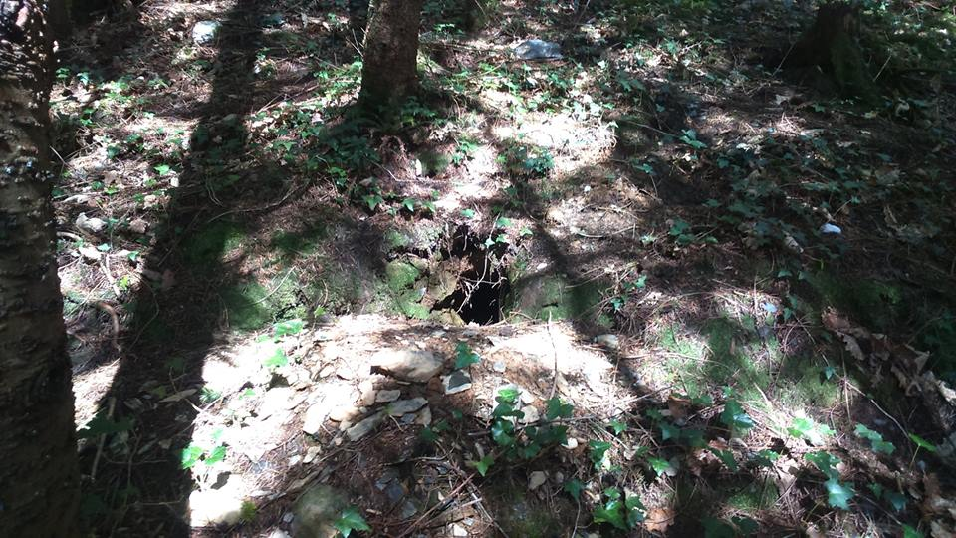
Ecology

Slide 16
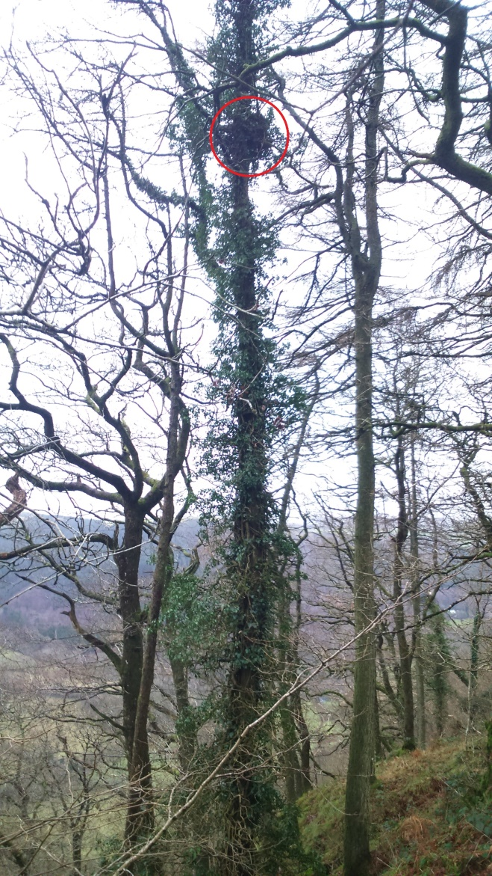
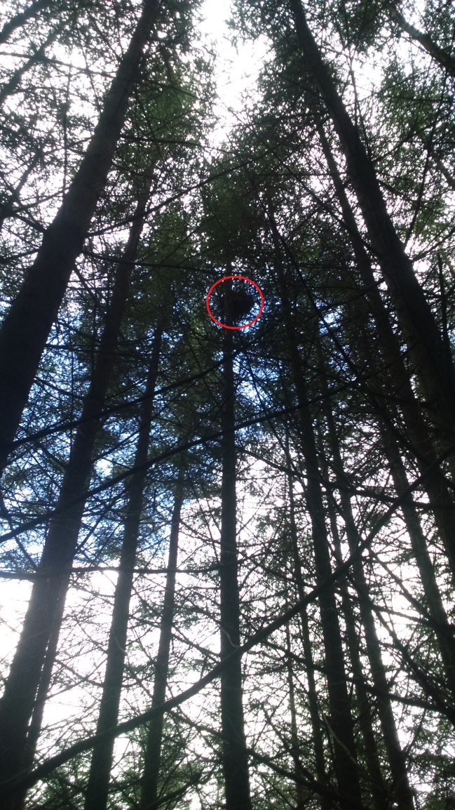
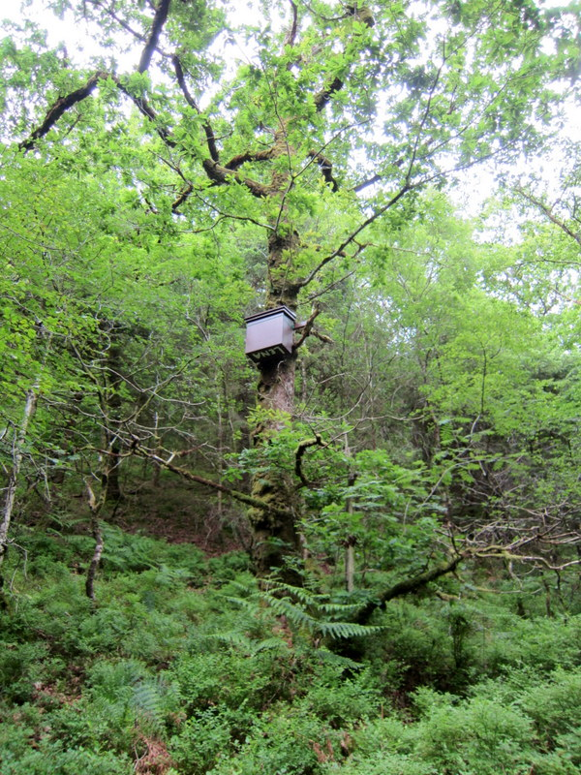
Ecology

Slide 17
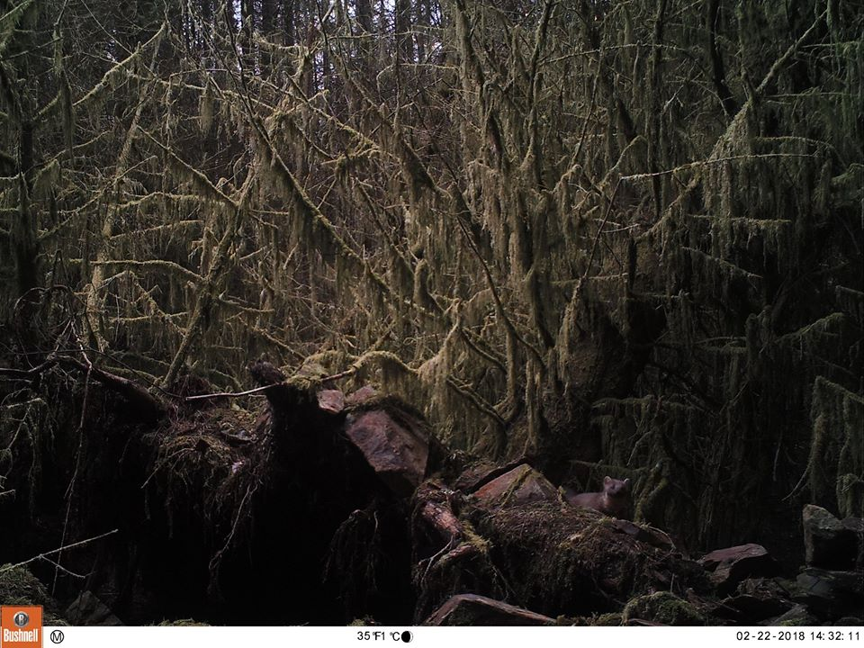
Camera trapping
Matt Davies
Camera trapping

Slide 18
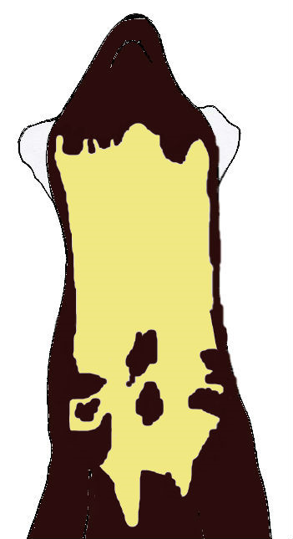
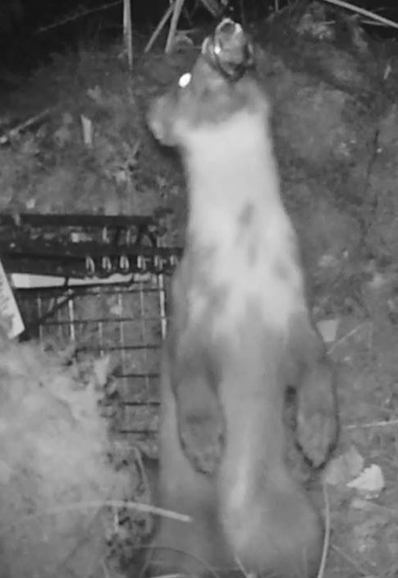
The bibliography – PM31
Matt Davies

Slide 19
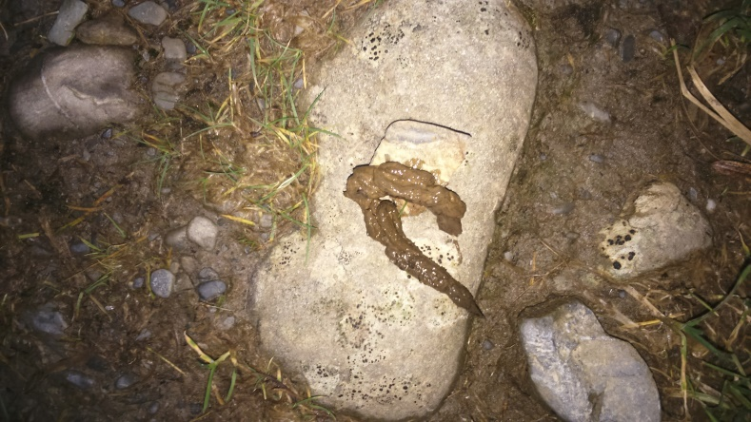
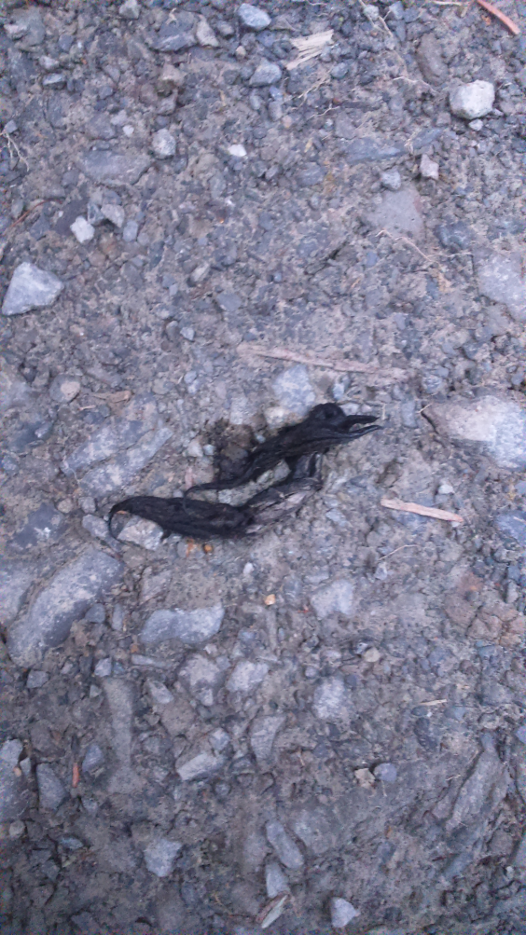
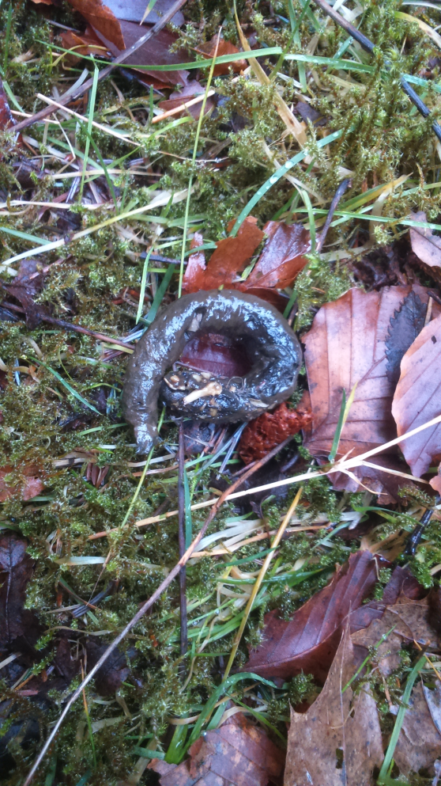
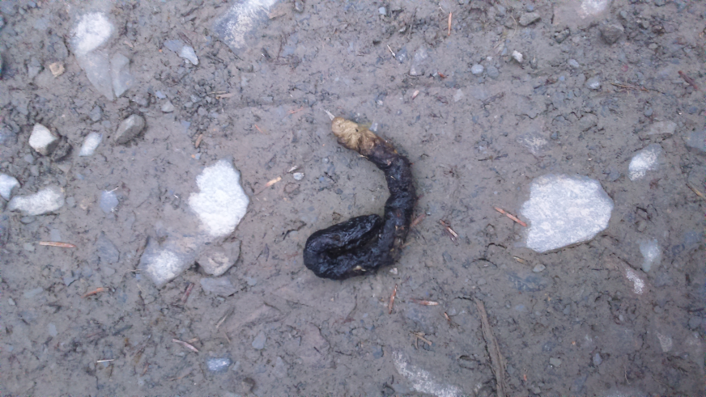
Ecology

Slide 20
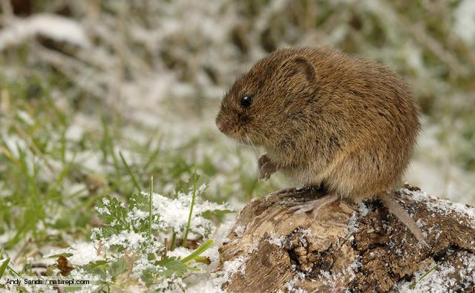
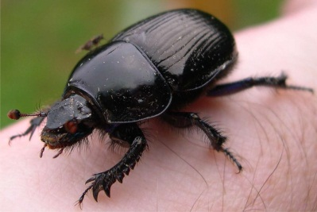
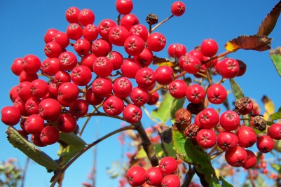
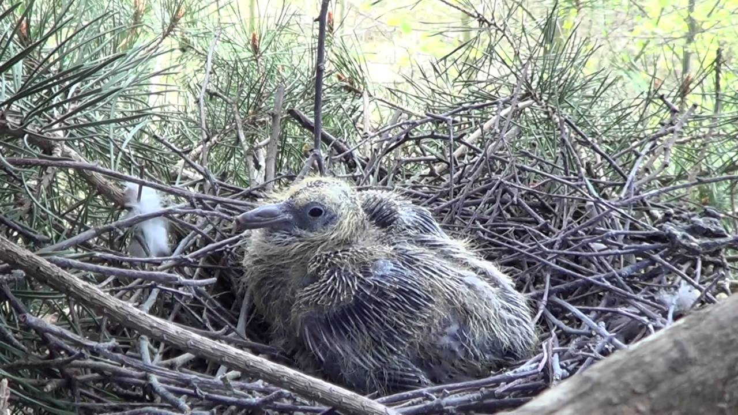
Pine marten diet
Adapted to exploit 3D environment
Carnivore, but varied diet - seasonal
Carrion 9%
Birds 20%
Fruit & nuts 11%
Small mammals
32%
Invertebrates
27%

Slide 21
Ecology

Slide 22
Mortality
Pine Marten ID | Sex | Cause of death
PM18 | F | Fungal encephalitis
PM15 | M | Fungal encephalitis
PM19 | M | Probable predation (remains scavenged)
PM09 | F | Fox predation
PM05 | M | Unknown
PM12 | M | Fox predation
PM30 | F
PM48 | M

Slide 23
Breeding
Marten | Year | Kits
PM02 | 2015 | 2 - checked in den box. One survived to adulthood.
PM11 | 2015 | >1 - heard at natal site. One kit observed in roof.
PM16 | 2015 | 1 - checked in owl box.
PM13 | 2015 | 1 - captured on trail cam.
PM30 | 2016 | Road casualty. Nipples suggested she had bred.
PM21 | 2016 | At least 1 - observed with endoscope.
PM22 | 2016 | Unknown. Kit chew marks on collar, natal site behaviour.
PM27 | 2016 | Unknown. Kit chew marks on collar, natal site behaviour.
PM34 | 2016 | At least 1 - observed with endoscope.
PM35 | 2016 | At least 2, captured on trail cam.
PM16 | 2016 | 4, captured on trail cam.

Slide 24
Monitoring the Scottish source sites.
Dr Jenny Macpherson, PMRP Project Manager & Lizzie Croose, Mustelid Conservation Officer.

Slide 25
Future monitoring
Hair tubes, scat surveys, den boxes, camera trapping.

Slide 26
Ecology

Slide 27
Ecology
March 2018

Slide 28
Ecology
March 2018
Good neighbours!
Huw Denman (SelectFor), Bryn Arau Duon

Slide 29
Ecology
Catherine McNicol, PhD candidate with University of Exeter.

Slide 30
Ecology
Catherine McNicol, PhD candidate with University of Exeter.
What is the mechanism behind the relationship?
Dietary analysis; stable isotope & traditional hard parts.
High resolution tracking.
Behavioural response of squirrels; landscape of fear.

Slide 31
Grey squirrel trapping
Grey squirrel trapping considerations
Where there is a risk of catching red squirrels or other non-target species it is a legal requirement that traps are checked twice daily.
This is particularly important during the pine marten breeding season (March to the end of June) when there is a risk of trapping a lactating female marten.
We do not want to deter you from squirrel control; if unsure, contact Jenny Macpherson at jennymacpherson@vwt.org.uk

Slide 32
Grey squirrel trapping
What to do if you accidently trap a pine marten.
Please try to contact Jenny Macpherson immediately on 07584 415760, particularly if the animal has a radio collar on.
Otherwise, take a photo if possible and release the marten: put on thick (i.e. gardening) gloves to protect against being bitten and then carefully prop open the trap door with a stick or cable tie and move away from the trap until the animal has left.
If you trap a marten during the breeding season, could you please close down any traps in the area and move them, or stop trapping in that area until July.
Please report any marten sightings or captures to The Vincent Wildlife Trust enquiries@vwt.org.uk; Tel: 01531 636441.

Slide 33
Key support
Research Education Conservation

Slide 34
Contact information
Email: davidbavin@vwt.org.uk / jennymacpherson@vwt.org.uk
Phone: 07794 985350 (DB), 01531 636441 (Bronsil office)
Website: pine-marten-recovery-project.org.uk
facebook.com/VincentWildlifeTrust
instagram.com/vincentwildlifetrust
twitter.com/vincentwildlife
linkedin.com/company/the-vincent-wildlife-trust
© 2016 The Vincent Wildlife Trust
Charitable Company Limited by Guarantee. Registered in England No. 05598716 Registered Charity No. 1112100 (England), SCO43066 (Scotland), DCHY00019 (Ireland)

