Slide 1
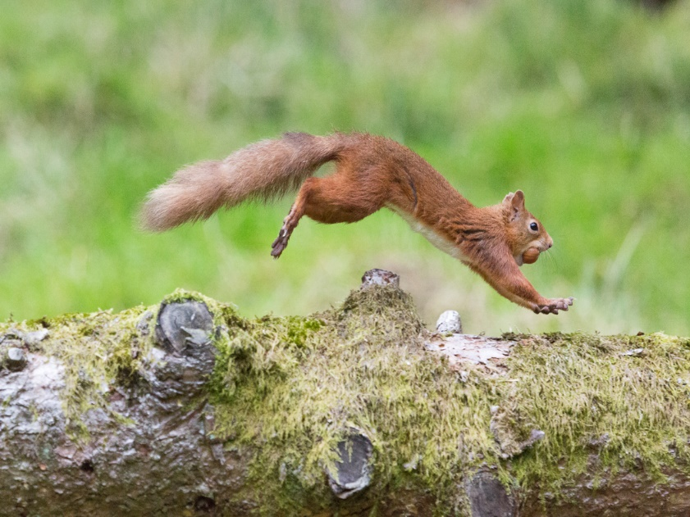
Julie Bailey – Belfast – March 2017
Community Conservation

Slide 2
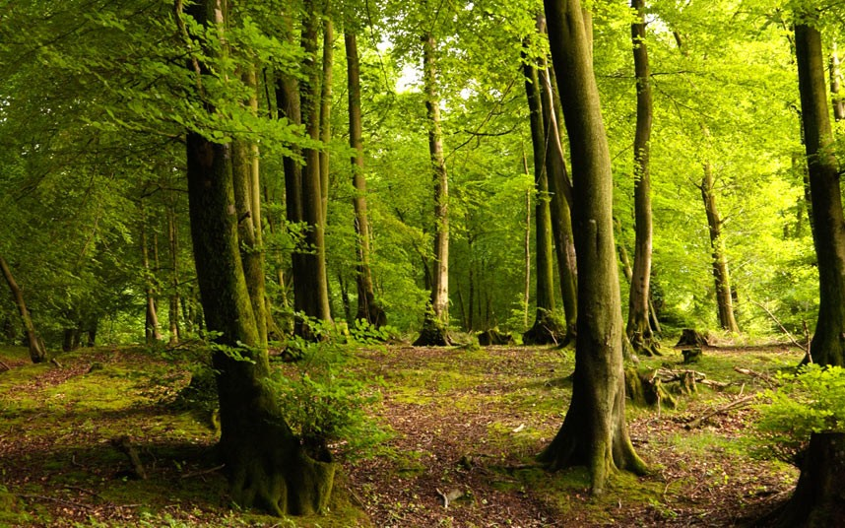
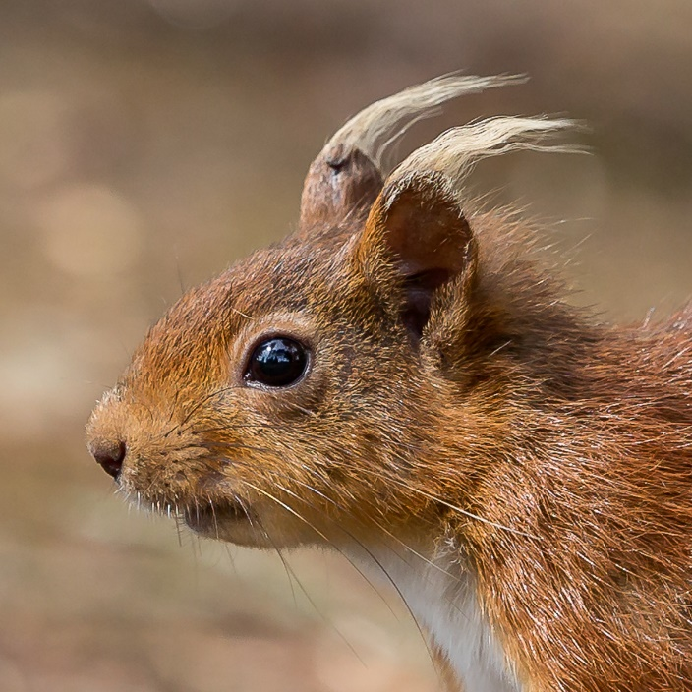
Community Groups – the ‘front line’ Leaders of Red Squirrel Conservation
NRS organisation
Group profiles
Strategy
Stats
Records
Resources
Issues
Solutions
Setting up new groups
Summary

Slide 3
Brief History of JB
Been involved with red squirrels since they came to my garden in Oct 1993 (24 years)
Took my reds for granted for 16 years with up to 8 named individuals visiting daily
until !
Xmas 2009 single grey appeared
Lost all reds within 3 weeks to SQPVD
Research led to becoming involved as a Volunteer 2010

Slide 4
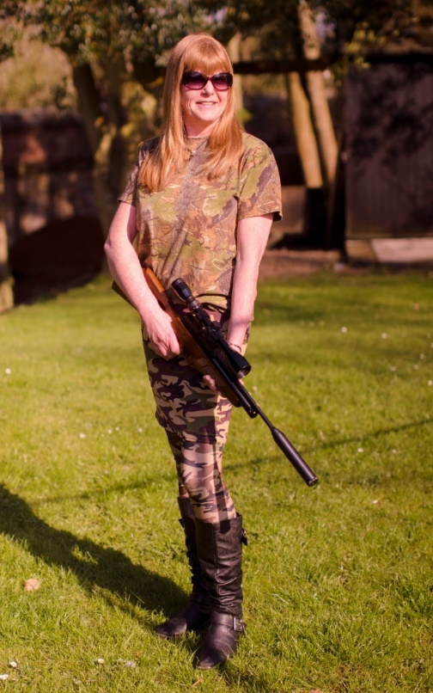
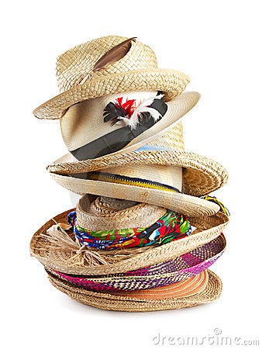
Culling the Greylians!
Penrith group
Brampton group
NRS
Solway group
RSNE
North Pennines AONB
Also Self employed in squirrel world too!
Grey Squirrel Removal
B&DRSG Secretary/Trustee/Records Coordinator/NRS Rep
P&DRSG Administrator/Trustee/Records Coordinator/NRS Rep
SRSG Secretary/Trustee/Records Coordinator/NRS Rep
NRS Sightings Coordinator
NRS Cumbria Chairwoman
RSNE Data Officer

Slide 5
Northern Red Squirrels (NRS)
NRS is an established constituted umbrella organisation that was created to unite all independent voluntary groups and individuals who are working to help save our red squirrels from extinction in the North of England. It is a ‘network of voluntary action’ that shares news, ideas and best practice. Each of the member groups are completely independent which allows them to address issues within their own areas in the most appropriate way.
NRS currently has 39 member groups (NRS Cumbria 14, NRS Northumberland 16, other areas 9)
*1 of our other area member group is a beneficiary of RSU funding - RST Wales*
NRS provides information, advice and guidance to enable and encourage more people to become involved in red squirrel conservation.
*Next year will be the 10th anniversary of NRS*

Slide 6
NRS Aims
NRS aims to:
Improve the effectiveness of voluntary groups and individuals by providing information, advice and guidance to ensure consistency of approach to conservation activities.
When required, co-ordinate any action taken jointly by several groups and individuals.
Provide support and guidance for people who wish to become involved in safeguarding red squirrels including those who wish to set up their own voluntary group in an area where none currently exists.
Contribute to the work of the funded projects by supporting their activities.

Slide 7
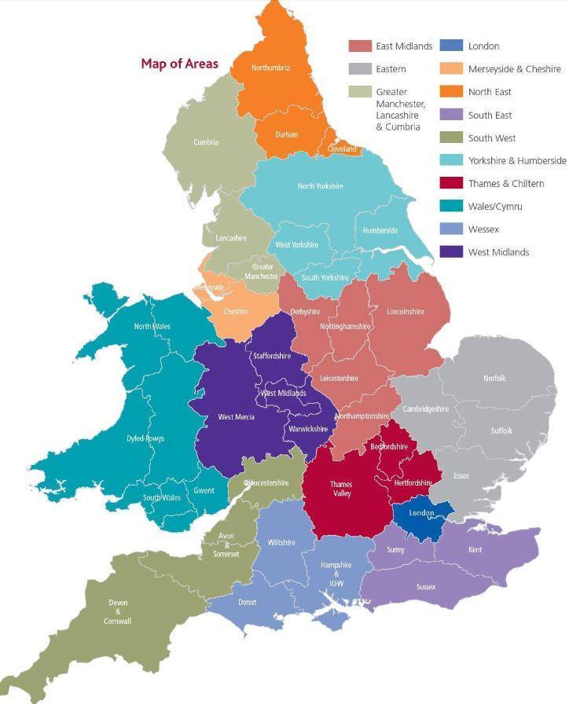
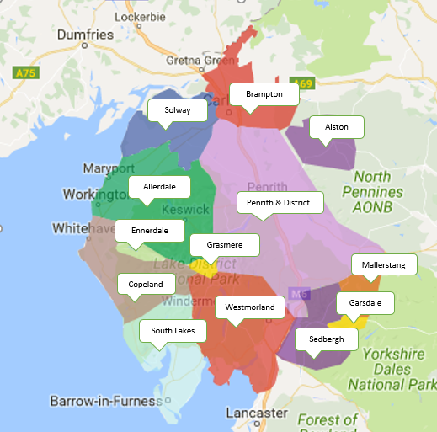
Where are we?
UK Map
NRS Cumbria Map
Cumbria area is 6,768 km² (2,613 sq mi)

Slide 8
NRS Cumbria Groups
The County of Cumbria is the third largest county in England by area, 6,768 km² ⁽2,613 sq. mi) and one of the most sparsely populated counties in the UK with approx. 75 people per km² (190/sq mi).
It is bounded to the north by Scotland, to the west by the Irish Sea, to the south by Lancashire, the southeast by North Yorkshire and to the east by County Durham and Northumberland.
Cumbria is predominantly rural and contains the Lake District. Much of Cumbria is mountainous, and it contains every peak in England over 3,000 feet.
Consists of 6 districts and approx. 400 towns & villages.
whole County coverage

Slide 9
Groups’ Profiles
Encompassing over 1400 individuals

Slide 10
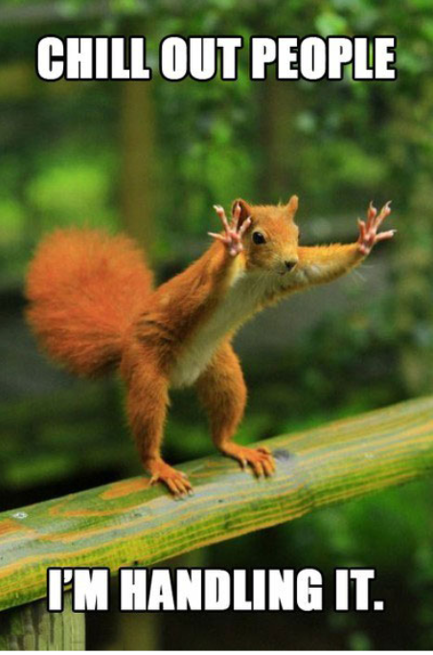
Strategy
Run coordinated systematic programmes using a combination methodology of shooting and trapping as the most effective means of grey squirrel clearance, to allow safe havens for our reds
I Identify all wooded areas – OS 1:25000 scale map
S Seek access/permission – define specific protocols of action etc
K Knowledge – woodland – ‘hot spots’ – complete risk assessment
E Establish – feed and monitoring areas
Y You’re on your way

Slide 11
Group Stats
From data submitted that is usable for this analysis

Slide 12
Why Keep Records?

Slide 13
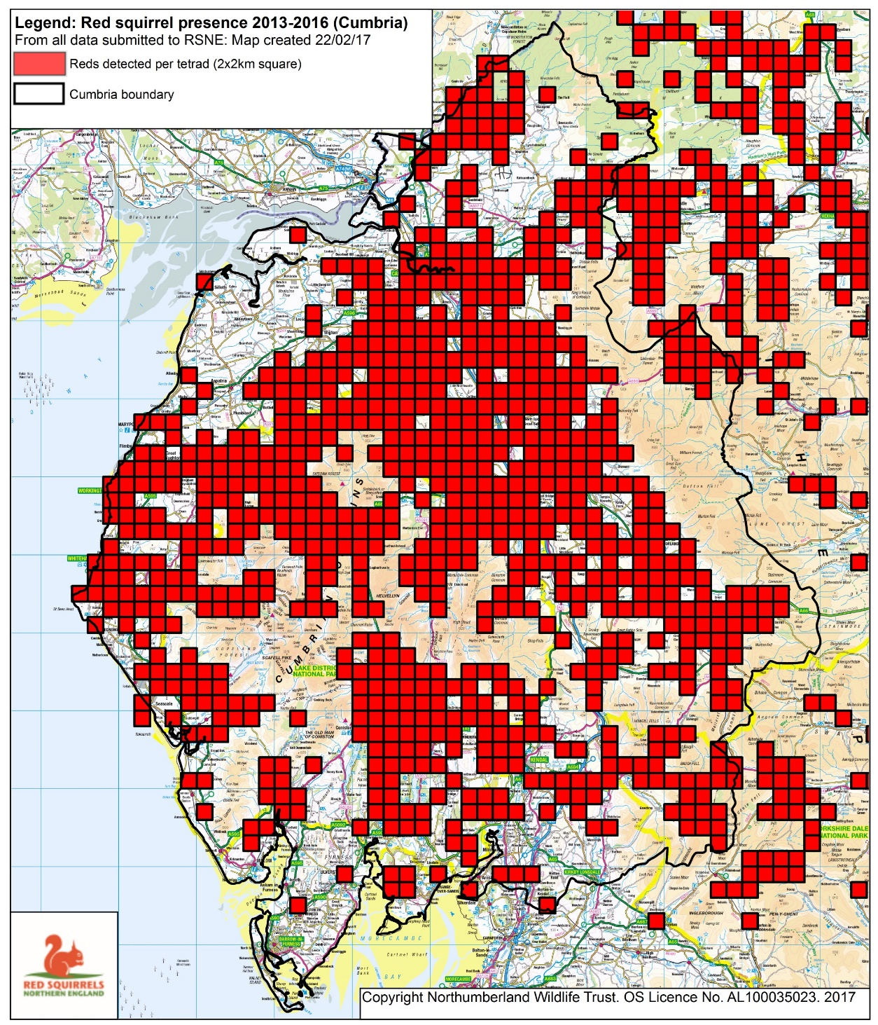
Red presence in Cumbria (2013 -2016)
Data still to come in for 2016
We must be getting something right!

Slide 14
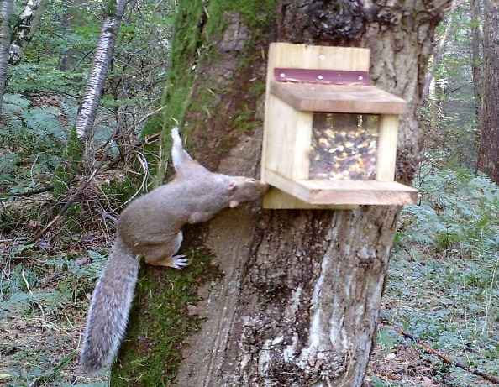
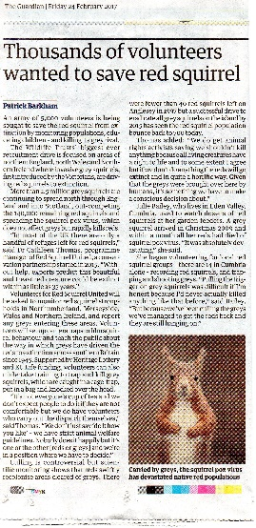
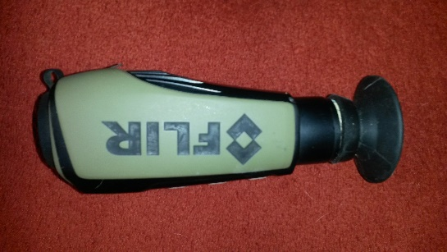
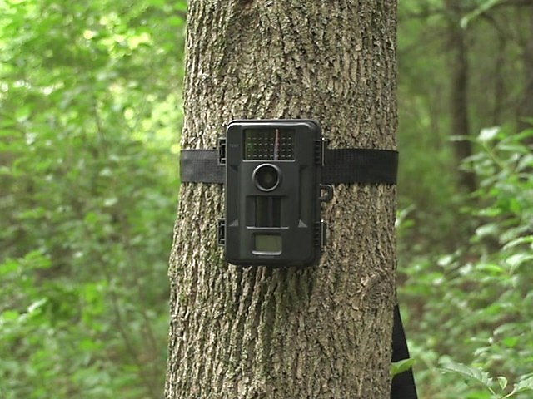
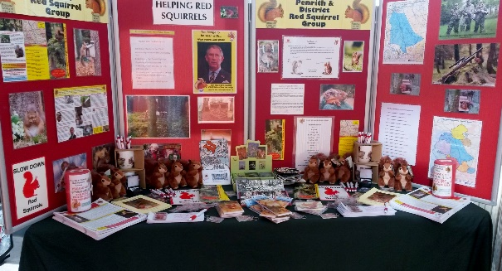
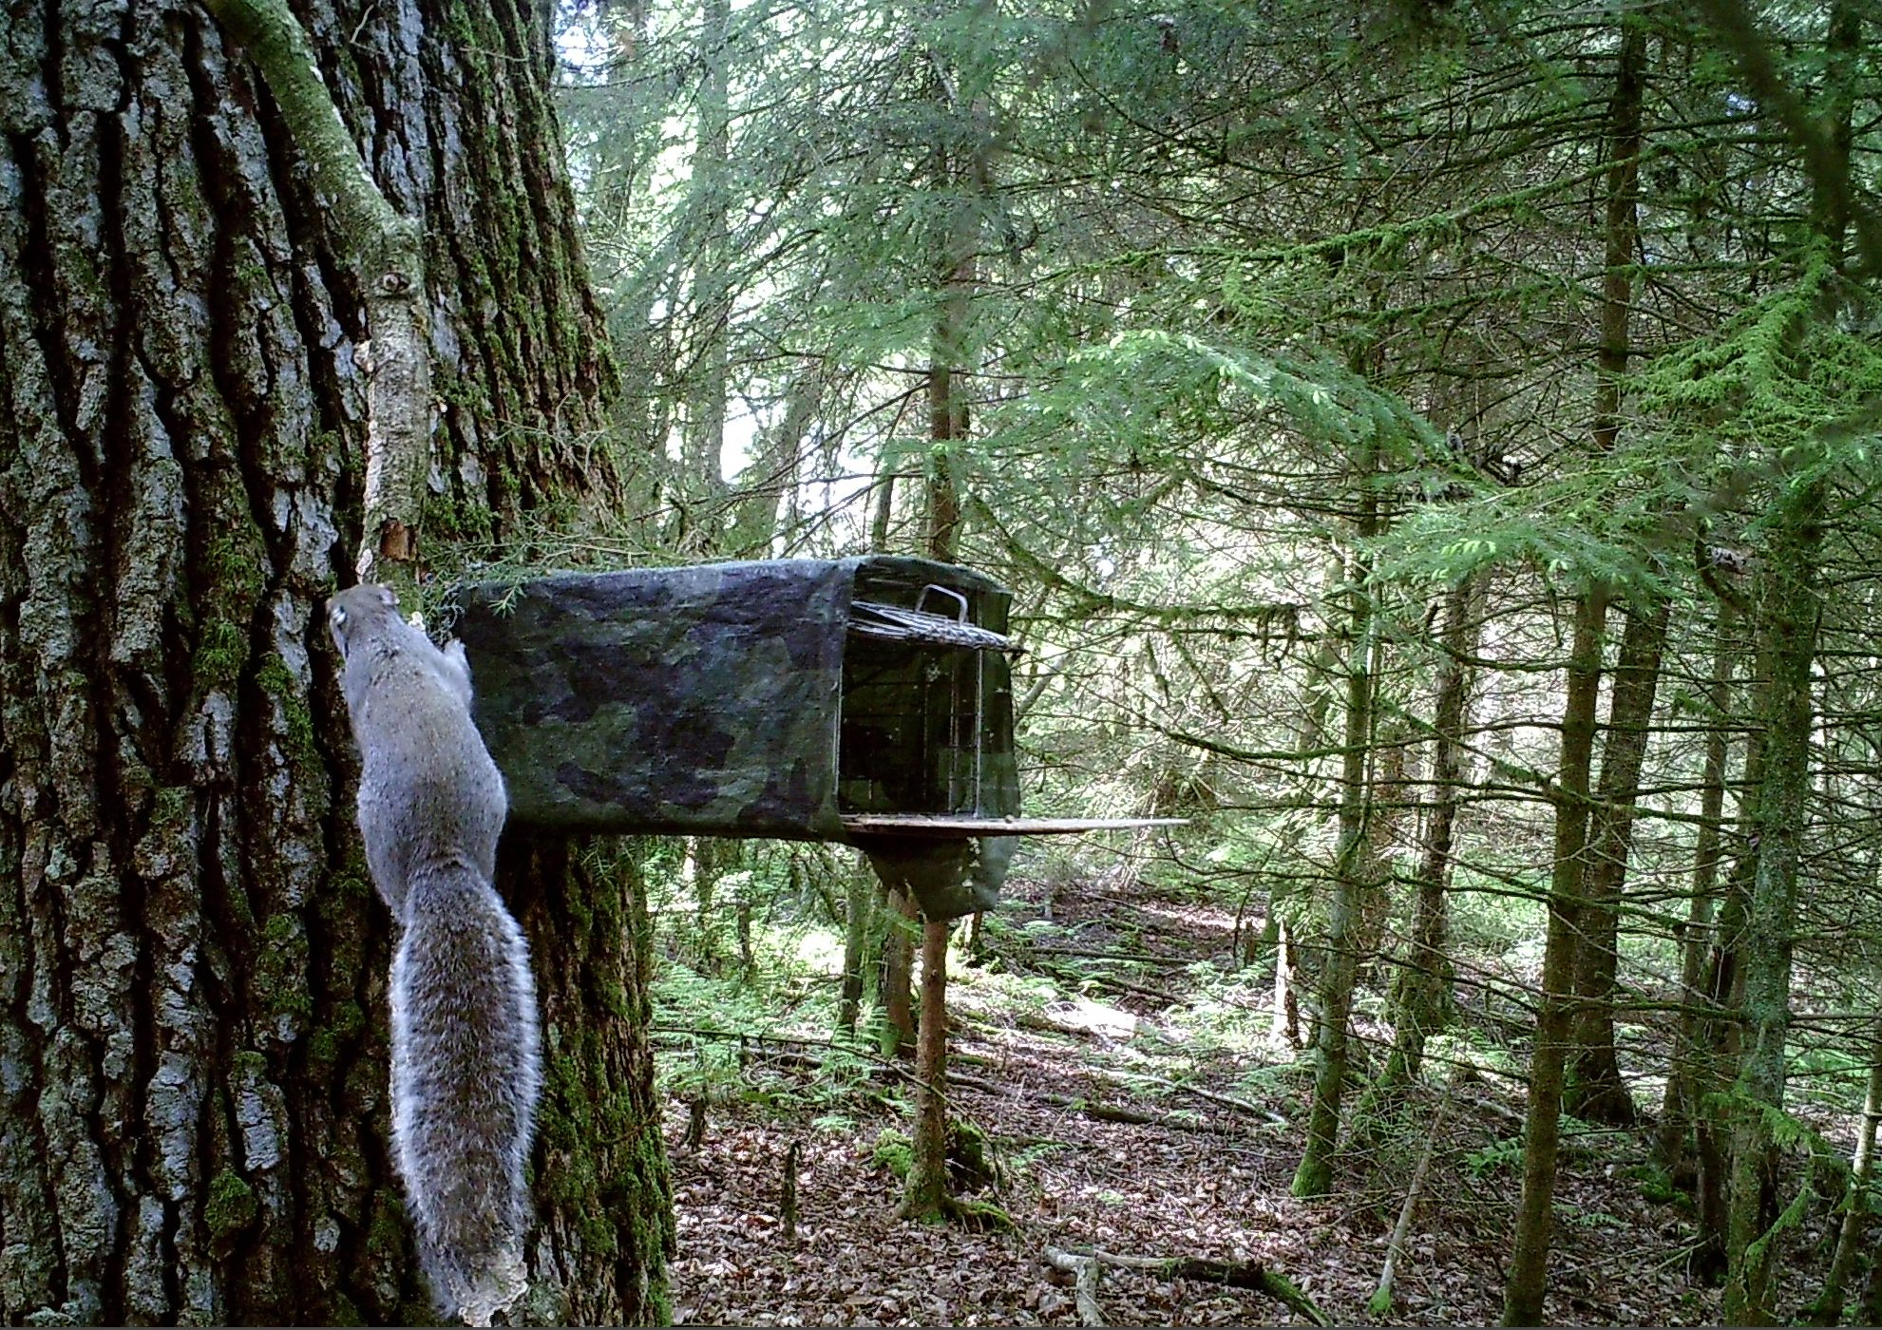
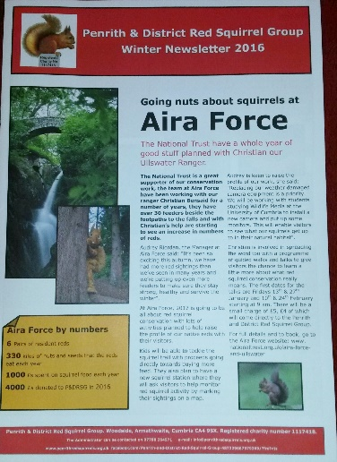
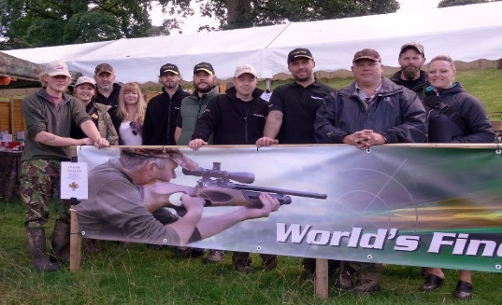
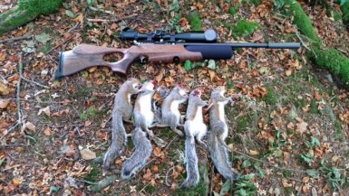
Resources
Standardised recording and group paperwork packs
Current funded projects as platforms

Slide 15
Issues
Squirrel organisations’ confusion – NRS, RSST, ESI, RSNE, UKSA, BRS, RSU (RTD2 ?)
Access – public parks/other greenspaces – some don’t allow clearance
Sustainability of non-funded community groups – huge lack of funding provision for the ‘leaders on the ground’
Policies – current ‘stronghold’ criteria
Guidelines for grey control – put reds at risk
Manpower – time restrictions/work commitments

Slide 16
Solutions
Squirrel organisations’ confusion – accept it, there will be others as one project ends and another commences (new funding/new project/new name)
Access – introduce new laws nationally
Sustainability of non-funded community groups – introduce substantial funding schemes applicable to the consistent work of the local communities
Policies – encourage ‘strongholds’ criteria review to reflect the current picture as we have viable red squirrel populations too!
Guidelines for grey control – continue to use our own protocols but encourage a change to current guidelines to a high standards protocol
Manpower – continuous awareness campaigns

Slide 17
Setting up a new group - Basics
Few likeminded individuals
Host a public meeting to determine need
Hold an interested parties meeting – minute this
Recruit a Chair/Secretary/Treasurer
Open a bank account – minutes, £1 coin and basic constitution
Host induction/training workshops – grey control, protocols, paperwork

Slide 18
Setting up a new group – cont’
Shows
Events
Talks – waive speaker fee
Bi-annual appeal letters – shopping list (feeders/traps/monitoring cams/thermal imaging/equipment for shows)
Grants
Posters, leaflets
Parish Newsletters
Newspapers – free advertising
Local landowners – Who?
Walk n talk, control workshops/Days out to see reds
W.I.’s, local community groups etc
Civil Parishes
Merchandise
Member pack
Don’t have to kill

Slide 19
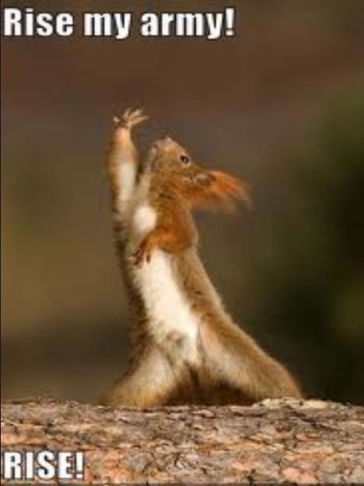
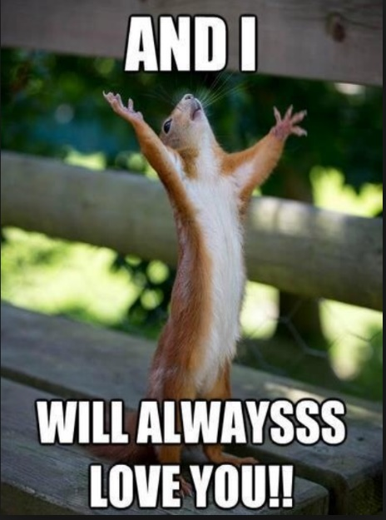
Join the ‘front line’ Red Army and follow their lead
Seek
Monitor
Analyse
Remove
Train
Resilience
Effort
Dedication
Success
Educate
Acknowledge
Transparent
New groups
Unite
Together
Safe havens

Slide 21
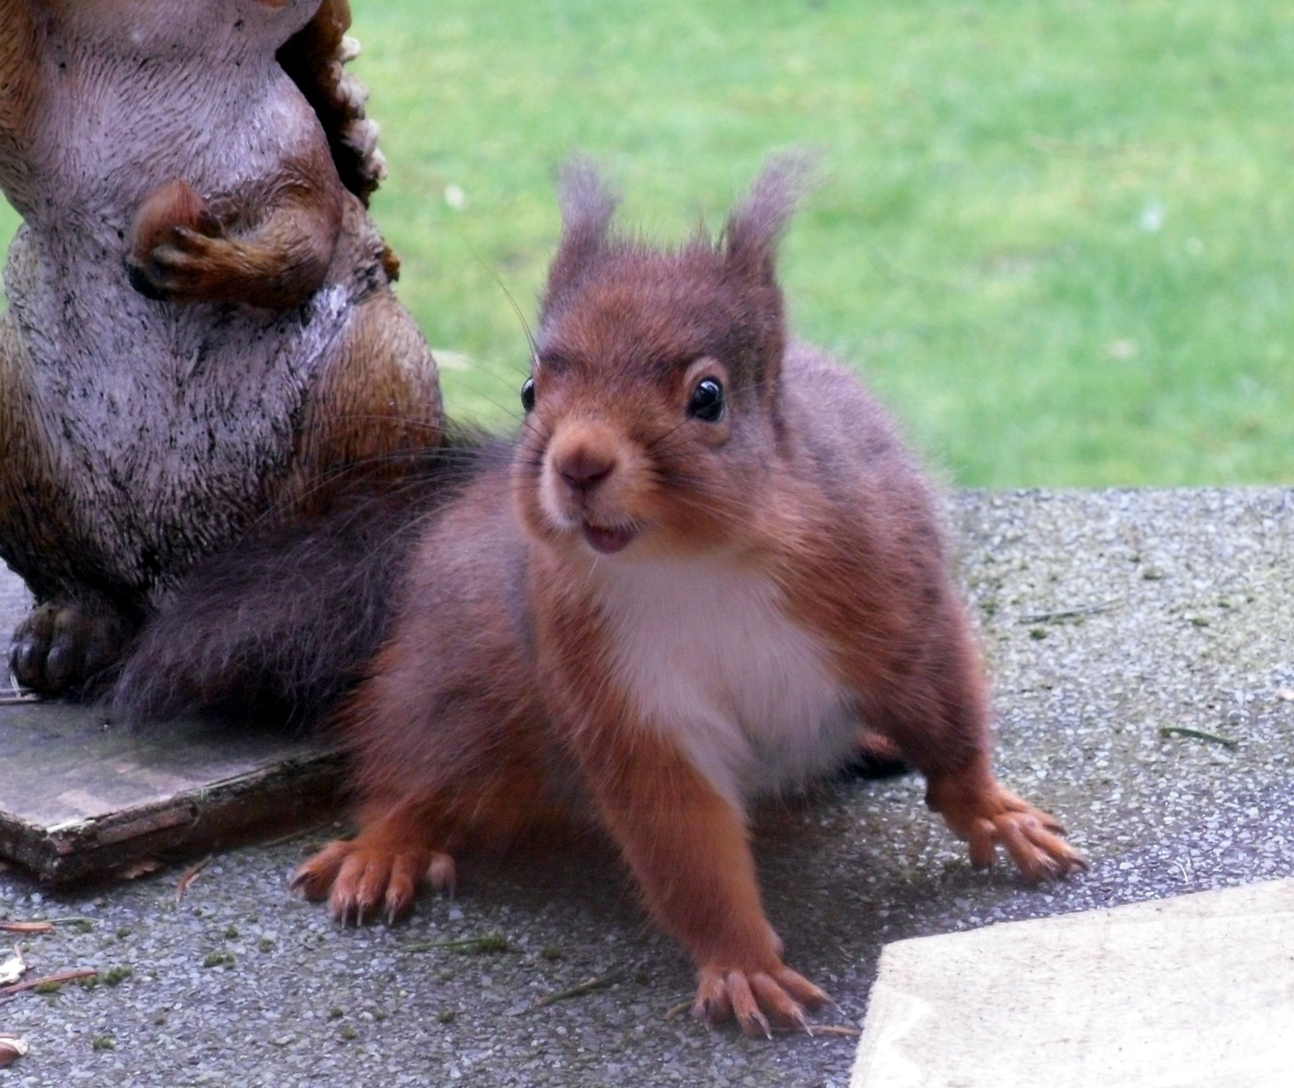
Thank you
Julie Bailey
07788 264 571
J.bailey203@btinternet.com

